Slide 1
Interreg SIV Webinar Series
Webinar Innovative Employment
Social Enterprise Neue Arbeit
Labour market beyond placement rates: Privately financed labour market instruments as a complement to state instruments
Anja Grunow (Lead Partner)

Slide 2
Verbund Neue Arbeit
Statutory mission
Commercial and non-profit
62 Million turn over
1600 employees
workshop for disabled people
60 nationalities
1. labour market
Since 1978

Slide 3
Target groups: heterogeneous public funding
EU
Federation
Work instead of punishment
Work for migrants
EU:
State, Federation EU ESF, EFRE,...
State
Municipality
Employment Agencies
Work for the mentally ill
Work for the longterm
unemployed
Work for disabled people Integration companies
Work with the Homeless
School concepts Transition from school to work
Work instead of drugs
Youth Vocational Assistance
Advisory work
Integration specialist service

Slide 4
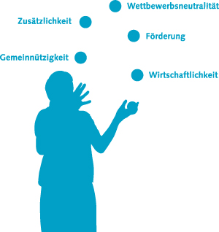
Job description of commercial managers
We do the impossible immediately,
miracles take a little longer
competitive neutrality
Additionality
Promotion
Non-profit status
Complex to impossible
Legal to the point of theft of legality
economic efficiency
Adaptability
Innovative spirit

Slide 5
Public funds versus market revenues

Slide 6
Public funds versus market revenues

Slide 7
Alternative financing
Philanthropic consumption capital
Social investment capital
Fundraising
Foundations
Church funding
Consumption Foundation
Profit participation certificates
Mezzanine capital
Social Venture Capital
Crowdfunding
Social consumption capital
https://www.santa-fu.de/
Lottery
Social Impact Bonds
Employer premiums
Agency fees
Merchandising
Compensatory levy transferred to long-term unemployed
https://www.diakonie.de/fileadmin/user_upload/Diakonie/PDFs/Diakonie-Texte_PDF/01_2019___Finanzierung_diakonischer_Unternehmen_Web.pdf
https://www.sozialministerium.at/Themen/Soziales/Soziale-Themen/Soziale-Innovation/Social-Impact-Bond.html

Slide 8
It is a matter of winning the future.
is what is needed!

Slide 9
Contact
https://www.interreg-central.eu/Content.Node/SIV-.html
CE 1345 SIV
Project Management
Anja Grunow
Social Enterprise NEUE ARBEIT gGmbH
Gottfried-Keller-Straße 18c,
D-70435 Stuttgart
Germany
www.neuearbeit.de
interreg.ce1345@neuearbeit.de
+49 711 27301 135

