Slide 1
ZOOM
Employment Voucher Programmes
Lubomir Billy / Centire (PP11) and guests

Slide 2
Germany

Slide 4
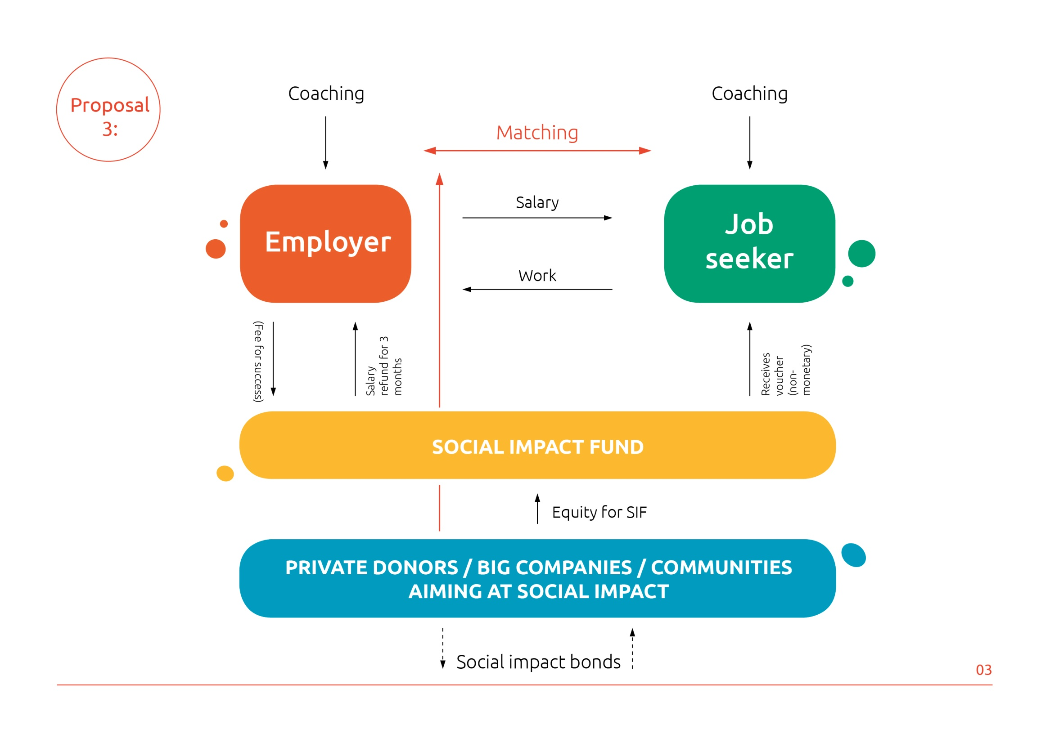

Slide 5
Austria

Slide 6
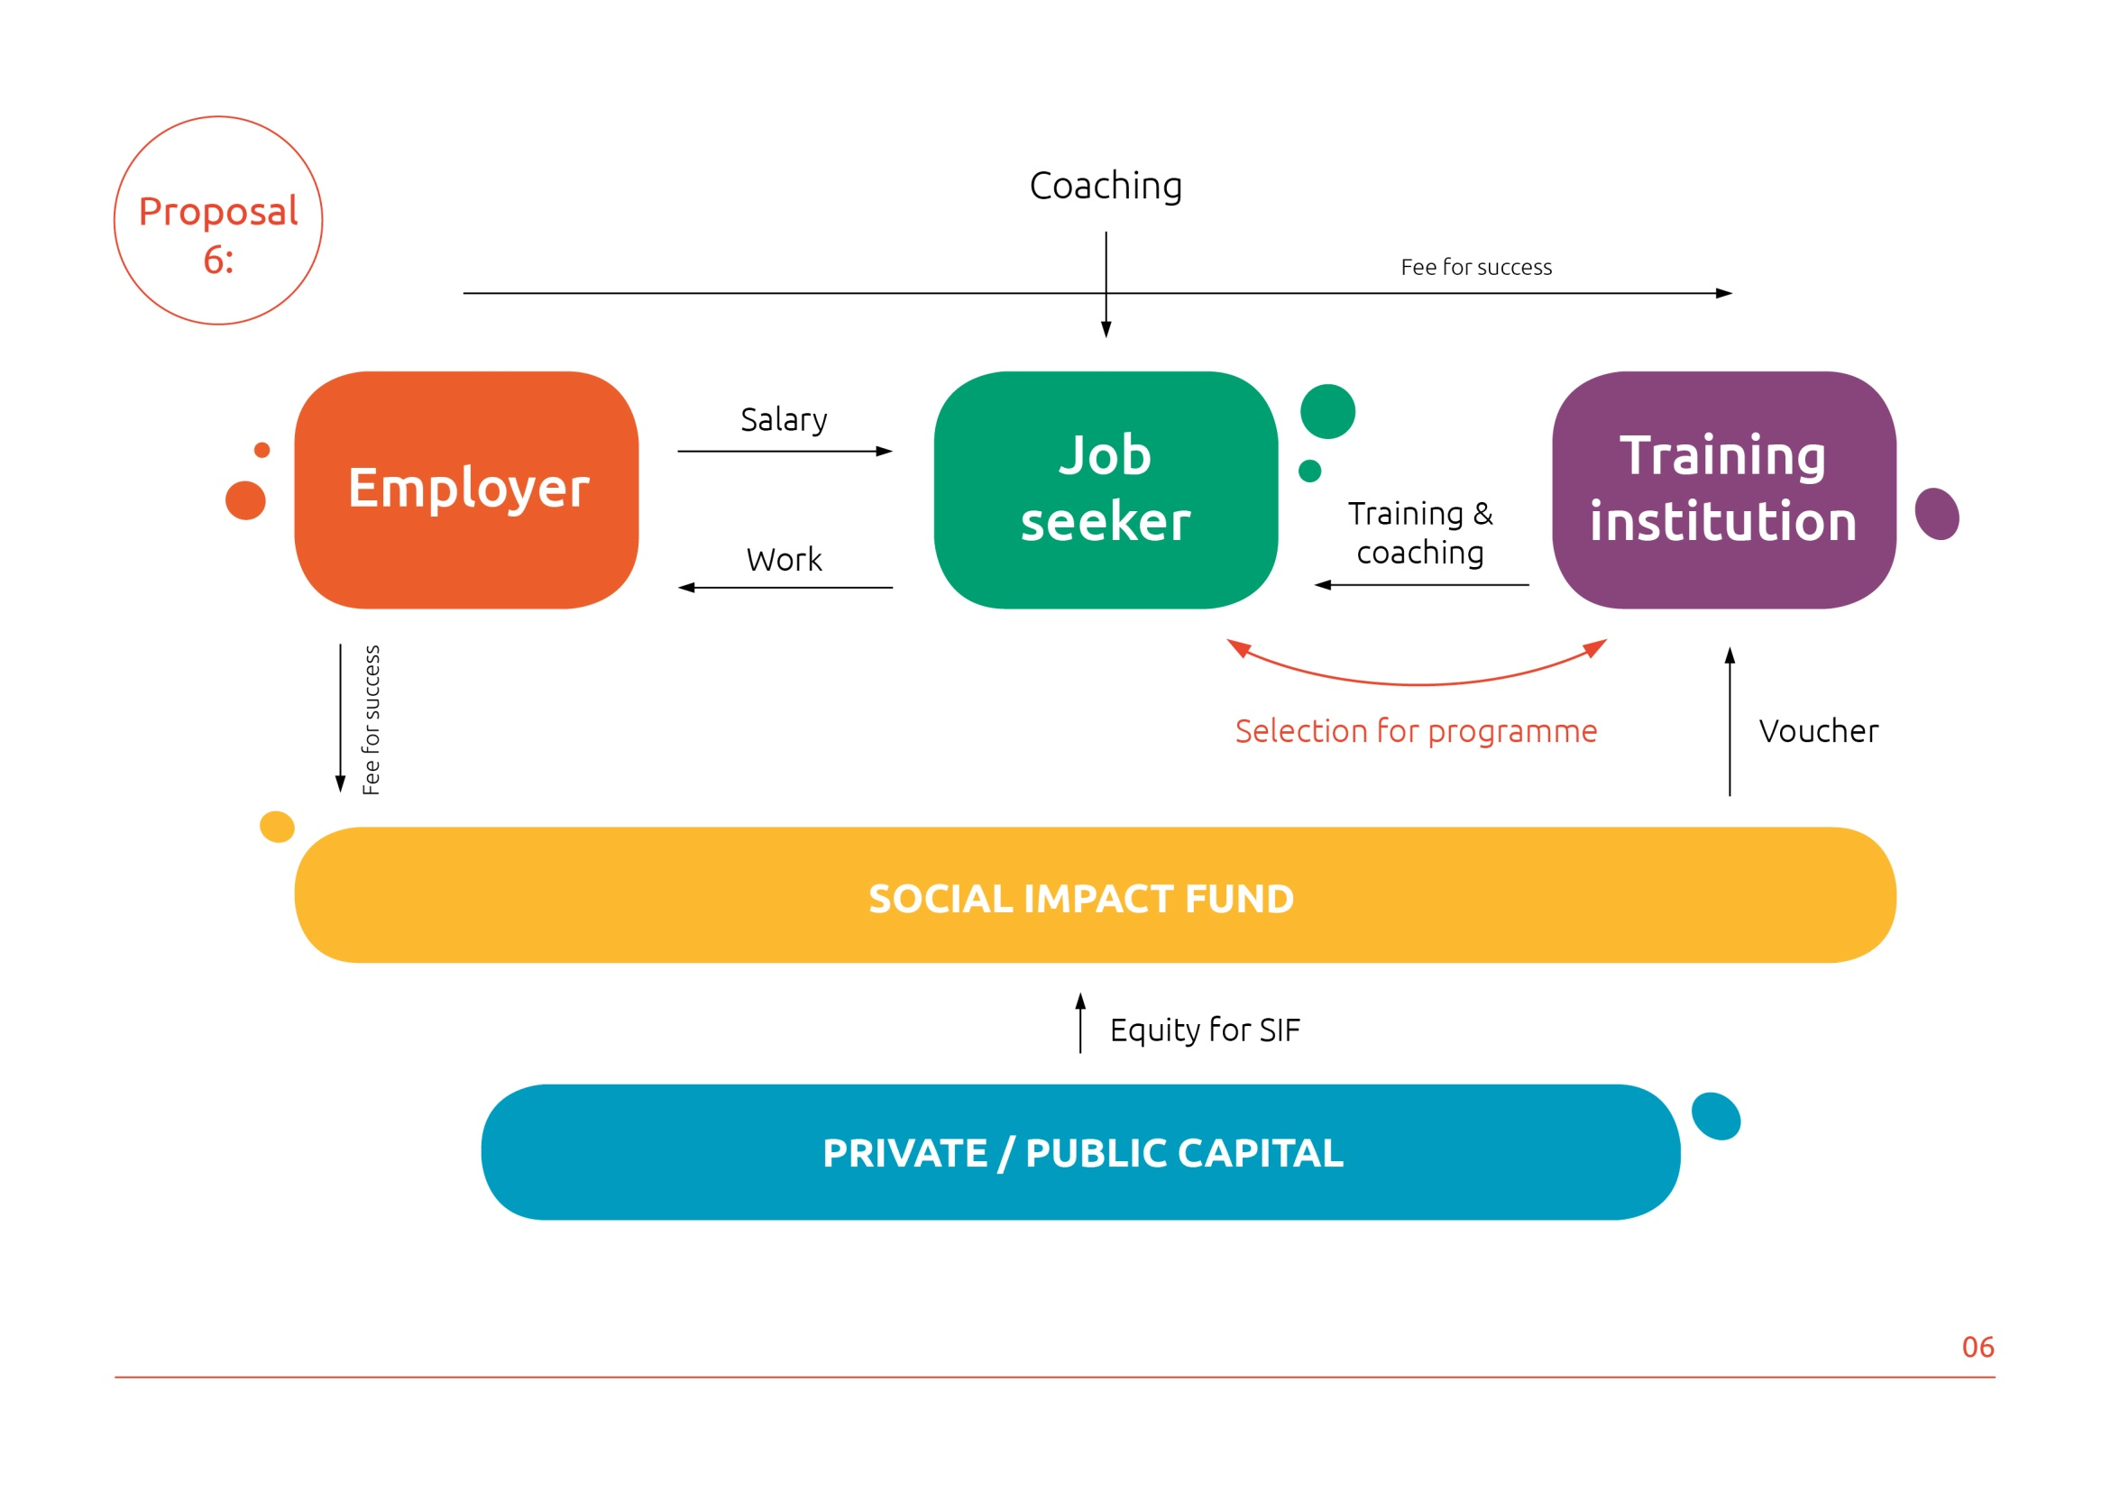

Slide 7
Croatia

Slide 8
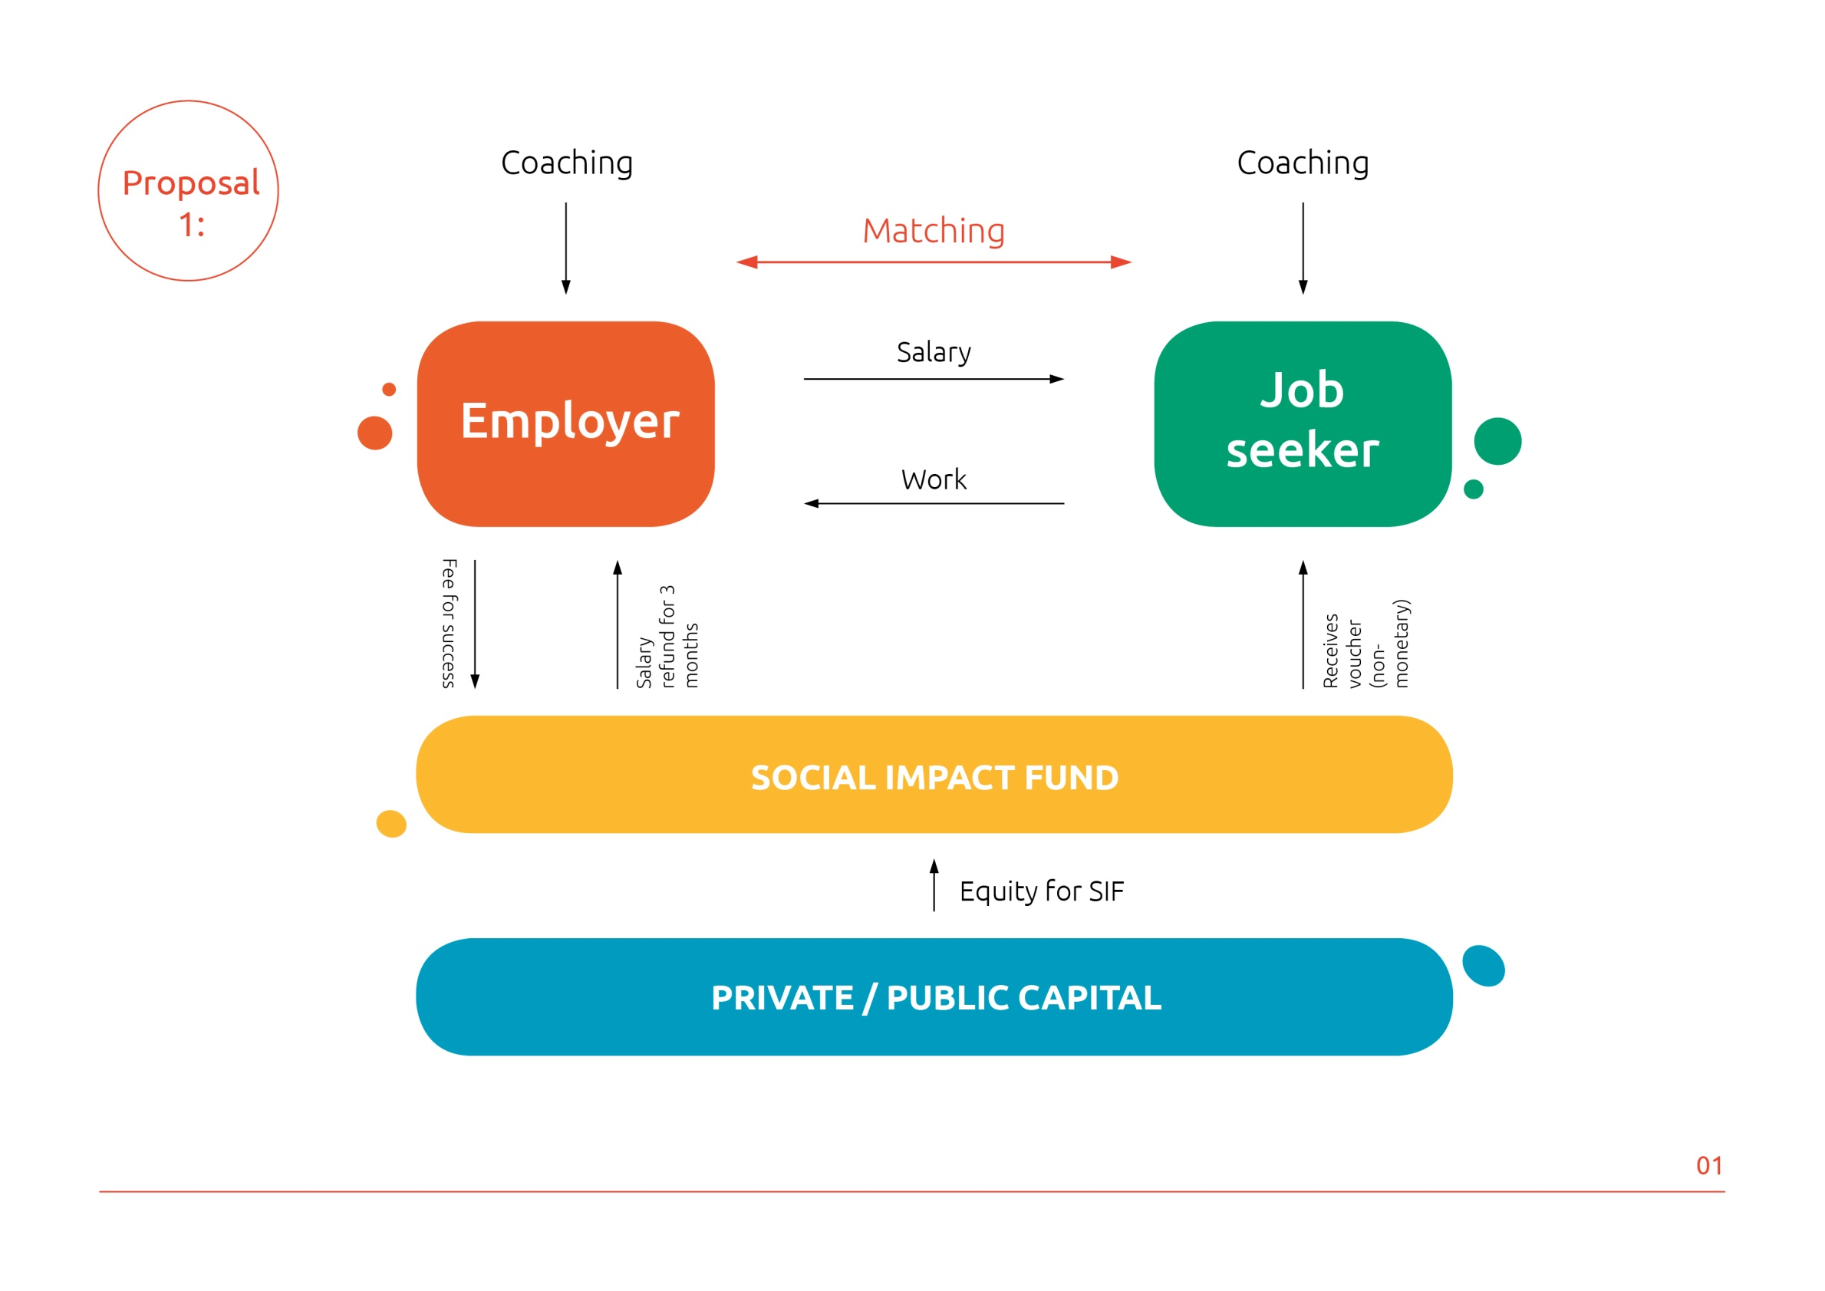

Slide 9
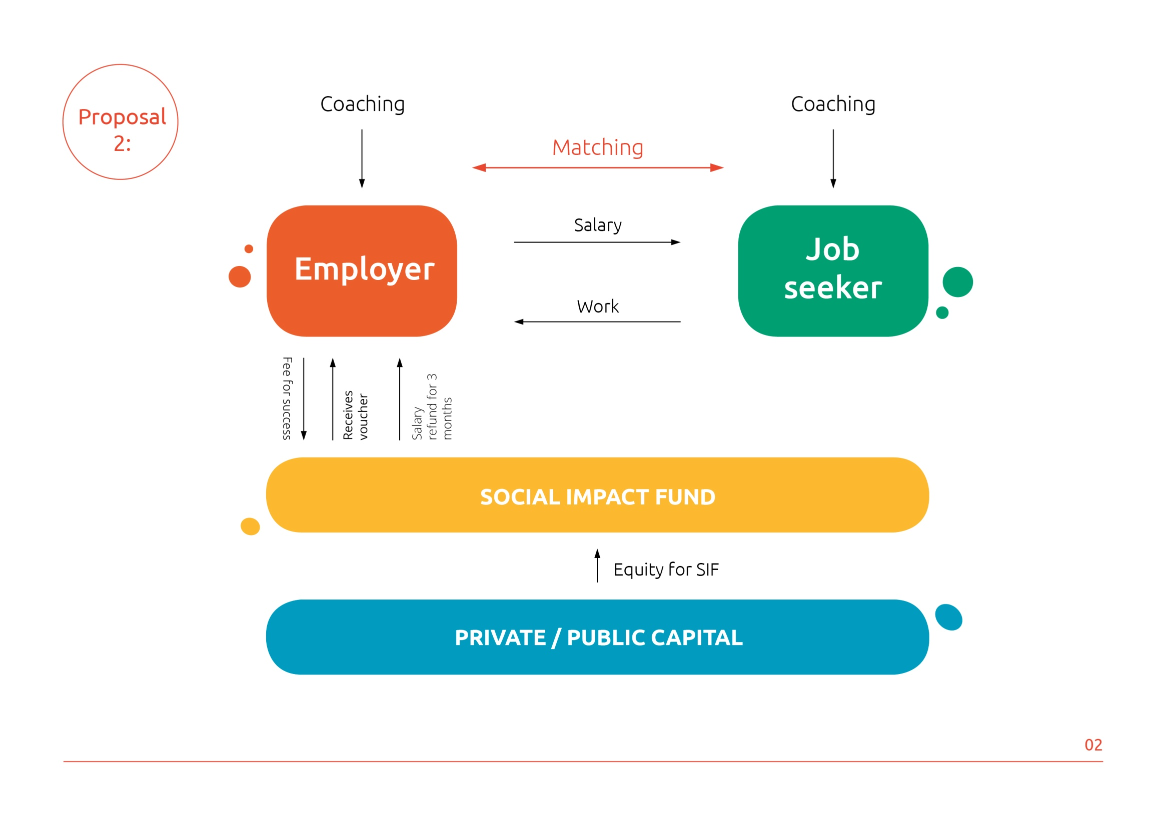

Slide 10
The Czech Republic

Slide 11
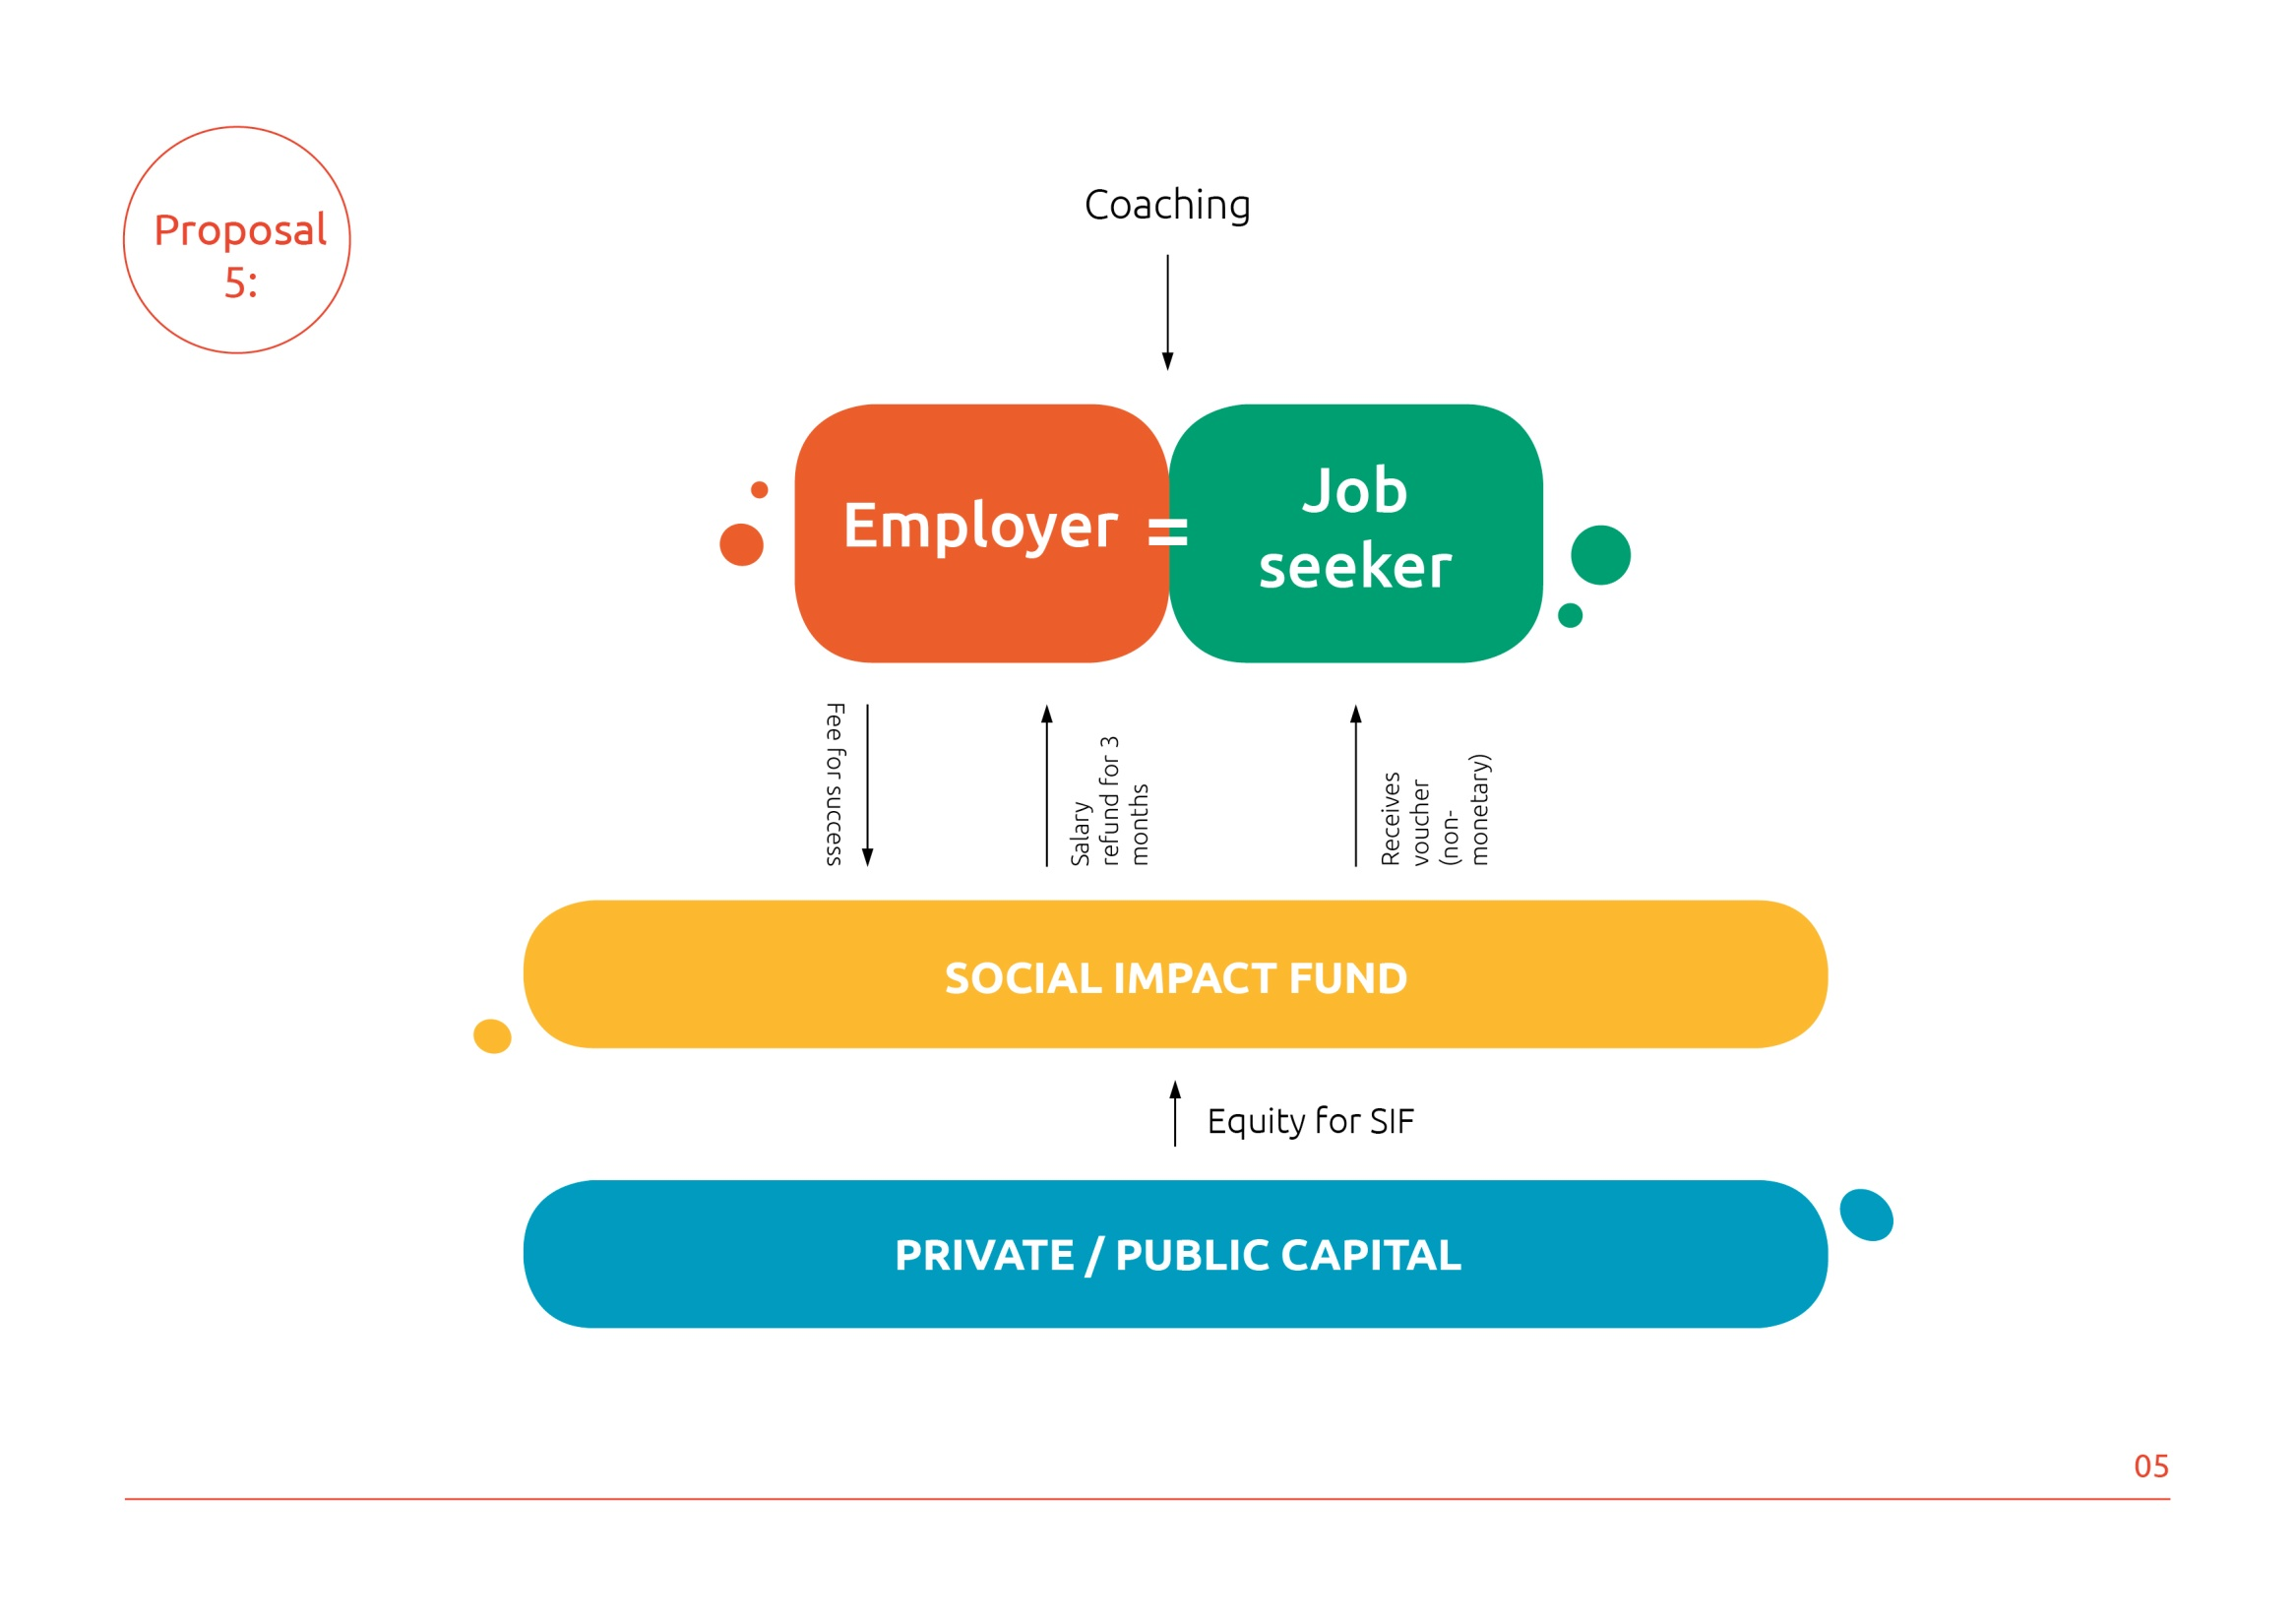

Slide 13
Hungary

Slide 15
Poland

Slide 16
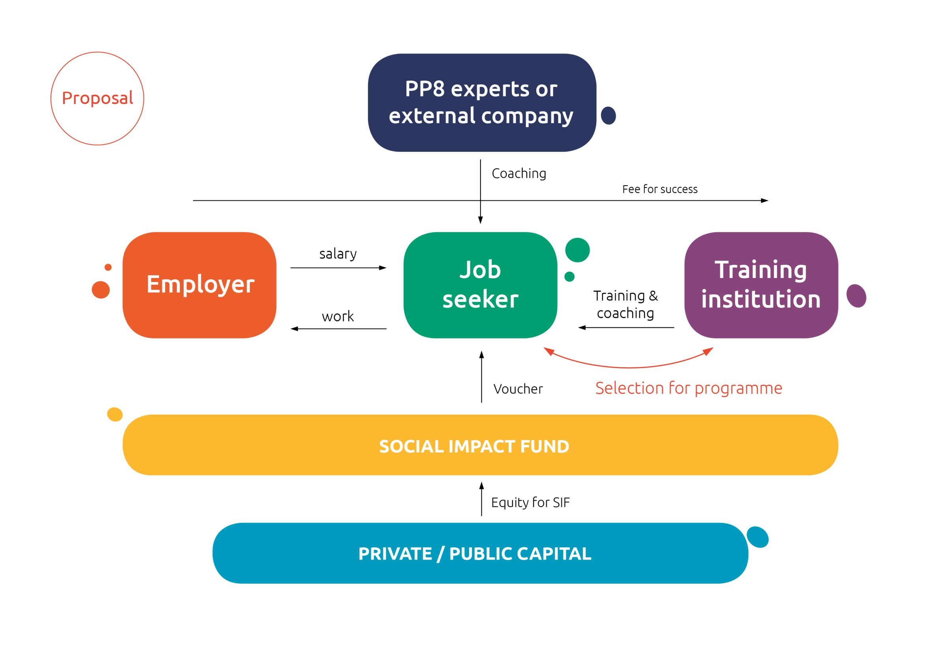
Slovenia

Slide 17
Slovenia

Slide 19
Slovakia

Slide 25
Q & A

