Slide 1
Interreg SIV Webinar Series
Online| May 12th 2022
Webinar „Impact Measurement and Assessment“
NPO & SE Competence Centre WU Vienna | Flavia Bogorin
Social Welfare Service of the Protestant Churches Württemberg | Klaus Kittler

Slide 2
Agenda
Part 1:
Methods and tools for analysing impact
What is impact?
How to conduct an impact analysis?
What is an SROI analysis?
Part 2:
Key findings from the Interreg SIV evaluation
The SROI analysis of the German voucher programme (Württemberg)
Part 3:
Discussion with Klaus Kittler (SWSW) about the potential and limitations of the SROI method

Slide 3
Agenda
Part 1:
Methods and tools for analysing impact
What is impact?
How to conduct an impact analysis?
What is an SROI analysis?
Part 2:
Key findings from the Interreg SIV evaluation
The SROI analysis of the German voucher programme (Württemberg)
Part 3:
Discussion with Klaus Kittler about the potential and limitations of the SROI method

Slide 4

What is impact?
Impact describes those (positive and/or negative) changes that can be observed in beneficiaries or affected person (e.g. individuals, groups, corporations, society) as well as in the environment after an intervention has taken place
Impacts can occur short-, medium- and long-term
Impacts can occur at micro, meso and macro level
Impacts can roughly occur in six different dimensions:
Where do the
impacts arise
structurally?
For which
stakeholders?
economic
social
political
ecological
cultural
physical/psychological
When do the
impacts occur?
Which time
horizon is
relevant?
Which
impacts?
Source:
Grünhaus, Christian/Rauscher, Olivia (2021): Impact and impact analysis in non-profit organisations, businesses and organisations with social added value. NPO & SE Competence Centre. Download: https://short.wu.ac.at/working-paper-impact-EN
Then et al. (2017): Social Return on Investment. Palgrave Macmillan. https://www.springer.com/de/book/9783319714004

Slide 5
At the core of each impact analysis:
The impact Value Chain
Input
(Resources)
Activities/ Services
Output
Intended Outcome
_
Dead-weight
=
Intended Impact
+
+
Broad Impact Analysis
Unintended Outcome
_
Dead-weight
=
Unintended Impact
=
=
Social Value
Social Added Value
Input refers to all resources invested in the analysed project or organization (money, time, skills, knowledge).
Activities refers to those services or products designed/carried out with the invested input.
Output refers to the extent and quantity of services or products delivered.
Intended/ Unintened Outcome refers those positive and/or negative changes that can be observed in beneficiaries or affected persons after the activity or service/product has been performed or consumed. In sum it defines the Social Value of an intervention.
Deadweight refers to those outcomes that would have occurred anyway (ceteris paribus), even without the concrete activities.
Intended/ Unintended Impact refers all those outcomes that occur only due to the intervention analysed, taking deadweight into account. In sum it defines the Social Added Value of an intervention.
Source:
Grünhaus, Christian/Rauscher, Olivia (2021): Impact and impact analysis in non-profit organisations, businesses and organisations with social added value. NPO & SE Competence Centre. Download: https://short.wu.ac.at/working-paper-impact-EN
Then et al. (2017): Social Return on Investment. Palgrave Macmillan. https://www.springer.com/de/book/9783319714004

Slide 6
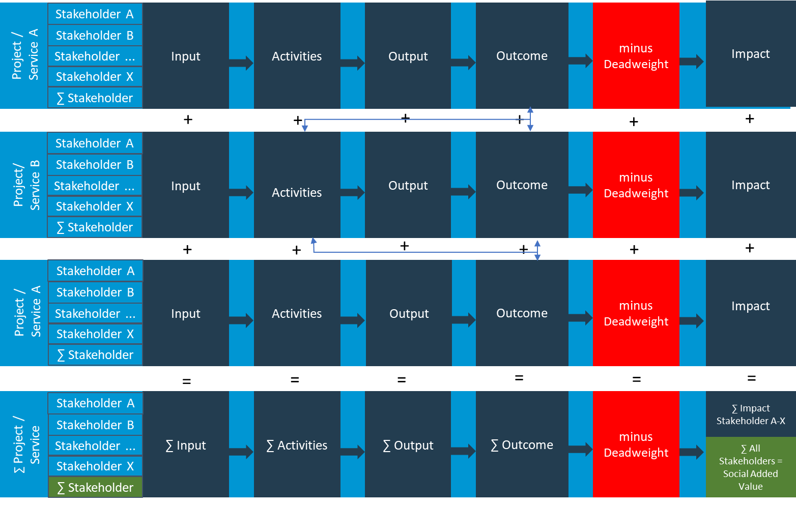
Identifying and structuring impact
The impact model
An Impact Model is set up for a project/intervention or can be set up for an entire organisation.
An Impact Model consists of various impact value chains. For each stakeholder one impact value chain.
It shows the overall social added value/ impact of the whole organisation or a sector
It might show the interconnectedness and synergies between different project or services of an organisation.
It can serve as a basis for an impact oriented strategic development, for example to identify potential partners for cooperation to increase the impact
Source:
Grünhaus, Christian/Rauscher, Olivia (2021): Impact and impact analysis in non-profit organisations, businesses and organisations with social added value. NPO & SE Competence Centre. Download: https://short.wu.ac.at/working-paper-impact-EN

Slide 7
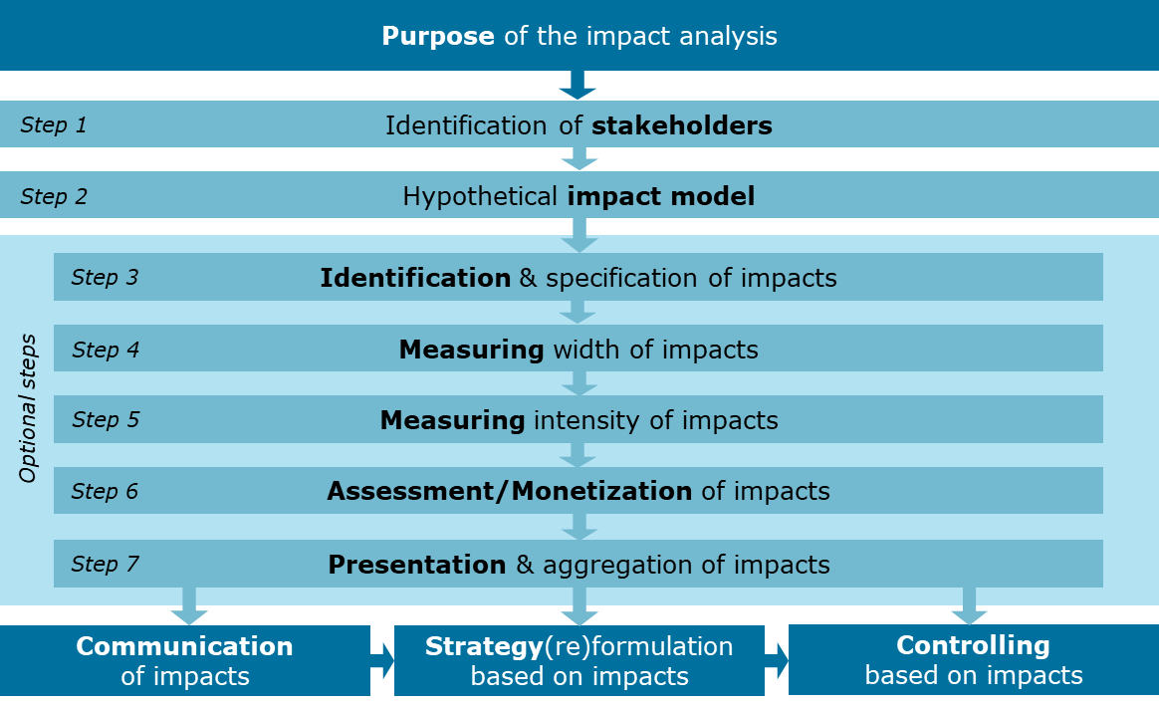
Steps of an Impact Analysis
Source:
Grünhaus, Christian/Rauscher, Olivia (2021): Impact and impact analysis in non-profit organisations, businesses and organisations with social added value. NPO & SE Competence Centre. Download: https://short.wu.ac.at/working-paper-impact-EN

Slide 8
Impact Measurement:
For what Purpose?
External communication
Reputation building, branding
Establish/secure legitimacy in external perception
Finding investors, fundraising
Mobilize resources
Establish/secure legitimacy towards financiers e.g. social impact investors
Strategic and organizational development
Improve strategy development; basis for strategic decisions
Promoting organizational learning; optimizing processes
Control of the organization on the basis of key impact indicators
Impact-oriented control
Establishment of an impact controlling system
Strategic cooperation and scaling
Enter into cooperation that are in the spirit of social value chains
Increase social added value through scaling of the business model
Increasing employees motivation and satisfaction
→ The purpose, the resources and the possibilities of data collection define the type and breadth of an impact analysis
Source:
Grünhaus, Christian/Rauscher, Olivia (2021): Impact and impact analysis in non-profit organisations, businesses and organisations with social added value. NPO & SE Competence Centre. Download: https://short.wu.ac.at/working-paper-impact-EN
Then et al. (2017): Social Return on Investment. Palgrave Macmillan. https://www.springer.com/de/book/9783319714004

Slide 9
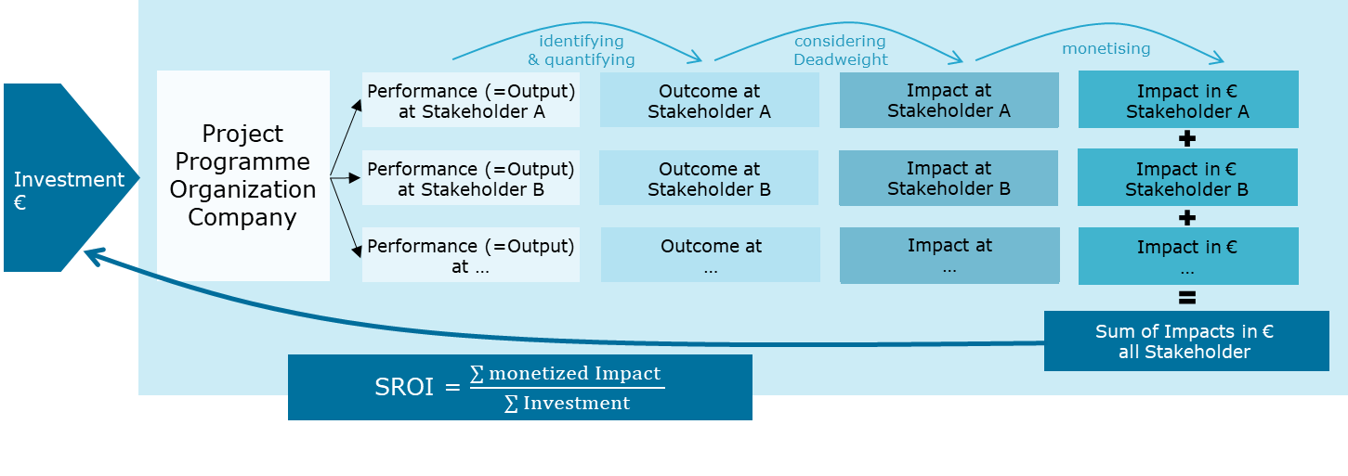
Impact Measurement:
The Social Return on Investment (SROI)-Analysis
Source:
Grünhaus, Christian/Rauscher, Olivia (2021): Impact and impact analysis in non-profit organisations, businesses and organisations with social added value. NPO & SE Competence Centre. Download: https://short.wu.ac.at/working-paper-impact-EN
Then et al. (2017): Social Return on Investment. Palgrave Macmillan. https://www.springer.com/de/book/9783319714004

Slide 10
Advantages of Impact Measurement
Abandonment of pure input-output orientation
Includes stakeholder perspective
Analysis of the needs and benefits of stakeholders (resp. impacts of an intervention) leads to a better understanding of (lack of) services
Evidence of mission fulfillment
Helps to define goals and an impact model and to better understand one's own activities effect beneficiaries, other stakeholders and society
Increase in the effectiveness, efficiency and quality of service provision
Gives evidence where changes are particularly effective
Provides adequate legitimacy for activities of non-profit organizations and social businesses
Provides decision support for investors between different programs, projects, organizations – Benchmarking (depends on the method)
Impact orientation opens up room for innovation
Source:
Grünhaus, Christian/Rauscher, Olivia (2021): Impact and impact analysis in non-profit organisations, businesses and organisations with social added value. NPO & SE Competence Centre. Download: https://short.wu.ac.at/working-paper-impact-EN
Then et al. (2017): Social Return on Investment. Palgrave Macmillan. https://www.springer.com/de/book/9783319714004

Slide 11
Challenges of Impact Measurement
Can a consistent logical link between services (output) and effects (impact) be demonstrated? → Problem of the imputability of effects
How many level of impact should be included? (e.g. income = benefit for employees → Income is spent and creates jobs again ...)
Can indicators be found that measure impacts validly? How complex is data collection and measurement? Certain facts are extremely difficult to measure (e.g. life satisfaction in patients with severe dementia)
Difficulty of subjectivity → Objective measurement of impacts is often difficult; frequently, only a subjective evaluation of achieved impacts can be recorded
Lack of standards in impact analysis and measurement → Many different approaches
Source:
Grünhaus, Christian/Rauscher, Olivia (2021): Impact and impact analysis in non-profit organisations, businesses and organisations with social added value. NPO & SE Competence Centre. Download: https://short.wu.ac.at/working-paper-impact-EN
Then et al. (2017): Social Return on Investment. Palgrave Macmillan. https://www.springer.com/de/book/9783319714004

Slide 12
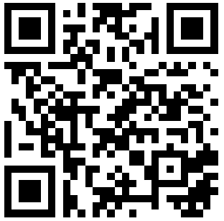
Agenda
Part 1:
Methods and tools for analysing impact
What is impact?
How to conduct an impact analysis?
What is an SROI analysis?
Part 2:
Key findings from the Interreg SIV evaluation
The SROI analysis of the German voucher programme (Württemberg)
Part 3:
Discussion with Klaus Kittler about the potential and limitations of the SROI method
Download study report:
https://short.wu.ac.at/sroi-siv-en

Slide 13
Aims of the study
Presentation of the short- as well as medium- and long-term social and economic impacts of the support programme "Employment Vouchers"/ the Interreg CE "Social Impact Voucher" (SIV) Programme in Germany (Württemberg)
Monetary evaluation of the effects and their comparison with the investments made
Research Questions:
  FF 1: What are the impacts of the "Employment Vouchers" programme of the Social Welfare Service of the Protestant Churches in Württemberg?
  FF 2: To what extent (quantity) do the identified impacts occur?
  FF 3: How can the identified and quantified impacts be monetised?
  FF 4: What is the total monetised benefit of one euro invested in the voucher programme?
  FF 5: Which Sustainable Development Goals (SDGs) are achieved through the identified impacts?

Slide 14
Scope and design of the study
Analysis period: the year 2019
Inclusion of all program participants and employment providers who participated in the voucher program in 2019 in the analysis:
  126 programme participants (65 volunteers, 2 mini-jobs, 59 jobs subject to social insurance contributions)
  24 employment agencies
Data Collection:
  Secondary material research and analysis
    Literature & statistical data research
    Review and analysis of internal documents (e.g. application list)
  Qualitative survey of key stakeholders (9 personal and telephone interviews)
  Quantitative questionnaire surveys:
    Collection of financial, performance and output data via Excel form at Social Welfare Service Württemberg
    Offboarding survey of selected programme participants (n=47)
    Collection of output, financial and impact data from employment providers by means of a quantitative telephone survey (n=12)

Slide 15
Stakeholders included
Excluded stakeholders
Programme participants (job seekers)
Personal or family environment of the participants
Employment companies and church congregations
Partner organisations; EU/ Interreg Central Europe; Social Welfare Service Württemberg; Broader social environment of participants
Future perspectives; additional income; daily routine/ structure; development of professional as well as personal and social skills; mental stress
Stabilisation or improvement of the family situation; relief of strain
Image improvement; network expansion; savings in terms of recruitment costs
Investors/ Regional Church
Work colleagues of the participants (key employees)
SIV Voucher Program
Stakeholder is only considered on the input side
Sensitization regarding the target group; work relief; excessive demands on the team due to participants‘ social and personal needs
State (federal government, federal states, stricts, municipalities)
Additional tax and duty revenue through the employment of participants, SWSW employees and employment companies‘ employees.
Employees of the Social Welfare Service Württemberg
Suppliers
Social insurance institutions
Employment agencies/ job centres
additional orders
Income; broadening horizons; positive feeling
Additional social insurance contributions of the participants, the employees of SWSW and employment companies
Ease of workload; saving on basic security benefits for participants with jobs subject to social insurance contributions

Slide 16

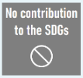



Impact model (excerpt)
Stakeholder | Input | Activities | Output | Effects
Programme participants (job seekers) | Time | Placement, employment, support | Number of participants placed, employed and supported | Sense of purpose and the opportunity to make a contribution to society
 | Skills |  |  | Creation of routine and structure in everyday life
 | Willingness to be helped |  |  | Knowledge enhancement or acquisition of professional competences
 |  |  |  | Mental stress or mental overload due to the world of work (e.g. due to conflicts at work, assumption of responsibility, stress)
 | … | … | … | …
Employment companies and church congregations | Additional financial resources | workplace promotion, support with recruitment activities; mediation | Number of participants placed, employed and supported | Savings in terms of recruitment costs and time facilitation due to the preparatory work of the Social Welfare Service Württemberg
 |  |  |  | improved image and recognition through employment of the target group
 | Time and personnel resources for support
 |  |  |  | Establishing relationships with potential cooperation partners and network expansion
 | … | … | … | …

Slide 17
Calculation methods (excerpt)
Monetized effects
Programme participants (job seekers)
Creation of routine and structure in everyday life Average costs of a project management / time management seminar Related to the year 2019 multiplied by the number of programme participants who have learned to better struc-ture their daily routine (quantification: voluntary work: 76%; mini-jobs: 62%; jobs sub-ject to social insurance contributions: 47%) minus deadweight: share of participants who would have similar outcomes through alter-native programmes (assumption: voluntary work: 5%, mini-jobs: 5%, jobs subject to social insurance contributions: 10%) Impact | € 110,409
Employment agencies and church congregations
Improved image or recognition through employment of the target group Costs for an online advertising campaign Related to the year 2019 multiplied by the share of employment companies that reported an improved image through the voucher programme (33%) minus deadweight: share of employment companies that would have similar outcomes through alternative programmes (assumption: 25%) Impact | € 20,790

Slide 18
SROI value
SROI
1 : 4.62
SROI
medium-term scenario
1 : 6,10
long-term scenario
1 : 8,38

Slide 19
Investment and added value of the voucher programme
Overall view
Stakeholder | Investments | Monetized added value | share of total profit
Programme Participants |  | € 3.368.996 | 77,80%
Social Insurance Institutions |  | € 280.342 | 6,47%
Employment agencies/ job centres |  | € 264.210 | 6,10%
Employment companies and church congregations | € 482.549 | € 206.716 | 4,77%
State (federal government, federal states, districts, municipalities) | € 159.676 | € 117.139 | 2,71%
Work colleagues of the participants |  | € 54.446 | 1,26%
Personal/family environment of the participants |  | € 35.458 | 0,82%
Employees of the Social Welfare Service Württemberg |  | € 1.653 | 0,04%
Suppliers |  | € 1.348 | 0,03%
Investors/ Regional Church | € 294.835 | Stakeholders is only considered on the input side
Overall result | € 937.061 | € 4.330.307 | SROI 1 : 4,62

Slide 20
Résumé and Conclusion
With an SROI value of 4.62, the voucher programme proves to be particularly effective
  This value represents only the short-term impacts directly related to the 2019 analysis year.
  If the effects are extrapolated for the medium and long term, the SROI value increases to 6.02 and 8.38 respectively.
The programme participants are by far the main beneficiaries of the voucher programme. The second and third largest social added value is generated by the social insurance institutions and the employment agencies/job centres.
The voucher programme makes a significant contribution to the achievement of the Sustainable Development Goals (SDGs) and thus generates socially and economically sustainable added value in addition to monetised added value.

Slide 21
Questions
?
Thank you for your attention!
Do you have any questions?

Slide 22
Agenda
Part 1:
Methods and tools for analysing impact
What is impact?
How to conduct an impact analysis?
What is an SROI analysis?
Part 2:
Key findings from the Interreg SIV evaluation
The SROI analysis of the German voucher programme (Württemberg)
Part 3:
Discussion with Klaus Kittler about the potential and limitations of the SROI method

Slide 23
Discussion Questions I
Where do you see the need as well as the potential for activating private money for supporting labour market integration?
  Is this a goal that the Social Welfare Service Württemberg is actively pursuing?
  Do you have any good practice examples in this regard?
How did the SWSW make use of the results of the SROI analysis up to this point?
  In external settings?
  For your everyday work at the SWSW?
  For involving potential private investors or donors in employment programmes?

Slide 24
Discussion Questions II
How do you picture the future of labour market inclusion measures from a policymaking as well as an investment perspective?
  What further arguments or concrete activities do you think would better support labour market inclusion on a policy-level?
  By what means do you think private investors or donors can in future be more closely involved in labour market inclusion activities?
  To what extent is advocating for different target groups of labour market measures decisive for the success of these measures?
  What are in your opinion the most promising approaches for steering labour market inclusion activities in the future?
  What role could impact analyses in general – either in form of SROI analyses or other impact-oriented approaches – play in raising awareness for the importance of labour market inclusion among policy-makers and private investors or donors?
Do you have any closing statement or additional thoughts on this matter?

Slide 25
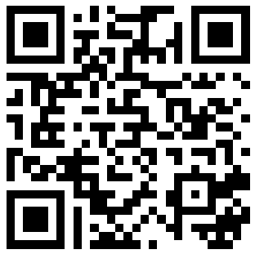
Thank you & Feedback
Thank you for attending today‘s webinar!
And please send us your feedback by filling out a short online survey.
Link to feedback survey:
https://short.wu.ac.at/SIV_webinars_feedback
or please scan the QR code to
access the feedback survey →

Slide 26
Contact
Flavia-Elvira Bogorin, MSc
Researcher
Competence Center for Nonprofit Organizations and Social Entrepreneurship
WU
Vienna University of Economics and Business
Tel: +43 1 31336 5818
Email: flavia-elvira.bogorin@wu.ac.at
www.wu.ac.at/npocompetence
Klaus Kittler
Technical advisor
Social Welfare Service of the Protestant Churches in Württemberg (SWSW)
Email: Kittler.K@diakonie-wuerttemberg.de

