Slide 1
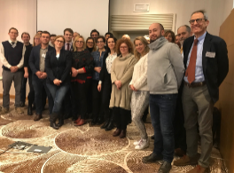
FIRECE Newsletter #1
2019 – #1
Innovative Financial Instruments for industry
low carbon energy transition in Central Europe
OVERVIEW
FIRECE-project was set up in order to support national targets for renewable energy shares of final energy consumption. CE regions have the common challenge to keep investing and even to accelerate the financing of concrete actions to deliver sustainable energy measures.
Visit our homepage for further information:
https://www.interreg-central.eu/Content.Node/FIRECE.html
Therefore, the main objective of FIRECE is to increase capacities of regional operator to manage energy plans to enhance the investments in renewable energy by industry, especially SMEs. For this purpose main tasks of FIRECE are “to increase competences to manage Regional Energy Plans” and to support the “implementation of instruments, their testing and transferability actions”. 10 partners from Central European regions coming from Italy, Germany, Austria, Hungary, Poland, Croatia and Czech Republic are cooperating at these important topics.
TRAININGS
Training workshop in Brüssel
The training workshop - jointly organised by Interreg CE FIRECE project and FI Compass - started on the afternoon of the 17th of January. All project partners were involved in the workshop including experts and representatives of their regional/national authorities. They presented concepts and innovative financial instruments to increase energy efficiency and enhance the use of renewable energy sources.
Page 1

Slide 2
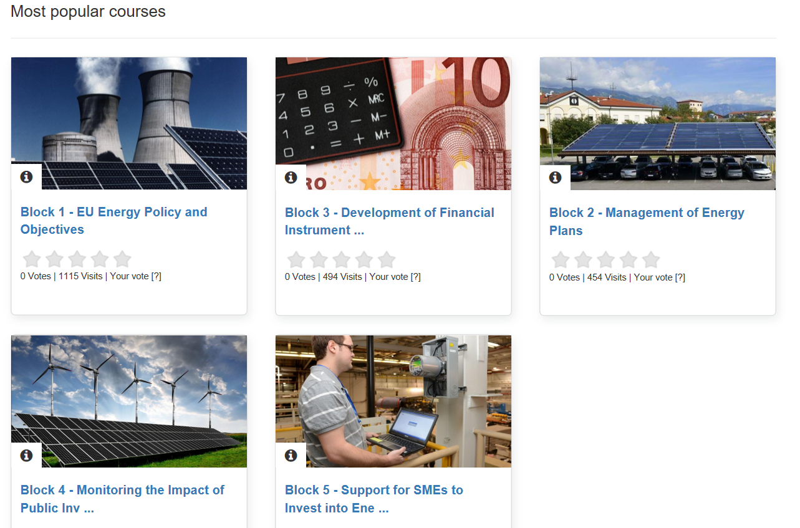
FIRECE Newsletter #1
2019 – #1
There was a focus on buildings renovation carried out with the support of the EU. An example from the Baltic States proved to be very interesting. Blocks of flats with over 50.000 units have been renovated with the support of EU funds. On the second day, examples and information on "energy saving contracting" were presented, which had successfully been carried out in various EU countries. It was particularly interesting to learn that such projects or programs can also be submitted outside of a classical funding framework.
Free training course for low carbon energy transition
A first draft of the online training course concerning low carbon energy transition was elaborated by the FIRECE partner ENVIROS. This free training course is addressed to coordinators and operators on innovative financial instruments of partner-regions and consists of following 5 training blocks:
EU energy policy and objectives
Management of energy plans
Development of financial instruments
Monitoring the impact of public investments
Support for SME to invest into energy efficiency
.
To get free access to the online training course, please contact: pavel.ruzicka@enviros.cz from FIRECE partner ENVIROS.
Page 2

