Slide 1
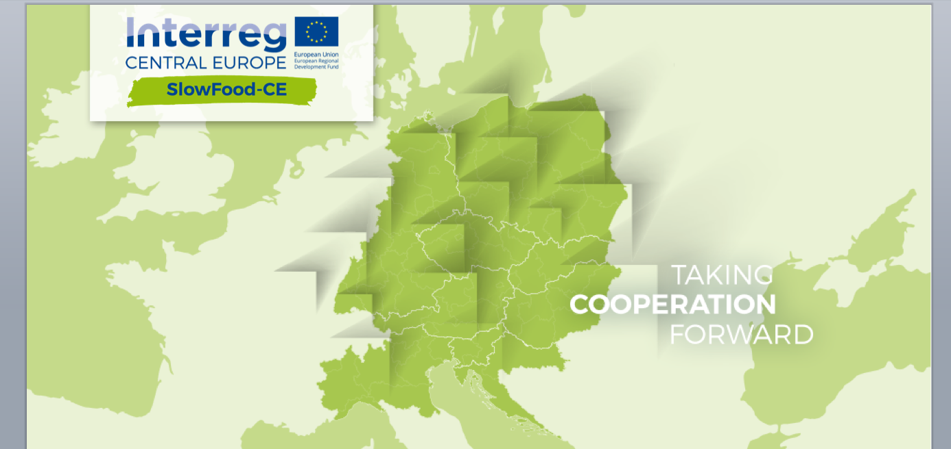
Training COURSE IN GCH
RESOURCES VALORISATION

Slide 2
Training course in GCH resources valorization
Course aims and project phase
Valorization: what does it mean?
Slow Food’s approach to Valorization
How to Valorize: 4 Clusters

Slide 3
Course aims
The training aims to provide basic concepts, best practices and guidelines for the sustainable valorisation of foods that are part of the gastronomic cultural heritage (GCH) of a territory

Slide 4
Project phase
This is the second phase in the development of the project Slow Food-CE
We are here
IDENTIFICATION/ MAPPING
OF GCH
VALORISATION
OF GCH
PILOT ACTION
TRANSNATIONAL
STRATEGY
WPT1
WPT2
WPT3
WPT4

Slide 5
Training course in GCH resources valorization
Course aims and project phase
Valorization: what does it mean?
Slow Food’s approach to Valorization
How to Valorize: 4 Clusters

Slide 6
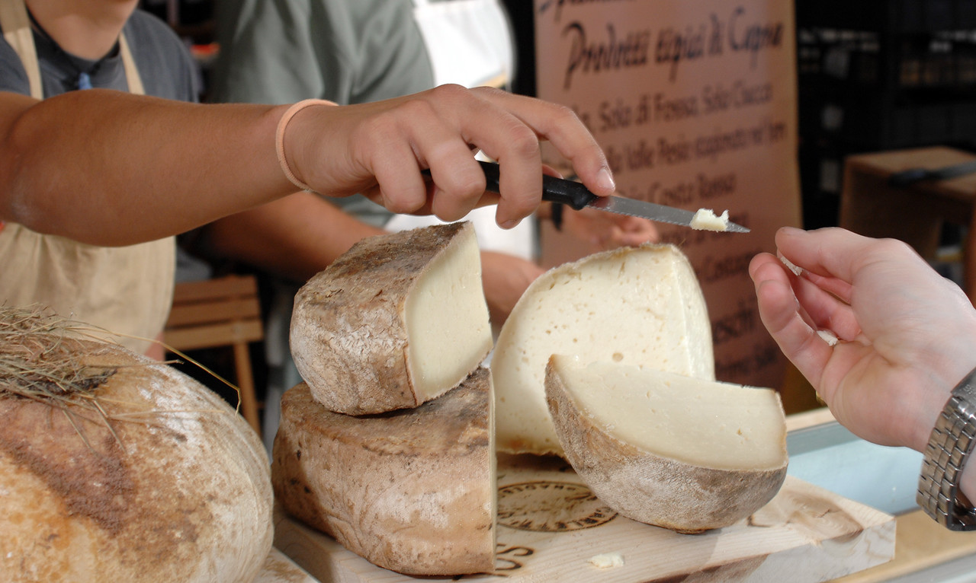
Valorisation: what does it mean?
All the techniques and methodologies that increase the value of a given good and the
management and promotion mechanisms through which this value can be transmitted to beneficiaries.
Valorisation is also education that serve to increase knowledge and,
consequently, increasing the ability of beneficiaries to benefit from these goods.
Objects of valorization can be:
Material goods
Immaterial goods (traditions, know-how …)

Slide 7
Training course in GCH resources valorization
Course aims and project phase
Valorization: what does it mean?
Slow Food’s approach to Valorization and projects
How to Valorize: 4 Clusters

Slide 8
Slow Food approach to Valorisation
What should be valorized?
2 main criteria for a food product
1. GOOD
2. AT RISK OF DISAPPEARANCE

Slide 9
Slow Food approach to Valorisation
What elements are involved in this valorization process?
Key element
The Product
Producers faces
Production area
Cultural aspects
Actors
Slow Food = process facilitator
Producers = main actor
Consumers = co-producers
Success factors’
Education
Technical skills,
Communication skills (storytelling)
Networking with other producers
Community

Slide 10
Training course in GCH resources valorization
Course aims and project phase
Valorization: what does it mean?
Slow Food’s approach to Valorization and projects
How to Valorize: 4 Clusters

Slide 11
How to valorise
Clusters have been identified in order to group the different initiatives and activities that are possible in the attempt to valorise cultural heritage
Best practices
Projects which are examples od valorisation of GCH. Developed by Slow Food, their methodologies and tools can be used to develop the pilot actions
PUBLIC MARKETS
EARTH MARKET
COOKS AND CHEFS
CHEFS’ ALLIANCE
SUSTAINABLE TOURISM
SLOW FOOD TRAVEL
EDUCATION
SLOW FOOD EDUCATION

Slide 12
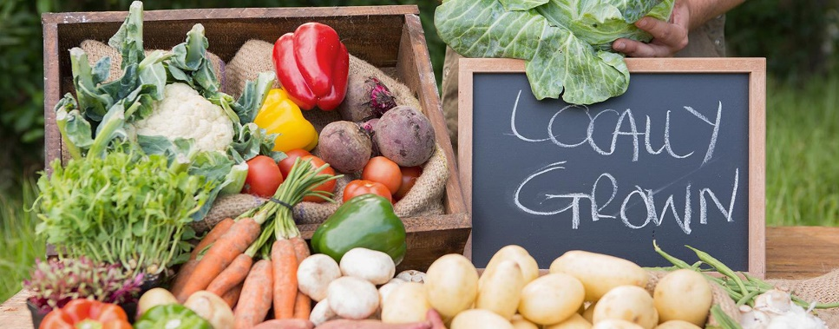
Public Markets
What is their role
in the valorisation
of GHC?
Direct sell (from producers to consumers)
Urban communities meet farmers
Specific High Quality products
Multifunctionality selling, buying, meeting, exchanging knowledge, training, testing, networking, making community
Notes:
To discuss the topic further:
- present the Slow Food Markets as best practice of this cluster; find information to share on the website https://www.fondazioneslowfood.com/en/what-we-do/earth-markets/
- print and hang out the «guidelines» - download the documento from here → http://www.granaidellamemoria.it/edu/pluginfile.php/464/mod_page/content/22/PUBLIC%20MARKETS_The%20guidelines.pdf

Slide 13
Cooks and chefs
What is their role
in the valorisation
of GHC?
create relationships of mutual understanding and collaboration with small-scale, local, sustainable food producers;
promote sustainability in food consumption by informing consumers on biodiversity, food environmental footprint, sustainable farming and fishing, responsible meat consumption, etc.
Notes:
To discuss the topic further:
present the Slow Food Chefs’ Alliance of this cluster; find information to share on the website https://www.fondazioneslowfood.com/en/what-we-do/slow-food-chefs-alliance/
show the videos you can find here in Moodle → http://www.granaidellamemoria.it/edu/mod/page/view.php?id=176
- print and hang out the «guidelines» - download the document from here → http://www.granaidellamemoria.it/edu/pluginfile.php/476/mod_page/content/25/COOKS%20AND%20CHEFS_The%20guidelines.pdf

Slide 14
Sustainable tourism
What is its role
in the valorisation
of GHC?
Make optimal use of environmental resources, maintaining essential ecological processes
Conserve natural heritage and biodiversity
Respect the socio-cultural authenticity of host communities
Ensure viable, long-term economic operations, providing socio-economic benefits to all stakeholders that are fairly distributed
Notes:
To discuss the topic further:
present Slow Food Travel as best practice of this cluster; find information to share on the website https://www.fondazioneslowfood.com/en/what-we-do/slow-food-chefs-alliance/
show the videos you can find here in Moodle → http://www.granaidellamemoria.it/edu/mod/page/view.php?id=176
- print and hang out the «guidelines» - download the document from here → http://www.granaidellamemoria.it/edu/pluginfile.php/479/mod_page/content/34/SLOW%20TRAVEL_The%20guidelines.pdf

Slide 15
Education
What is its role
in the valorisation
of GHC?
Recognise cultural and ecosystemic heritage as common goods that need to be valorised and transmitted.
Increase awareness on the sustainable use of cultural heritage
Increase the sense of belonging to the cultural heritage, developing projects that promote emotional connections and cultural assimilation through the valorisation of the different elements of a territory Develop and promote networks that include schools, public authorities, cultural institutions and the territory in which they operate
Develop reflective and experiential “journeys” focused on understanding territories as a “diffused cultural good”
Notes:
To discuss the topic further:
Present Slow Food Education Manifesto (download the document from here → http://slowfood.com/filemanager/official_docs/SlowFood_Education_manifesto.pdf
Find more informantion about Slow Food approch to education in the handbook → http://slowfood.com/filemanager/Education/ENG_manuale.pdf

