Slide 1
Energy roundtable
06 May 2021
Project CE1312 InNow
Piotr Pawelec

Slide 2
Innovation Support Package
Large companies
The goal
To understand large companies innovation needs in cleantech and their problems with finding solutions
Tools
Innovation audits
To zdjęcie, autor: Nieznany autor, licencja: CC BY-SA
Notes:
HEP ESCO d.o.o. CROATIA It develops, implements and finances market-based energy efficiency projects. in energy and maintenance costs.
From the very beginning, HEP ESCO has been associated with international organizations such as the World Bank (WB), the Global Environment Facility (GEF), the German Development Bank (KfW) and the United Nations Development Program (UNDP).
Tungsram Group HUNGARY Main activities of the company in manufacturing, a company with 125 yrs tradition in manufacturing and innovation. They are interested in extending their product portfolio
Veolia Energia Polska S.A. POLAND Veolia is part of international group from France. In Poland Veolia group companies activities concentrate in Energy sector activities – from RES through district heating, waste water and sewage systems. The group is looking actively for new solutions to help its companies develop.
ZSE SLOVAKIA is provider of electricity distribution in the Western Slovakia to more than 1 Million supply points and supplier of electricity and gas to households and companies. The company provides additional services and complete solutions to energy customers aimed at using renewable energy sources and technologies for intelligent households. ZSE Group has been part of the German energy Group E.ON since 2002
BPT d.o.o. SLOVENIARuns four hydropower plants, and also deals with real estate. Keen to expand their innovation portfolio, their main focus is energy, more specifically renewable energy, storage, and waste management. The main reason for participation in the project is to expand the deal flow, and also to learn and gain experience as mentors and investors to passionate entrepreneurs.

Slide 3
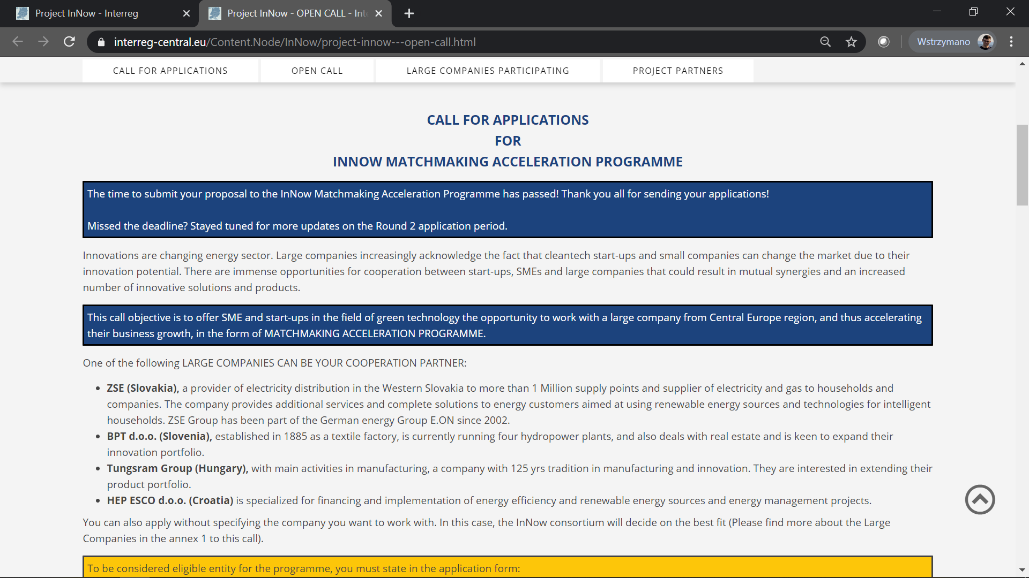
What we found out and what we have done (so far)
Large companies are eager to scout for innovative ideas outside their organisations
Main deficiency of startups with interesting ideas are underdeveloped business skills causing problems with efficent cooperation
Business Support Package – development of business skills for innovative startups
Scouting for solutions and support in their development

Slide 4
INNOVATE NOW! INNOVATION SUPPORT FRAMEWORK FOR FOSTERING THE COLLABORATION OF STARTUPS, SMES AND LARGE COMPANIES ON CLEAN-TECH PROJECTS
http://interreg-central.eu/Content.Node/InNow.html
https://www.facebook.com/InNow.Interreg/
https://twitter.com/InNow_Interreg
https://www.linkedin.com/company/innow-interreg-central-eu/
innow@innoenergy.com
Project management: piotr.pawelec@innoenergy.com Communication: veronika.cegielski@innoenergy.com
Finance: katarzyna.machowska@innoenergy.com
To zdjęcie, autor: Nieznany autor, licencja: CC BY-SA

