Slide 1

CE-CONNECTOR
Building bridges for early stage investments
Name and Surname, Project Partner Name
Notes:
1

Slide 2

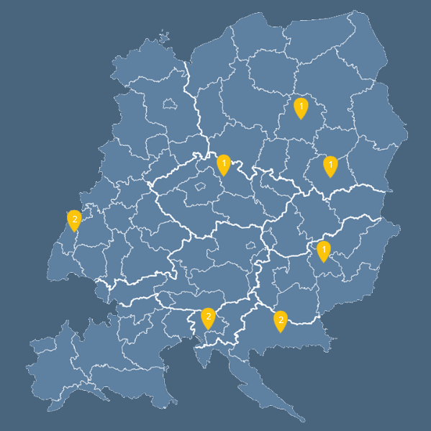











COOPERATING REGIONS
Czech Republic
(Lead Partner)
Croatia
Optimization
Zagreb Innovation Center Ltd.
Germany
Automotive Engineering Network - The Mobility Cluster e.V
City of Karlsruhe
Hungary
P-INVENT Consulting,
Trading and Services Kft.
Hungarian Foundation for Enterprise Promotion (MVA)
Poland
Center for Entrepreneurship Support CRETAEHUB”
Lodzkie Region
Slovenia
Bogatin, market research and consulting
Technology Park
Ljubljana

Slide 3
PROJECT DATA
PROJECT NAME: CE-CONNECTOR
(Central European Connector)
Project Budget: 1.979.513,30; ERDF Funding 1.655.807,62
Project duration: April 2019 – June 2022

Slide 4
MAIN PROJECT OBJECTIVE
Build ecosystems
to close the gap
between 3F and VC funding for early stage Startups.
Public Providers
Business Angels
Start-ups
Project
Partners
Business Experts

Slide 5




CE-CONNECTOR - OUR APPROACH
ACIF – ANGEL CO-INVESTMENT FUND
Private
investors
Public Support
Min 3 Business Angels
Available Public instruments
Start-ups

Slide 6
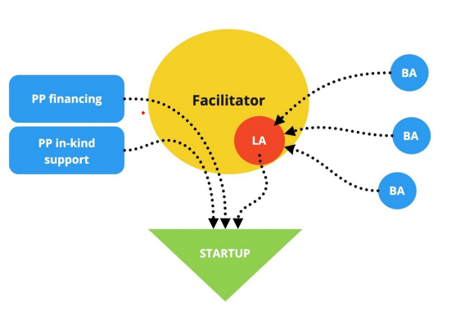
CE-CONNECTOR - OUR APPROACH
ACIF in CE-CONNECTOR
CECONNECTOR PROJECT PARTNERS
Private
investors
Public Support

Slide 7




CE-CONNECTOR - OUR APPROACH
SCOUT START-UPS
MATCH WITH PRIVATE INVESTORS
LEVERAGE WITH PUBLIC FUNDS

Slide 8

CE CONNECTOR RESULTS:
INVESTMENT DEALS
MORE THAN:
2 400 000, 00 EUR

Slide 9

CE CONNECTOR RESULTS:
INVESTMENT DEALS - HUNGARY:
TOTAL INVESTMENT: 769,691 EUR

Slide 10

CE CONNECTOR RESULTS:
HEATVENTORS:
TOTAL INVESTMENT: 530,191 EUR
The first innovative thermal energy storage with optimization control
We made a modelling algorithm, to simulate the processes inside these materials and create more efficient energy storages. Since than we verified our solution with prototypes and pilot projects and now we have many working systems in the national and international market.
We are the proof that everybody can reach his or her dreams with hard work and commitment.

Slide 11

CE CONNECTOR RESULTS:
YOUR PARKING:
TOTAL INVESTMENT:192,900 EUR
Imagine that you don't have to stress or waste your time while searching for parking spots in downtown areas. Moreover nobody will occupy your own parking place if you want. How about making money with your parking place?
The Yourparking smart parking barriers with all of their features are able to make your parking experience comfortable and predictable.

Slide 12

CE CONNECTOR RESULTS:
WATERSCOPE:
TOTAL INVESTMENT: 46,600 EUR
Industry 4.0 in water management
Wireless data transfer from sensors to server
Real-time monitoring with AI aided analysis
Sensors2Net water systems, developed by Water Scope Inc., offer innovative, intelligent, solutions; data collection, interpretation, design and implementation.
Whether in tight urban applications or over distances in rural and suburban communities: sensors remotely transfer data wirelessly to any dedicated server, where users perform. Artificial Intelligence aided analys is and water management decisions regardless of space and time. The result is superior circulatory water planning across the entire spectrum of activates in the water cycle. Realtime monitoring, early error detection, water loss prevention, and implementation of predictive maintenance vs. preventive maintenance.

Slide 13

CE CONNECTOR RESULTS:
INVESTMENT DEALS - SLOVENIA:
TOTAL INVESTMENT:
49,300 EUR

Slide 14

CE CONNECTOR RESULTS:
ALBATROSS:
TOTAL INVESTMENT: 49,300 EUR
Ever wished you could fly?
Experience the world's lightest e-surf.
Albatross e-foil surf allows you to go places you've never been before. It's unique and stable design allows you to fly over water, offering you unforgettable surf sessions in weather conditions previously incompatible with surfing.

Slide 15

CE CONNECTOR RESULTS:
INVESTMENT DEALS – SLOVENIA & CROATIA:
TOTAL INVESTMENT:
238,739 EUR

Slide 16

CE CONNECTOR RESULTS:
B2BEE:
TOTAL INVESTMENT: 238,739 EUR
For those who do not match the limitations - BUSINESS BEE – a package completely tailoredmade to your business!
B2Bee company deals with the automation of wholesale sales processes in integration with customer ERP. They have developed their own software platform within which several integrated applications operate. Strategy is to encompass all the needs of wholesalers through all sales channels - from receipt to delivery. B2Bee are very interested in the development of artificial business intelligence, so they are developing this segment in parallel with our wholesale applications.

Slide 17
CE CONNECTOR RESULTS:
INVESTMENT DEALS CROATIA:
TOTAL INVESTMENT:
809,000 EUR

Slide 18

CE CONNECTOR RESULTS:
AMPNET:
TOTAL INVESTMENT: up to $3.6M + 350,000 EUR
AMPNET IO Ltd., - crowdfunding platform for electricity trading and renewable energy investment built on the blockchain technology. The company's platform provides automated billing and transactions and offers one-click investment traceability and reporting tools, enabling citizens to invest in renewable energy and trading electricity amongst themselves by automating their processes.

Slide 19

CE CONNECTOR RESULTS:
MOBILITY ONE:
TOTAL INVESTMENT: 459,000 EUR
The Future of Fleet Services.
Now!
Make IT Easy is startup which has developed specialized fleet management and full service leasing Software as a Service / SaaS branded as MobilityONE for B2B segment, including corporate & SME customers and smart cities. MobilityONE is a platform for vehicle fleet management and fleet services, corporate car sharing, car pooling and full service leasing.

Slide 20

CE CONNECTOR RESULTS:
INVESTMENT DEALS - GERMANY:
TOTAL INVESTMENT:
1 545 408 EUR

Slide 21

CE CONNECTOR RESULTS:
EQUALTO:
TOTAL INVESTMENT: 620,408 EUR
EqualTo sets a new standard for how companies manage commissions and motivate teams with real-time data.
Finally, a commission platform for modern teams
EqualTo is redefining commission management taempowering both business and technical teams to drive value through incentives.
A seamless, fully automated process that you can trust.
See all transactions in transparent reward accounts – similar to digital bank accounts but for commission.
Improve transparency and motivation with real-time insights
Create and maintain incentive plans in a true no-code environment and be autonomous from day one.
Manage your commission process at scale with powerful APIs Show real-time commission data and charts in existing IT systems, including your CRM or proprietary portals.

Slide 22

CE CONNECTOR RESULTS:
NINETAILED:
TOTAL INVESTMENT: 305,000 EUR
Ninetailed is the first personalization platform for the modern web.
Enhance your visitors experience and grow your customers with personalization for headless CMS and modern Jamstack frameworks without performance trade-offs.
Convert your traffic more efficiently
Empower your website with personalization experiences and build better data-driven experiences to improve your lead generation, prospect quality and sales.
Explore Personalization for Marketers
Headless personalization platform
Personalization for Contentful
Easy and fast content curation
Explore Personalization for Content Creators

Slide 23

CE CONNECTOR RESULTS:
TILO TECH:
TOTAL INVESTMENT: 620,000 EUR
Connect unstructured data, in real-time and at scale
The easiest, fastest way to match and deduplicate unstructured data: Empower your team to work on the full data picture. Data ingestion and search in real-time with unlimited scaling.
Transform your data with TiloRes:
TiloRes is the next-generation entity-resolution technology that enterprise Data Engineers and Data Scientists have been waiting for.
Super fast searches,
Unlimited scaling,
Real-time deduplication,
Flexible matching rules,
Easy integration,
Data protection compliant.

Slide 24
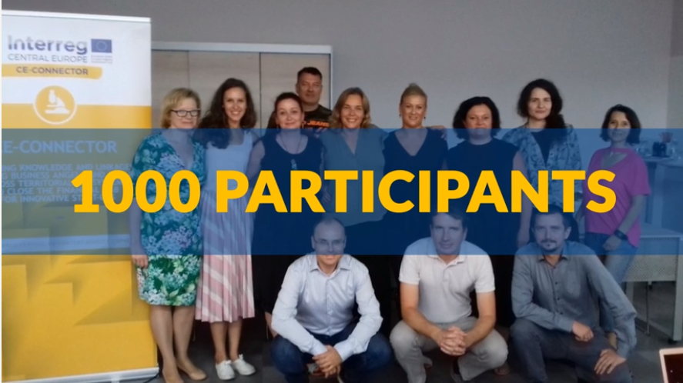
CE CONNECTOR RESULTS:
1000 PERSONS WERE TRAINED:

Slide 25
CE CONNECTOR RESULTS:
1000 PERSONS WERE TRAINED:
2BEANGEL – trainings for future Business Angels
BREAKFAST - focus on key aspects such as Due Diligence, Early stage investment, Deal making, managing assets and Exit strategy, depending on the background knowledge of the participating Business Angels.
LUNCHES - during which Business Angels learn from industrial representatives (RIS3 topics).
CE-CONNECTOR PUBLIC PROVIDERS WORKSHOPS - build the competence and attitudes of Public Leverage Providers to enable their involvement in the building of sustainable full-scale ACIFs

Slide 26
EXPECTED RESULTS
As a result, the project has created and sustained linkages between:
Business Angels
inside of territorial ecosystems
The ecosystems
of participating
territories.
Business Angels
and Industry
Business Angels and Providers of public leverage

