Slide 1
online
Implementation of modePROCON showcasing for karst aquifer –Jadro and Žrnovnica springs, Croatia
boDEREC-CE I Chair of Hydrology and River Basin Management

Slide 2
Outline
1
2
3
4
Study area
Detected PPCPs
Applying modePROCON
Model results

Slide 3
Study area
Investigated springs: Jadro and Žrnovnica springs (Croatia)
Catchment area: 250-500 km²
Complex flow regime with varying velocities
Rural area
WWTP discharging in the nearby river Cetina

Slide 4
Detected PPCPs
The following Emerging Contaminants (ECs) were detected in the nearby river and in the groundwater:
  Benzotriazole
  DEET (Diethyltoluamid)
  Ibuprofen
  Metformin
Can the detected ECs reach the springs?

Slide 5
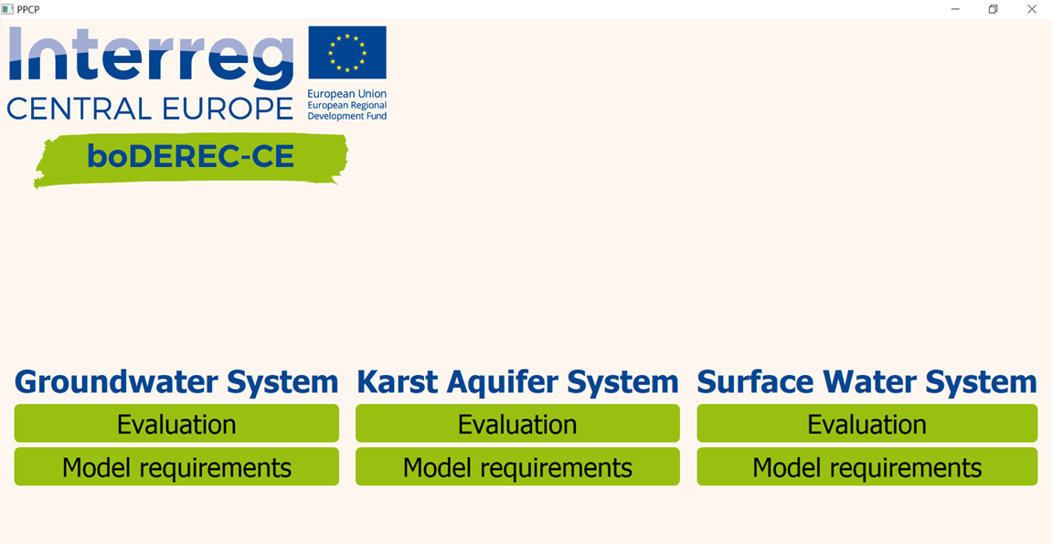

Applying modeProcon
Selecting the water source

Slide 6
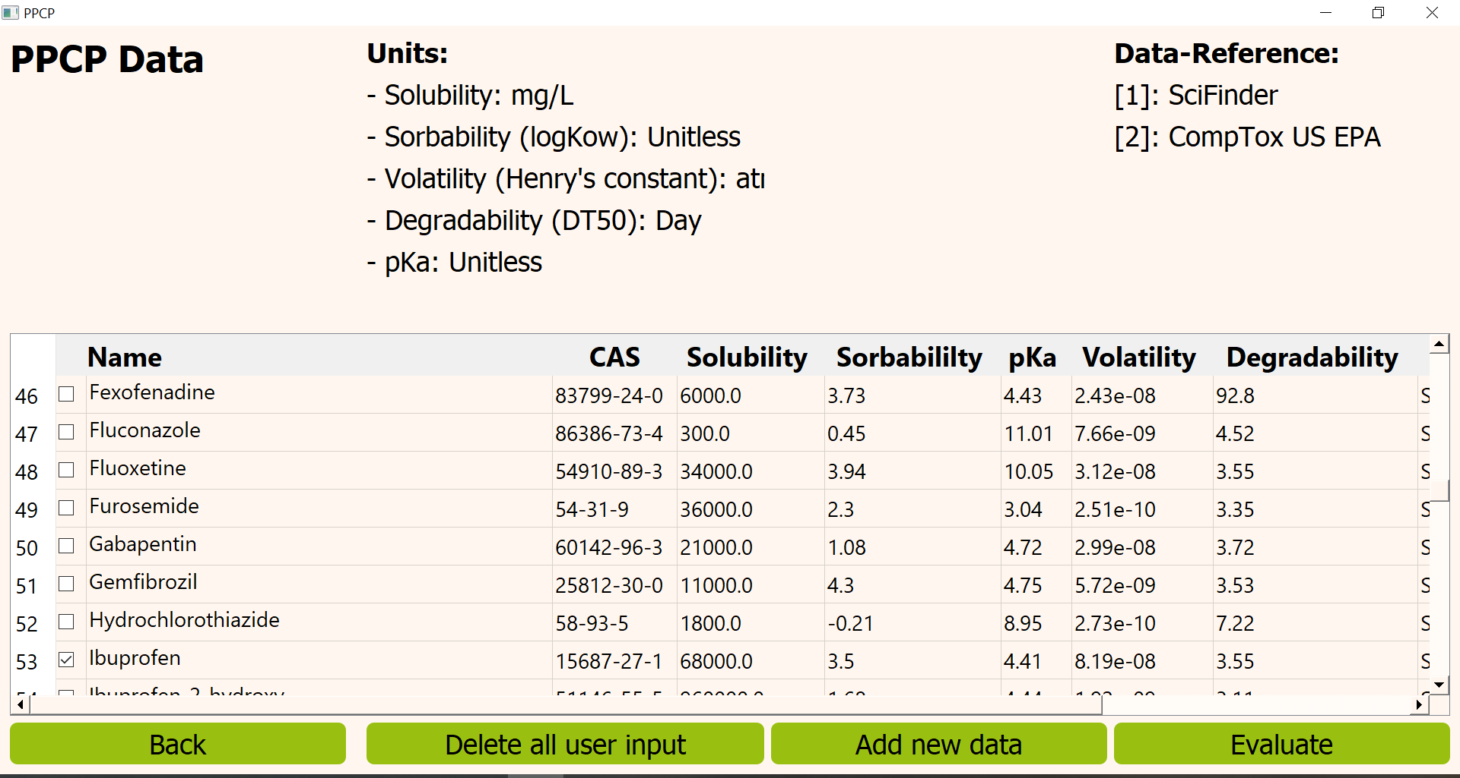
Applying modeProcon
Selecting the PPCPs
The detected PPCPs benzotriazole, DEET, ibuprofen and metformin are contained in the database and can be selected simultaneously.

Slide 7
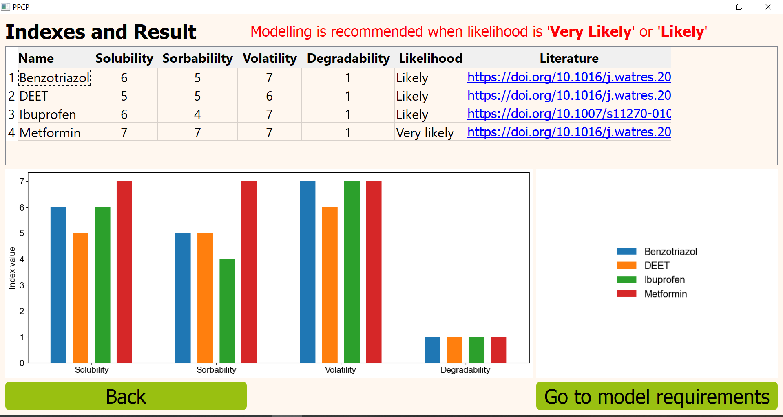
Applying modeProcon
Probability Estimation
Although all the investigated compounds are easily biodegradable, they are likely or very likely to be detected in karst aquifers.

Slide 8
Applying modeProcon
Probability Estimation
Due to the high index values, the detection probability of benzotriazole, DEET and ibuprofen is likely.
This is related to the low volatility combined with a high sorption capacity.

Slide 9
Applying modeProcon
Probability Estimation
Metformin, is very likely present in the karst aquifer, since the index values are very high.
This results by the little volatility and sorption capability in combination with a high solubility.

Slide 10
Applying modeProcon
Probability Estimation
As all considered PPCPs are very likely or likely to be detected in the karst aquifers, modePROCON recommends to model the situation for further investigation.

Slide 11
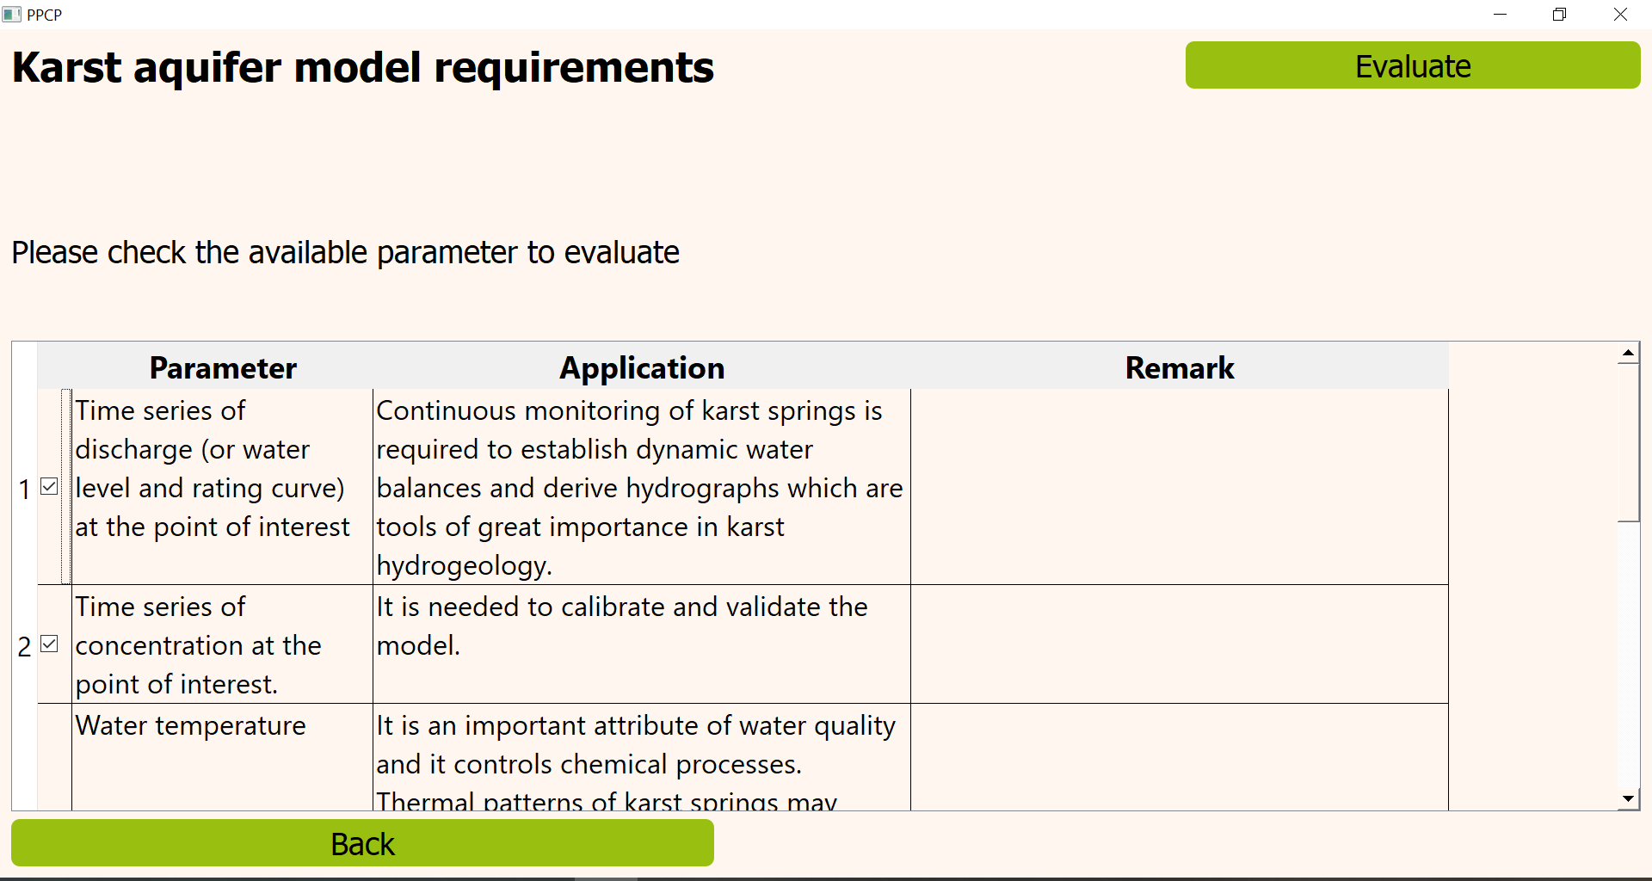
Applying modeProcon
Model requirements
All the required model parameters are known in this case.
modePROCON evaluates the data…

Slide 12
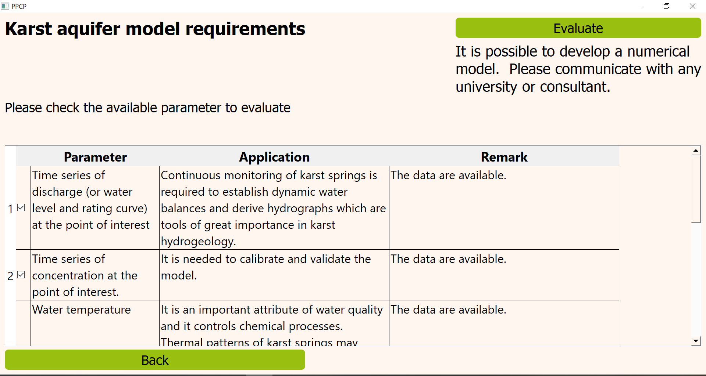
Applying modeProcon
Model requirements
… and replies that a model can be built.
In a next step, a modelling expert should be contacted to set up a transport model.

Slide 13
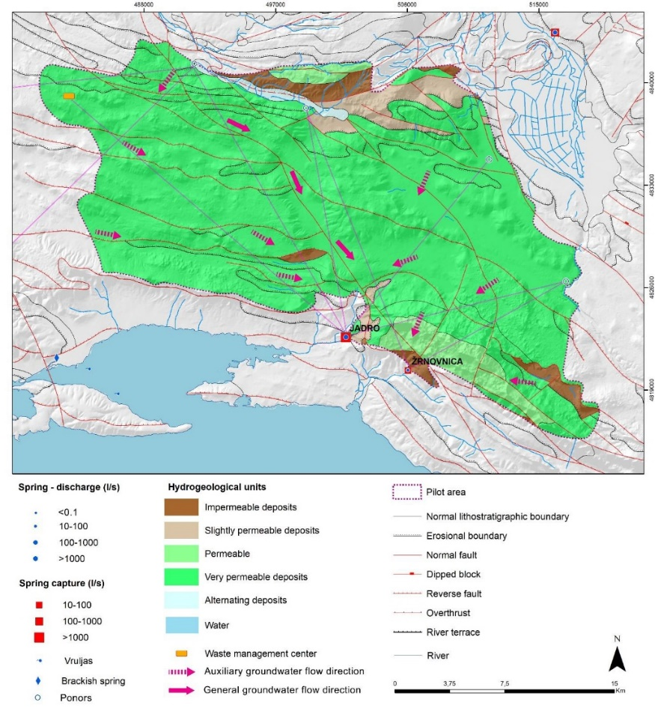
Model results
Indeed, some PPCPs were detected in the springs during the sampling campaign.
Even a conceptual model shows that several PPCP sources may explain the observation.
One explanation might be the river water, infiltrating in the groundwater.
Other potential sources in the catchment area (esp. permeable zones) should be considered.

