Slide 1

TOOLKIT FOR THE IMPLEMENTATION OF INFORMAL EVENTS FOR TECHNICIANS AND ENTREPRENEURS – DT334

Slide 2

TOOLKITS FOR THREE FORMAT OF EVENTS FOR TECHNICIANS AND ENTREPRENEURS – DT332, DT334, DT336
This toolkit is related to the involvement of technicians and entrepreneurs.
It is part of a package of three useful toolkits for the development of three different format of events, indicated by DT332, DT334 and DT336.
Spot seminars
Informal events
Design workshops
TOOLKITS

Slide 3

TOOLKITS FOR THREE FORMAT OF EVENTS FOR TECHNICIANS AND ENTREPRENEURS – DT332, DT334, DT336
Who are technicians?
Professionals and organizations working in the field of HBA management that could demonstrate a good reputation of work in the area. Their expertise in implementing projects in the region is highly valued by other stakeholders and long-lasting trust ties have been created with this organizations and individuals. The objective of working with technicians is to provide them with inputs during the implementation of the project. It is important to organize consultations with technicians and other stakeholders, develop workshops and other forms of events where they obtain some value for their work and see it as beneficial for them to continue and sustain cooperation even after the project finishes. They are the key bearers of the information with potential to further them to their peers and their clients.
Designers
Architects
Engineers
Building professionals
Professional associations
WHO?

Slide 4
TOOLKITS FOR THREE FORMAT OF EVENTS FOR TECHNICIANS AND ENTREPRENEURS – DT332, DT334, DT336
Who are Entrepreneurs?
Entrepreneurs are business owners and private sector managers who need to understand the impact of HBA management on their organizations. They are involved in different degrees in HBA management. It is critical for this target group to understand the inputs and outputs, characteristics and complexity of HBA management and how it affects not only themselves but wider context they are operating in. The monuments, their status management have direct or indirect impact on their businesses. They want to see the public sector determination to manage the HBA in sustainable way to ensure profits and to contribute to long-term benefits related to their involvement with the heritage. They often do not understand the complexity involved with management of HBA and the objective is to engage them in the process of HBA management and become a part of the process. Education and awareness to increase understanding on the impact of HBAs is necessary to be fostered and partnership between the public and private sector needs to be created and supported.
Private foundations
Investors
Business owners
Managers
WHO?

Slide 5
TOOLKITS FOR THREE FORMAT OF EVENTS FOR TECHNICIANS AND ENTREPRENEURS – DT332, DT334, DT336
There are three different levels of involvement related to three possibile aims of the participatory process:
Aims | Level of involvement
PROBLEM DEFINITION | INFORM: Providing balanced and objective information. Kepping community informed
CONFLICT MANAGEMENT | CONSULT: Seeking feedbacks on alternatives and/or decisions Keeping community informed, listen to issues & provide feedback as to how input affect the decision
SOLUTION IDENTIFICATION | INVOLVE: Working directly with the community during the process to ensure needs are considered Ensuring aspirations are directly reflected in the alternatives and provide feedbacks as to how input affected the decision
TOOLKITS

Slide 6
TOOLKITS FOR THREE FORMAT OF EVENTS FOR TECHNICIANS AND ENTREPRENEURS – DT332, DT334, DT336
For each aim/level of involvement there is a specific type of event dedicated to engage technicians and enterpreneurs :
Aims | Level of involvement | Event
PROBLEM DEFINITION | INFORM | Spot seminars
CONFLICT MANAGEMENT | CONSULT | Informal events
SOLUTION IDENTIFICATION | INVOLVE | Design workshops
TOOLKITS

Slide 7
DT334 – toolkit FOR THE IMPLEMENTATION OF INFORMAL EVENTS FOR TECHNICIANS & ENTREPRENEURS
INFORMAL EVENTS
DESCRIPTION OF DT334

Slide 8
DT334 – toolkit FOR THE IMPLEMENTATION OF INFORMAL EVENTS FOR TECHNICIANS & ENTREPRENEURS
The informal events will take the form of a community mapping session followed by an aperitif.
Community mapping consists of
a group of community members and people with technical skills undertaking observation-based community improvement. The objective of such technique for managing participatory process is to collectively create an incremental visualization of information produced by observation and storytelling.
DESCRIPTION OF DT334

Slide 9
DT334 – toolkit FOR THE IMPLEMENTATION OF INFORMAL EVENTS FOR TECHNICIANS & ENTREPRENEURS
The target: who and why
Methodology: goals, agenda and contents
Suggestions: before, during & after the event
Materials
TOOLKIT STRUCTURE

Slide 10
DT334 – toolkit FOR THE IMPLEMENTATION OF INFORMAL EVENTS FOR TECHNICIANS & ENTREPRENEURS
Differently from the spot seminars, this event could be open to a wider range of public, including thus not only entrepreneurs but also professionals interested in the initiative.
Professional associations
Building professionals
Private foundations for social/cultural/
environmental regeneration
Entrepreneurs
THE TARGET

Slide 11
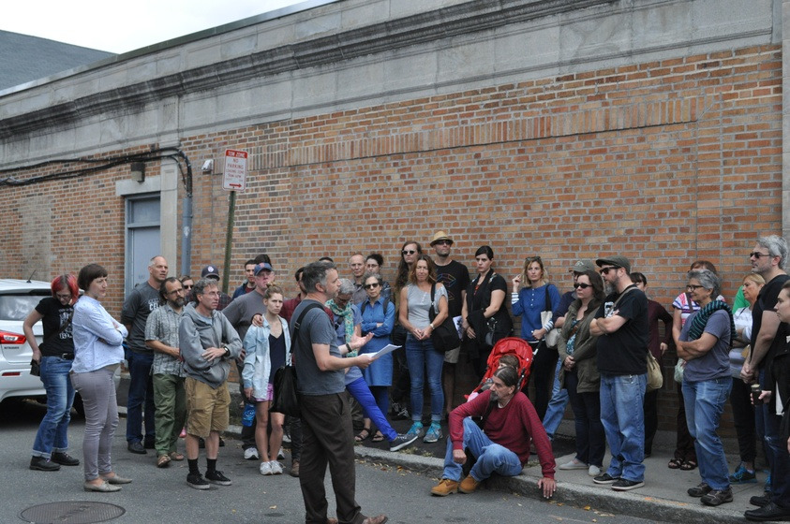
DT334 – toolkit FOR THE IMPLEMENTATION OF INFORMAL EVENTS FOR TECHNICIANS & ENTREPRENEURS
The objective of working with technicians and enterpreneurs is to provide them with inputs during the implementation of the BhENEFIT project since they can be considered as the key bearers of the information: the community mapping format is in this sense a useful tool to collect such information.
THE TARGET

Slide 12

DT334 – toolkit FOR THE IMPLEMENTATION OF INFORMAL EVENTS FOR TECHNICIANS & ENTREPRENEURS
to raise awareness about sustainable HBA management – which is often not perceived as relevant;
to create a community of practice;
to coordinate technicians and entrepreneurs actions;
to share practice examples and give inputs to technicians on how to implement them.
METHODOLOGY: GOALS

Slide 13
DT334 – toolkit FOR THE IMPLEMENTATION OF INFORMAL EVENTS FOR TECHNICIANS & ENTREPRENEURS
Introduction of BhENEFIT project
Briefing about the topics related to HBA mgmt
Community mapping
Exhibit of the map and aperitif
Sum up
METHODOLOGY: AGENDA

Slide 14
DT334 – toolkit FOR THE IMPLEMENTATION OF INFORMAL EVENTS FOR TECHNICIANS & ENTREPRENEURS
In this section of the toolkit there are some of the slides that should be used during the event: they mainly serve as introduction and context setting, and each organizer needs to include them as starting point for each event that will be held.
METHODOLOGY: CONTENTS

Slide 15

INTRODUCTION: THE PROJECT
Here the speaker should talk about the project and set the context for those participating to the workshop, trying to answer to these questions:
- What is BhENEFIT?
- What are the partners involved in the projects?
- Why the city/region/institution decided to take part in such process?
- What has been done so far?
METHODOLOGY: CONTENTS

Slide 16
HBA & MANAGEMENT
A definition:
A Historic Built Area is a Historic built environment, both limited to a portion of an urban area or extended to a not-natural, designed landscape, which is made up of innumerable unique and interlinked human-built elements (buildings, infrastructures, streets, canals, factories etc.) which tell the particular story and identity of the place.
In a HBA the morphology of the settlement, the designed structure of the place, the relationships between the different components are more important and significant than the individual monuments, because they are often visually more appealing and intellectually more satisfying because they allow us to realize the relationships between past activities or the structures of past societies.
Here the HBA - focus of BhENEFIT - should be deepened in order to have a common vocabulary and a shared idea of the issue as basis for the following session.
METHODOLOGY: CONTENTS

Slide 17
HBA & MANAGEMENT
What we talk about when we talk about sustainable management?
Sustainable management of HBAs is a global objective, the fulfilment of which requires a long-term strategy dovetailing policies for economically, socially and ecologically sustainable development of HBAs.
Sustainable management represents specific quality of the management, one of leading functions of which is the safeguarding the sustainability of the managed objects (processes, physical objects, communities etc). This function is an integrating function across other management functions, e.g. coordination, optimisation of the processes, minimisation of the resource consumption, maximising the benefit, or others.
Starting from the concept of Historic Based Area, the idea of sustainable management at the basis of the integrated approach needs to be explained. This implies talking about HBA integrated management and the goals that such approach requires.
METHODOLOGY: CONTENTS

Slide 18
AN INTEGRATED APPROACH
This slide shows the big complexity of heritage management, and consequently of HBA management. The relevant point that the teacher needs to stress here is the fact that such a multidimensional complexity requires a multiple-actors strategy – highlighting the role of different actors in such process.
METHODOLOGY: CONTENTS

Slide 19
WHAT IS IT ABOUT?
METHODOLOGY: CONTENTS

Slide 20

WHAT IS IT ABOUT?
Collecting data/information
Assessing conditions
Plan for conservation/management
The aim of this slide is pointing out the goal of the event - that is collecting data and information about the buildings eventually encountered during the walk in order to assess conditions and then plan for conservation and management.
Thought in relation to the targets involved for the event, it is clear that the second step – assessing conditions, would be more linked to a more technically expert category, while the first and the third ones are open to everyone who decides to take part to the mapping walk.
METHODOLOGY: CONTENTS

Slide 21
DT334 – toolkit FOR THE IMPLEMENTATION OF INFORMAL EVENTS FOR TECHNICIANS & ENTREPRENEURS
For the aperitif: choose a venue in the historic centre of the town, this will keep up a link with the project
Mail invitations in advance so that participants will have time to organize themselves
SUGGESTIONS: BEFORE THE EVENT
Include guests such as the urban conciliour of the municipality or some important professionals in the field
Participation could also be extended to architecture students
Think about sponsors for setting the food&beverage moment

Slide 22
DT334 – toolkit FOR THE IMPLEMENTATION OF INFORMAL EVENTS FOR TECHNICIANS & ENTREPRENEURS
The event should start with a brief introduction of the project and the reason why participants have been invited
The walking path should last 1-3 hours: think at spots to take some breaks and make a point with participants
SUGGESTIONS: DURING THE EVENT
Nametags will let participants networking thus adding value and positive feedbacks to the event participation
It’s important to create moment of collective discussion
Start and conclude the day with an introduction session and a social gathering concluding one set in the same building in the historic centre

Slide 23
DT334 – toolkit FOR THE IMPLEMENTATION OF INFORMAL EVENTS FOR TECHNICIANS & ENTREPRENEURS
Collect contact information of all those who will participate (see worksheet in the appendix)
Track feedbacks on what went right and wrong about the mapping session
SUGGESTIONS: AFTER THE EVENT
Prepare gadgets (like BhENEFIT markers) that participants could take away with them: this will help keeping their attention on the issue up.
Share photos and news about the meeting on proper social pages

Slide 24

DT334 – toolkit FOR THE IMPLEMENTATION OF INFORMAL EVENTS FOR TECHNICIANS & ENTREPRENEURS
Materials needed:
A1 format of a map of the historic centre of the city
MATERIALS
A set of coloured marks and pencils to draw on the map
A set of coloured marks and pencils to draw on the map
50 x coloured post-it notes to add information on the map while touring

Slide 25

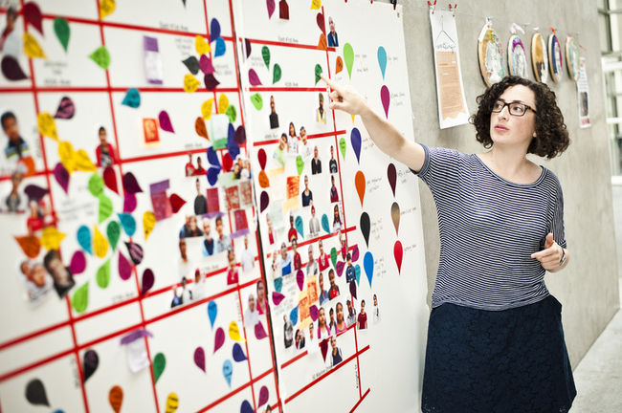
DT334 – toolkit FOR THE IMPLEMENTATION OF INFORMAL EVENTS FOR TECHNICIANS & ENTREPRENEURS
Information to distribute
Current status of buildings and works done on them
MATERIALS
History of renovation works – if present
Buildings property
Technical problems
Opportunities and possible reuses

Slide 26
DT334 – toolkit FOR THE IMPLEMENTATION OF INFORMAL EVENTS FOR TECHNICIANS & ENTREPRENEURS
Name and Surname | Company | Would you like to be involved in other events for BhENEFIT? | Contact Information
APPENDIX

