Slide 1

Date of training activity: .............. Trainer:....................
Locality of training: .....................
WP T3.2.2 E-learning tool
Author: BhENEFIT Consortium

Slide 2

Goals of the training
to develop awareness about the HBA management strategy
to develop awareness concerning the potential of the HBA strategy in planning and management of HBA sustainable development
to develop the knowledge about common international institutional frameworks of the HBA management
to mediate the best practice examples

Slide 3
content of the training lesson
project introduction
getting to know the theme
discussion and summarisation
planning game 1 – brainstorming
outputs from the game
planning game 2 – stakeholders‘ decision making
conclusions and interpretations of the outputs

Slide 4

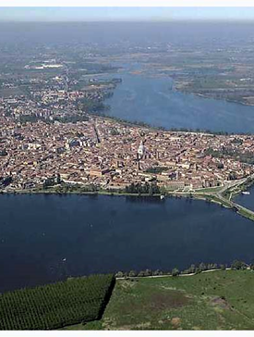
Project introduction -
HBA governance system analysis:
The main COMMON GOVERNING PRINCIPLES
CULTURAL HERITAGE IS OUR IDENTITY
CULTURAL HERITAGE IS PRESERVED BY CENTRALIZED PRESCRIPTIVE POLICIES
CULTURAL BUILT HERITAGE IS MANAGED BY AN “INTEGRATED APPROACH”
HERITAGE IS A LEVERAGE FOR LOCAL DEVELOPMENT
BUILT HERITAGE AND LANDSCAPE ARE COMPLEMENTARY ASSETS

Slide 5
Project introduction – the idea of hba
A HBA is a Historic built environment, both limited to a portion of an urban area or extended to a not-natural, designed landscape (shaped by complex human forces acting on the natural environment), which is made up of innumerable unique and interlinked human built elements (buildings, infrastructures, streets, canals, factories etc.) which tell the particular story and identity of the place.
A HBA is the result of a centuries-long process of evolution, a process dictated in part by changes in natural conditions but much more immediately and obviously by human effort, adding, adapting and replacing and it is, therefore, a powerful expression of culture and history, it shows how society has evolved, and its present form provides a focus around which communities define their identity.
In a HBA the morphology of the settlement, the designed structure of the place, the relationships between the different components are more important and significant than the individual monuments, because they are often visually more appealing and intellectually more satisfying because they allow us to realize the relationships between past activities or the structures of past societies.

Slide 6
Project Introduction and terminology
It is necessary to clarify several key terms for a better understanding of principles, actions and key words related to the protection of HBA with the main objective to implement strategies for a more sustainable governance and to develop a shared strategy for an integrated HBA.
HBA - historic built environment, both limited to a portion of an urban area or extended to a not-natural, designed landscape (shaped by complex human forces acting on the natural environment), which is made up of innumerable unique and interlinked human-built elements (buildings, infrastructures, streets, canals, factories etc.) which tell the particular story and identity of the place.
Although every country involved in BhENEFIT shares the definition of HBA, not one national normative report this peculiar matter that can be considered an intersection between urban planning and the protection of cultural heritage. The various national laws are about similar concepts, however.
Strategy - can be considered a plan of action designed to achieve a long-term or overall aim. For the BhENEFIT project, the term strategy represents one of the main outputs of the project (to produce a shared Strategy for the sustainable management of HBA), focused on governance issues that collects suggestions and advices developed by the partners to improve a more efficient and sustainable governance of HBAs.

Slide 7
Project Introduction and terminology
Governance and management - the boundary between governance and management of HBA is subtle but clear. In summary, we can say that governance concerned the decisional process, management the executive one. Governance sets general objectives; management specific goals and feasibility. Governance is a more general reflection that includes several aspects concerning the complexity of an integrated approach; management concerns guidelines and how we can do something.
Sustainable management of HBAs – sustainable development and, consequently, sustainable management is a global objective, the fulfilment of which requires a long-term strategy dovetailing policies for economically, socially and ecologically sustainable development of HBAs.
Sustainable management represents specific quality of the management, one of leading functions of which is the safeguarding the sustainability of the managed objects (processes, physical objects, communities etc). This function is an integrating function across other management functions, e.g. coordination, optimisation of the processes, minimisation of the resource consumption, maximising the benefit, or others.
Notes:
Management is a step after Governance and it concerns the day-to-day operation of the program within the context of the strategies, policies, processes, and procedures that have been established by the governing body. Whereas governance is concerned with “doing the right thing,” management is concerned with “doing things right

Slide 8
Project Introduction and terminology
Decision making – is continuous and indispensable component of managing any organization or business activities as well activities for the protection and valorisation of HBAs. Sustainable conservation, reuse and management is not feasible without a systematic data collection and registration that identifies history, architectural attributes, preservation state and the possible alterations during the entire lifetime. It constitutes a solid basis for any knowledge-based decision-making process to establish priorities of HBA protection
To achieve a shared strategy for the sustainable governance and management of CE HBAs a path has been developed consisting of analyses, meetings, visits and targeted workshops and trainings. With a generic definition, strategy can be considered a plan of action designed to achieve a long-term or overall aim. HBA administrations and stakeholders need to continually improve and build knowledge and skills to enable them to develop and implement sustainable HBA integrated strategies to respond to the manifold challenges they are facing.

Slide 9
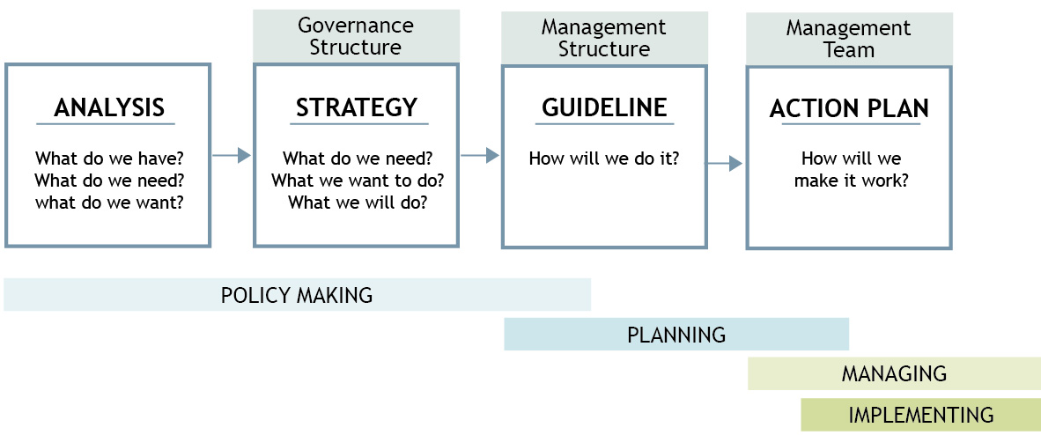
Introduction to strategy
graphic and schematic representation of the different steps of strategy and management processes

Slide 10
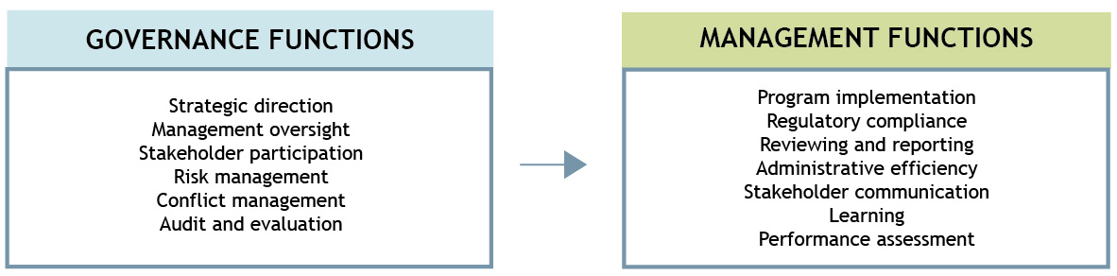
governance and management of hba
To understand the complexity of the governance and management of an HBA, the first step is to adopt the above mentioned HBA definition. When we realize that the HBAs influence different aspects of society and life, it should be obvious that spending the time to build an effective knowledge is the right direction. A strategy for the enhancement of HBAs must start from education and awareness, from information (i.e. tourism), data management and inter-operability. Decisions regarding the governance and management of HBA, programming and resource allocation are all based on an effective territorial understanding that helps to describe the overall context of the HBA.

Slide 11
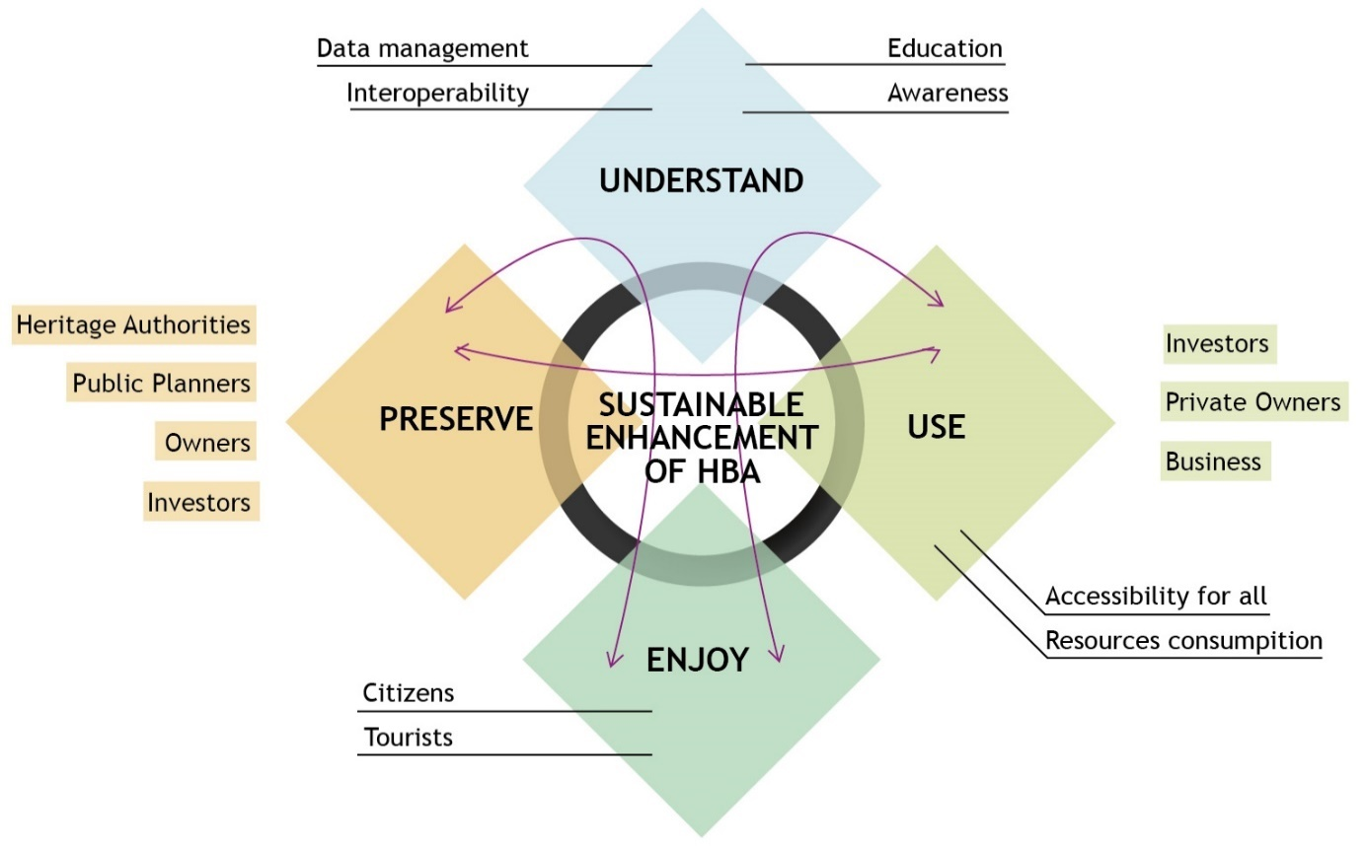
governance and management of hba
The diagram above is a graphic representation of the management complexity of HBA

Slide 12
TRAINING A - ENGINEERING AND ARCHITECTURAL FEATURES AND NEEDS FOR HBA MANAGEMENT
Planning game 1. – Brainstorming and silent decision making
(the planning game has to be well prepared in advance)
Step 1: dividing auditorium into the groups and explain their tasks individually
Step 2: group 1. listing of key factors for the HBA management (i.e. environmental, social, economic) – putting them on the coloured cards (10 min)
What are the main factors of HBA management?
Step 2: group 2. listing of how the HBA affects the city (i.e. the city center, as a tourist destination, city brand, place for living) – putting them on the cards (10 min) –
What is the effect of HBA on the city?
Step 3: both groups - in silent decision making, going around the table with the cards the groups mutually define the preferences among the factors and complete the lists writing down additional factors (10 min)

Slide 13
TRAINING A - ENGINEERING AND ARCHITECTURAL FEATURES AND NEEDS FOR HBA MANAGEMENT
Planning game 1. – Brainstorming - conclusions and interpretation of the outputs from the planning game 1 – interdependences between the factors of HBA management and the effect of HBA on the city
What are the main factors of HBA management?
What is the effect of HBA on the city?
Presentation of the comparison between the outputs from the groups showing the overlaps and parallels.
The confrontation of the demand represented by the needs (management) and offer represented by the contemporary state of HBA and its ability to satisfy the needs = HBA value

Slide 14
sustainability
The relationship between HBA conservation and a sustainable management can be understood in two ways (what is probably required is a combination of the two approaches):
1. As a concern for sustaining the HBA considered as a result in itself, and part of the environmental/ cultural resources that should be protected and transmitted to future generations to guarantee their development (intrinsic).
2. As the possible contribution that HBA and HBA conservation can make to the environmental, social and economic dimensions of sustainable development (instrumental).
The necessity to improve and manage the buildings’ sustainability of HBA is a central European question. How can HBA be used and managed efficiently? How can the management of HBA be able to tap the ecological and social innovation potential to ensure conservation and valorisation? The hope is to ensure that the HBA be protected, in a dynamic fashion, through an efficient, comprehensive and sustainable management system, strengthened by the effective coordination amongst the different stakeholders involved.

Slide 15
participation
A participatory approach to management is being promoted in various fields but particularly in the HBAs sector, given the perception of heritage as the shared property of communities and a factor in ensuring the sustainability of those communities. Achieving more efficient participation is one of the main goals of HBAs’ representatives that should be:
managed by local people more in mind,
managed to meet the needs of local people,
drew on local knowledge.
Information from the CE Countries shows that, in practice, HBAs management systems are often failing to involve local counterparts. Even when community involvement does take place, the level of participation in decision-making and the capacity of local stakeholders actually to engage and make contributions are often limited.
An effective participatory approach that delivers reciprocal benefits to the cultural property and to society depends on understanding:
who participates in decision-making, assessment, planning, implementation and evaluation processes, and how;
who contributes with experience, knowledge and skills, and how;
who benefits economically, socio-culturally and psychologically, and how.

Slide 16
Partnership principle – stakeholders’ involvement
Stakeholder involvement must be goal-oriented and refers to participation of interest groups (i.e. representatives of locally affected communities, owners, professionals, national or local government authorities, politicians, civil society organizations and businesses, citizens) in the planning or decision-making process of HBAs. Stakeholders can be defined as any group or individual who can affect or is affected by the management of HBAs. In general terms, four main stakeholder groups can be distinguished:
• stakeholders who directly benefit (beneficiaries),
• stakeholders who are negatively affected (burden),
• stakeholders who directly impact on HBAs’ ecosystem (services) (e.g. land owner, resource manager);
• stakeholders who indirectly influence on HBAs’ ecosystem (services) (e.g. decision maker, civil society organisation).
In HBAs we can divide the stakeholders in two main categories:
1. stakeholders by law: the institutional stakeholders that needs to be involved at the beginning of the decision-making process – essential elements (i. e. public bodies, municipalities, governmental institutions but also private owners, developers);
2. additional stakeholders: important to be involved in the decision-making process at different times and with different modalities (very broad category presenting very different characteristics – i.e. NGOs’, specialized sectoral agencies)

Slide 17
Pooling and optimizing resources
To delineate the sharing and optimization of resources, we started with identifying the main groups of actors involved, subdividing them into three macro-categories, and then trying to understand, for each one, what roles and resources could be put in common.
Public sector
.. is represented by local, regional and state authorities, public institutions (such as schools, research institutions, etc.), communities, NGOs.
The main competences are identification and protection of the public values, governance of social processes, urban development and decision-making.
Semi-public sector
.. is represented by universities, associations, clusters, public-private networks, religious institutions.
Their main competences are knowledge collection and development, value identification, argumentation and mediation among stakeholders and the public sector.
Private sector
..is represented by enterprises, banks and financial institutions, private institutions (research, consultancy, etc.)
The main competences are decision making, making sustainable businesses, using money and other resources for achieving specific benefits, attracting the investors, marketing.

Slide 18
Horizontal and transversal competences
Each sector has peculiar and crucial characteristics within the HBAs’ governance and management. It is inevitable the creation of a gap between sectorial skills and roles; this gap can only be filled by mutual comparison and collaboration. Hence the specific skills and competences of the public, semi-public and private sectors have been clearly recognized and analysed, we have identified some horizontal or transversal competences, for which execution a shared dialogue and ongoing collaboration between the involved sectors is necessary.
These competences belong to different and more complex fields including:
• environment: energy efficiency, urban heat island phenomenon, waste and water, pollution, mobility;
• society: services and facilities, cultural life and leisure facilities, identity perception, gentrification vs. mixite, accessibility, security;
• economy: tourism impact, maintenance costs, transformation costs.

Slide 19
Trade-off mechanism principle
In HBAs, also the trade-off principles should be used to find the balance between conservation of the historical buildings, their use, the economic profit and the maintenance of a high level of quality in the historical city centres. The results need to find the best technical solution adjusted to the conservation prescriptions of each CE Country.
This schematic process highlights the necessity to have a shared vision between the local administration (in the role of mediator) and the different groups of stakeholders, otherwise these strategic city players cannot be in the condition to contribute and implement the HBA’s sustainable enhancement strategy. In the result, the maintenance of the use and the activities cannot only depend on the public administration but must be a common (and principal) responsibility also of private owners and investors involved in the decision-making process.

Slide 20
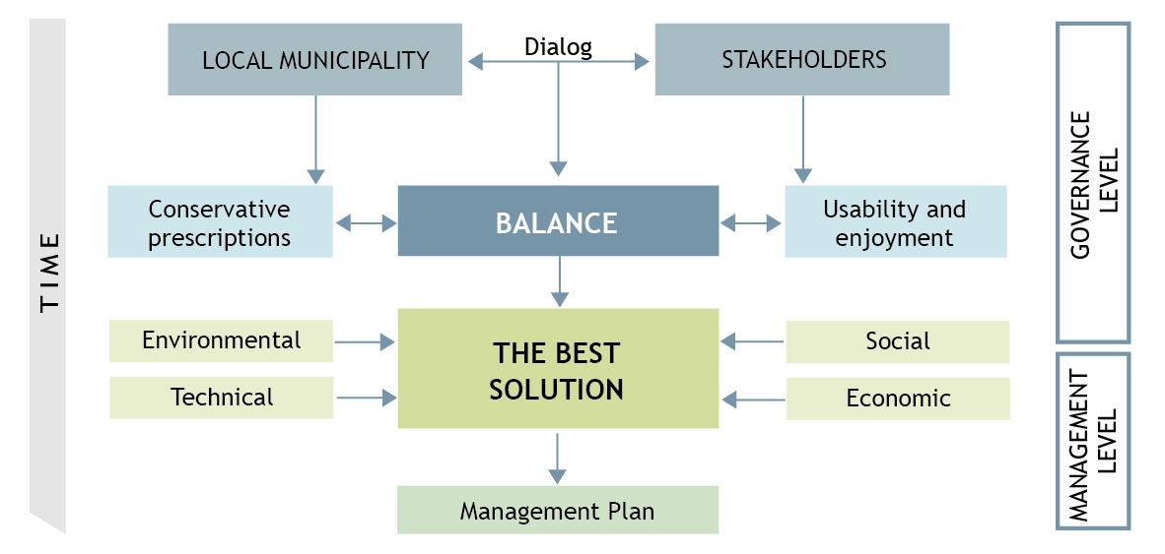
Trade-off mechanism principle
Together with clear conservation and planning prescriptions, we should also have management plans able to make the historical building lively and to plan a long-term use over time. The maintenance of the use and the activities cannot only depend on the public administration but must be a common (and principal) responsibility also of private owners and investors involved in the decision-making process

Slide 21
From challenge to strategy
The shift in the HBAs sector from simple physical protection through a more layered approach to the management that takes into account social, economic and environmental challenges. This provides a basis for giving the HBAs a function in the life of the community. HBAs are very often subjects of contention among multiple stakeholders, mainly in the face of rapid socio-cultural changes. This more holistic approach has made the management of HBAs all the more demanding.
The challenges of managing an HBA starting from a common framework representing the basis within the very wide range of possible governance and management systems. The challenges are defined with the problem posed and from the objectives to be achieved then end with strategic actions proposal useful for drawing up the local guidelines. See the action plan below:
Legislation
- Facilitation of the development of complementary instruments and regulations for HBAs Integration across cultural Heritage’s legislation and urban planning
Urban and Strategic Planning
- Planning of recurring working and updating meetings
- Involvement of different professionals in the design phase
- Planning the economic sustainability in the long term
Citizens
- Building the perception of the city as a Commons
- Organization of targeted and public meetings
- Openness to proposal for collaboration (e.g. pact of collaboration with citizens) Introduction of a participated budget

Slide 22
From challenge to strategy
Private sector for-profit
- Involvement through meetings and workshops
- Involvement in the monitoring phase
- Creation and definition of call for ideas
Specialised Technical Bodies
- Integration across information and resources:
- Best use of all information sources
- Across disciplines and sectors
- Identify major issues
- Documentation quality
- Involvement of professional associations (architects, engineers, lawyers ...)
Internal Collaboration
- Definition of more simple procedures with more rapid times
- Coordination of a sharing participation in decision-making, assessment, planning, implementation and evaluation processes
Sustainable Technology
- Evaluation of the building’s value
- Drafting of a check list for the choice of the most suitable type of intervention
- Definition of common evaluation parameters such as:
Sustainable Tourism
- Medium and long-term planning involving different stakeholders, in particular: local businesses, associations, cultural institutions and citizens)
- Educating travellers to responsible tourism also through experiential situations
Notes:
Sustainable Technology
- Evaluation of the building’s value
- Drafting of a check list for the choice of the most suitable type of intervention
- Definition of common evaluation parameters such as:
- historical value
- sustainability of the site
- water management
- energy and atmosphere
- materials and resources
- internal environmental quality
- innovation in the design
- territorial priority

Slide 23
TRAINING A - ENGINEERING AND ARCHITECTURAL FEATURES AND NEEDS FOR HBA MANAGEMENT
Planning game 2. – Multi-actors‘ decision making and their integration in HBA management - interactive excercise
(defining of the stakeholders involved in HBA including their main interests and engagement in HBA management - verifying different modes of actors’ behaviour and possible balancing of the interests across the whole scale of stakeholders)
Step 1: brainstorming and discussion: identification of the stakeholders in the development of urban green areas and their different activities in urban green
Step 2: distribution of the roles in the auditorium with prepared description the stakeholders have to play in the game; each role is characterised with formulated positions and demands
Step 3: comparing the power and position of the stakeholders in planning and decision making
Notes:
- defining of the stakeholders involved in HBA including their main interests
suggesting ways to engage the stakeholders in HBA management
The roles are e.g. journalist, owner of the plot, citizen, eco-activist, investor, representatives of the self-government, and representative of the opposition in the local authority.. The role of planner is to moderate the discussion and to argue against not objective or extremist requirements.

Slide 24
TRAINING A - ENGINEERING AND ARCHITECTURAL FEATURES AND NEEDS FOR HBA MANAGEMENT
Planing game 2. – Multi-actors‘ decision making and their integration in HBA management - conclusions and interpretation of the outputs from the planning game 2
after the game the outputs are compared – followed with interpretaion and stressing the roles of the planners
although the descriptions of the roles are identic as well as the composition of the players, the results from interactive decision making can be different from group to group as the personalities and personal abilities to argue are different
new understanding of planning and role of stakeholders in HBA management reflecting their specifics
HBA management is experiencing the movement from traditional model of hierarchical territorial government, across different levels of territorial units (local, regional), to the system of governance where the power is shared and split among a variety of stakeholders creating overlapping vertical and horizontal co-operation patterns between governmental and non-governmental public and private structures

Slide 25
TRAINING A - ENGINEERING AND ARCHITECTURAL FEATURES AND NEEDS FOR HBA MANAGEMENT
Planning game 2. – Multi-actors‘ decision making and their integration in HBA management
New roles of actors?
mediator and process catalyst
coordinator
one of stakeholders - shift from government to governance approaches
integrator - shift to integrative approaches

Slide 26


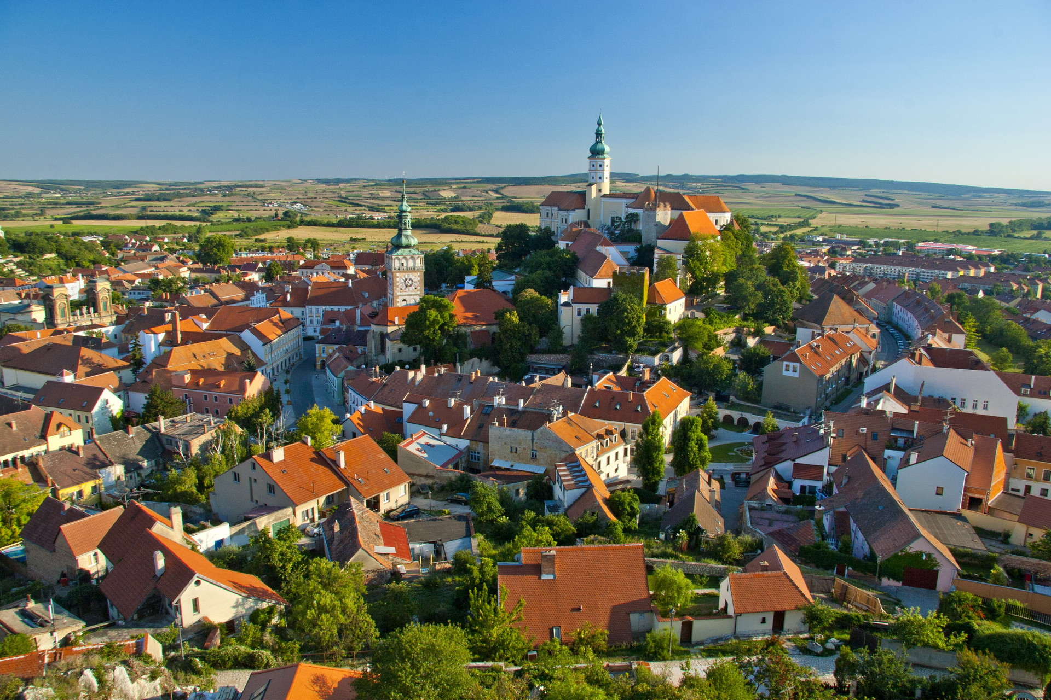

Guidelines for the implementation of the Strategy: CZECH rEPUBLIC
VISION
Mikulov is a cultural and tourist center of international importance.
...AND MISSION
Notes:
Vision
Mikulov is a cultural and tourist center of international importance. It has long been renowned destination for tourism. The managed regeneration of the HBA is an important part of the city life and is an integral part of its economic and social prosperity. All economic and social activities are friendly to the city's historical and cultural heritage. Mikulov keeps its "genius loci" and is a friendly and safe city for its residents and visitors. The monuments are appropriately used for tourism and cultural activities in accordance with their value and with universally valid principles for heritage conservation and protection
Mission

Slide 27
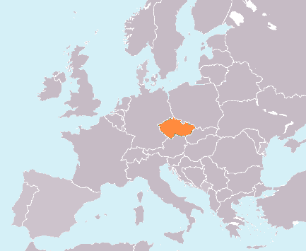

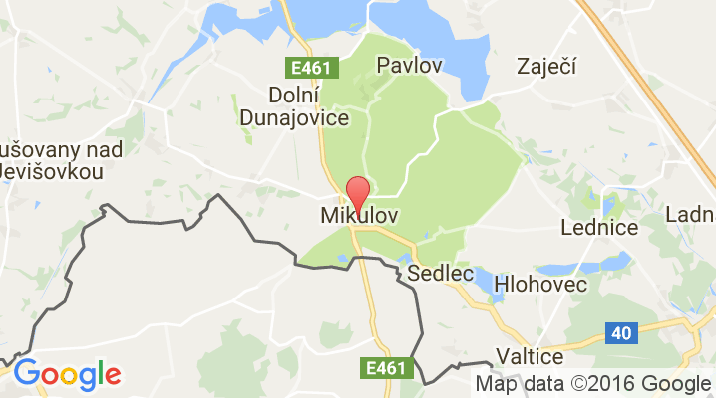
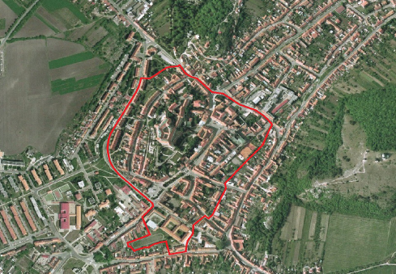
Location
Germany
Poland
Czech Rep.
Slovakia
Austria

Slide 28
Mikulov
Chateau
St. Vaclav Church
and Tower
Chateau
Garden
Dietrichstein
Tomb
Upper
Synagogue
Historical
Square
Jewish
Quarter
Goat Tower

Slide 29
Urban Herritage Reservation Mikulov
MPR MIKULOV ID
first written record: 1183
number of inhabitants: 7 371
MPR Mikulov area of interrest: 19,95 ha
herritage reservation since: 1982 (historical core since 1952)
number of objects in MPR Mikulov: 258
number of cultural monuments in MPR Mikulov: 146
number of cultural monuments ouf of MPR Mikulov: 36
total costs spent on regeneration process: € 14.8 mil.
  1995 – 2004: € 6.1 mil.
  2005 – 2014: € 3.9 mil.
  2015 – 2024: € 4.8 mil. (estimated)

Slide 30
Urban Herritage Reservation Mikulov
Why we chose it?
More than 800 year history of the city
Urban conservation area since 1982
Unique historical monuments concentrated in the area and rationally set in the landscape under the far-sighted management
Long term experience in conservation process, the first regeneration conception was launched in 1983
High quality of planning and architecture in the buffer zone out of a heritage-protected area
Link to the tourist areas of the Pálava Protected Landscape Area and the Lednice-Valtice Landscape Complex

Slide 31
Urban Herritage Reservation Mikulov
Relevance to BhENEFIT
Contemporary pro-active approach of the City in MPR rehabilitation process - management is designed in a multisectoral and participative way -> updated regeneration strategy 09/2017
Various coop. stakeholders - public involvement during the regneration process (e.g. Spolek přátel Mikulova Society)
Financial support through public and private funding processes
Results and impacts are documented and analysed
Long term sustainability of the case study
Follow-up projects in MPR, in protection zone and in adjacent UNESCO herritage areas
Transferability of the case-study

Slide 32
Methodological model for an integrated monitoring plan including GIS and BIM systems

Slide 33
Data processing and analyzing
Data processing is, generally, the collection and manipulation of items of data to produce meaningful information (French, 1996).
Data processing functions: validation, classification, sorting, transformation, etc.
Using of ICT tools - the ability to link spatial (geometrical) and non-spatial (descriptive) data of physical features
The aim is to review and to evaluate monitored data in the context.

Slide 34
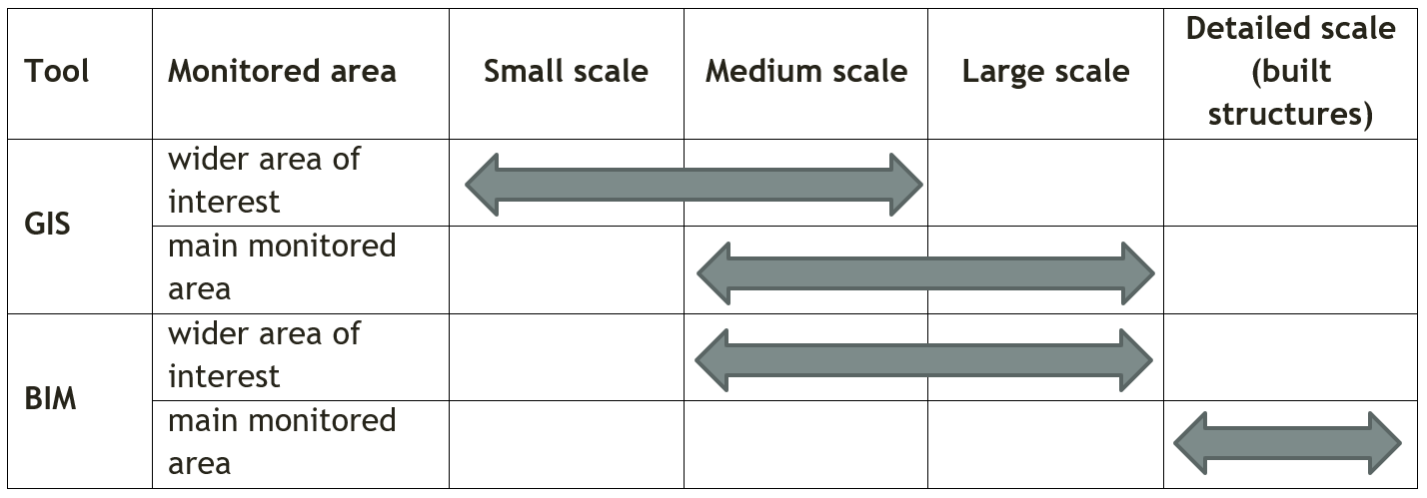
Relevant mapping tools for monitoring
Monitoring methods should be applied at a specific scale. The scale selection depends on the extent of selected area and on the ability to get needed data. This choice will affect a degree of details.

Slide 35
Data sharing
The aim of data sharing is to provide comprehensive information that is easily accessible and simplifies the process for obtaining the required information about HBA.
Processed and analyzed data
Data harmonization
WebGIS
Open data

Slide 36
Web-GIS
WebGIS (map portal) is a web map application that is used to view, browse, and present information displayed in the form of interactive map composition.
Deployment of WebGIS
Deployment of map portal and GIS in general requires useful data to provide comprehensive information that is easily accessible and can simplify related processes.
The priority is not to build a beautiful app, but to react to requirements on information obtaining, responsive design and „story telling“.
Main aim: to provide information (or story) not data

Slide 37





Web-GIS
Data
Server / cloud
Users
Map application

Slide 38
Web-GIS - advantages
Why?
A quick and effective way of spatial information dissemination
Attractive presentation in easy to understand form
Tool for linking data from different sources
Digitization of agenda
Many ways to establish and mantain WebGIS

Slide 39
Most common mistakes
We want GIS because it´s trendy
Expensive IT product
No added value of data
User-unfriendly
No desktop software

Slide 40
Using of BIM
Building information modeling is a computer-based process for modeling and managing buildings, constructions, and relevant data.
Advantages of using BIM:
3D visualization of buildings
Data management
Operational management
Advanced analysis - energy analysis, static analysis, collision detection, construction simulation, feasibility assessment, etc.

Slide 41
BhENEFIT platform
Every platform hosts general data and specific data.
• general data:
• cartographic basis: Who will use the platform? Depending on this, the basic map will be displayed on:
• technical map: Cadastral Cards, topographical maps, etc.
• user friendly map: general reference map (e.g. Google Maps, tourist maps, etc.)
• general information about location, for example data that help people in orientation, or property of the buildings (private or public), etc.
• specific data:
• thematic layers: information on specific topics depending on the goals and the purposes of the platform.

Slide 42
Example – city of Mantova
Concern: URBAN REGENERATION
Goals
• at the technical level, the goal is to identify and monitor the areas to be regenerated
• at the strategic level, the goal is to define the actions to be taken by putting in relation the characteristics of the areas with their states of degradation.
Users
• citizens, organizations and associations that will use the platform to report situations of deterioration
• the local government officials who will process the data and report the results.

Slide 43
Example – city of Mantova
Final results
• obtain a map which represent the perceptions of degradation from people
• after crossing the perception map with technical data, define which an where are the regeneration area and plan concrete actions.
• monitor the areas before and after urban regeneration projects.

Slide 44
Web references
eLearning Industry
https://elearningindustry.com

Slide 45
THANK YOU FOR THE ATTENTION

