Slide 1
Block 5: FEEDSCHOOLS applications
5.3 Best practice database
FEEDSCHOOLS, by ENEA (Maria-Anna Segreto)

Slide 2
Learning Objective: In last years nZEB number buildings is growing fast both for existing buildings and new construction ones. The identification of best practices, performance targets, technology solution sets and the definition of design guideline represent strategic actions that can support the designers in planning new nZEBs. The aim of the block is to show the FEEDSCHOOLS Database on nZEB best practices in the countries partner of the project.
5.2.1
Best Practices in Europe
(link)
5.2.2
FEEDSCHOOLS Database on Best Practices
(link)

Slide 3
5.1.1
Best Practices in Europe
5.1.1 obiective
This unit aims to show how Best Practices in nZEB can help the designers in planning new nZEBs.

Slide 4
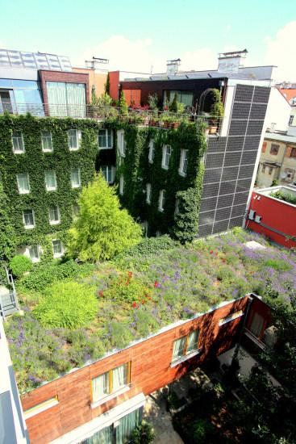
The technologies for nZEBs are ready and proven, the average EU rate of new nZEB construction is low and is increasing slowly, and thus targeted national countermeasures should be adopted.
There are a large number of European projects and an extensive literature in this field and there are several papers dealing with the definition of the general effective design approach based on cost-optimal principles and that analyzes specific technologies influencing the nZEB performances.
In particular, the focus is on envelope characteristics, HVAC system components and integration of renewable energies.

Slide 5
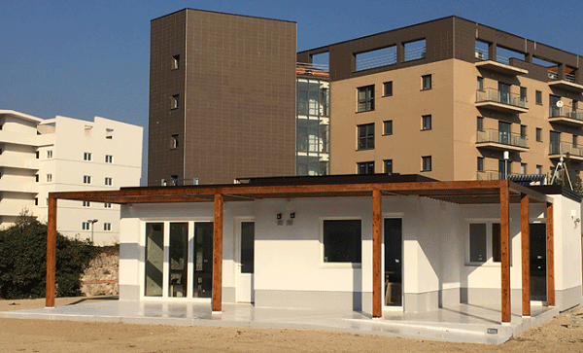
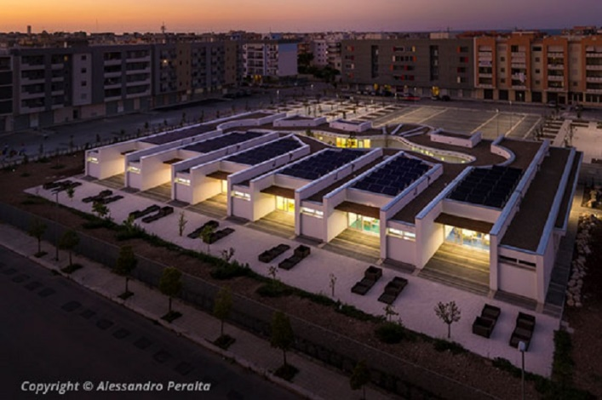
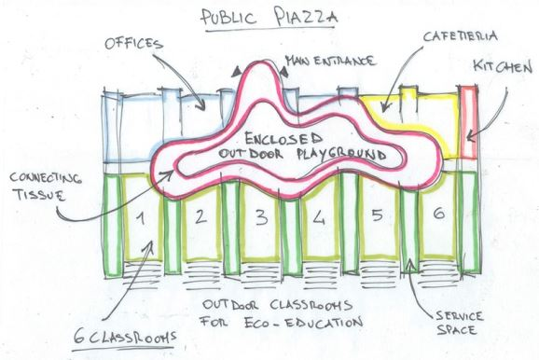
Nevertheless, although the large number of papers dealing with the topic, currently, the impact of the technologies as well as the final performances are evaluated or by simulation activities or by monitoring a reduced number of real buildings.
Currently, an evaluation of the nZEB features and related performances based on a large sample of buildings is missing. The main reason is the lack of structured and populated databases including nZEB data across Europe. In fact, in the past recent years, several European projects dealt with the setup of building databases, that represent an important starting point for this work, but none of them is specifically focused on nZEBs.

Slide 6

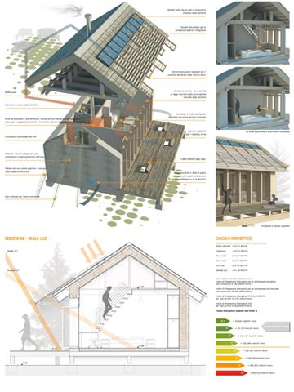
The creation of a database can be a crucial tool to spread and engage the good practices to reach nZEB goals on a wide scale.
Up to now various practices attempting to collect data about nZEBs can be identified. The main purpose could be to record nZEBs, which have been already built, with available monitored data and that represent concrete models for future designing.
The European Commission has been promoting the Green Building Programme (GBP) aimed at collecting data on energy efficiency improvement in non-residential buildings.

Slide 7
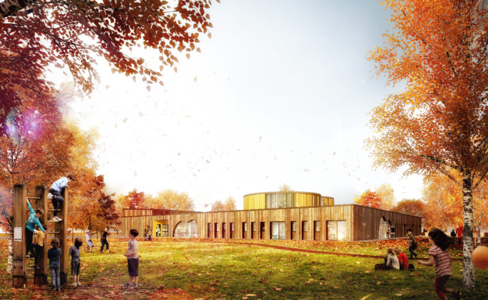
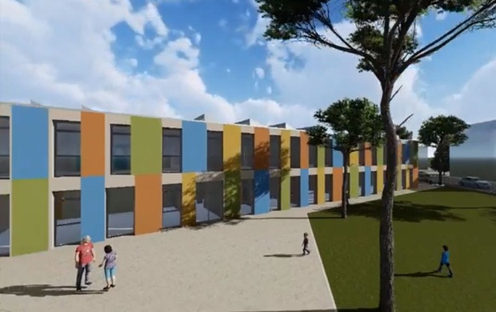
Following the achievements of the Green Building Programme, the Commission is launching another initiative to collect data on retrofit projects implemented in both residential and non-residential buildings. This new project is part of the European Energy Efficiency Platform, an instrument consisting of an IT platform to collect data and knowledge on energy efficiency topics at EU level. Based on the experience of Green Buildings, this new project will focus both on NZEBs that represents the new building target from 2018 onwards and on retrofit that is one of the biggest challenges faced by the Europe.

Slide 8

The importance of this tool is that it will allow establishing a harmonised NZEBs database that can furnish a comprehensive reference guideline about NZEBs retrofit. The collected data will provide an overview of the European status on retrofit buildings supporting good practices on building energy performance, interventions, savings and costs.
https://
https://e3p.jrc.ec.europa.eu/articles/refurbished-nzeb-data-collection
https://ec.europa.eu/energy/intelligent/projects/en/projects/zebra2020
https://www.politesi.polimi.it/bitstream/10589/136384/1/Nearly%20Zero%20Energy%20Buildings%20Comparison%20of%20the%20targets%20set%20by%20the%20European%20countries%20and%20analysis%20of%20their%20diffusion.pdf

Slide 9

This fervent activity aimed at disseminating information and technical notes on nZEB buildings underlines how important it is for technicians, designers, builders and all stakeholders to have references on what to rely on to implement on a large scale good practices already put in place.
For this reason, the FEEDSCHOOLS project has chosen to create a database that collects good practices from all the partner countries of the project, with the aim of supporting those who wanted to venture into the world of nZEB.

Slide 10
5.1.2
FEEDSCHOOLS Database on Best Practices
5.1.2 obiective
This unit aims to give an overview of the Best Practices Database included in the FEEDSCHOOLS Website
Notes:
Unit’s introductory page; it is needed per each unit

Slide 11
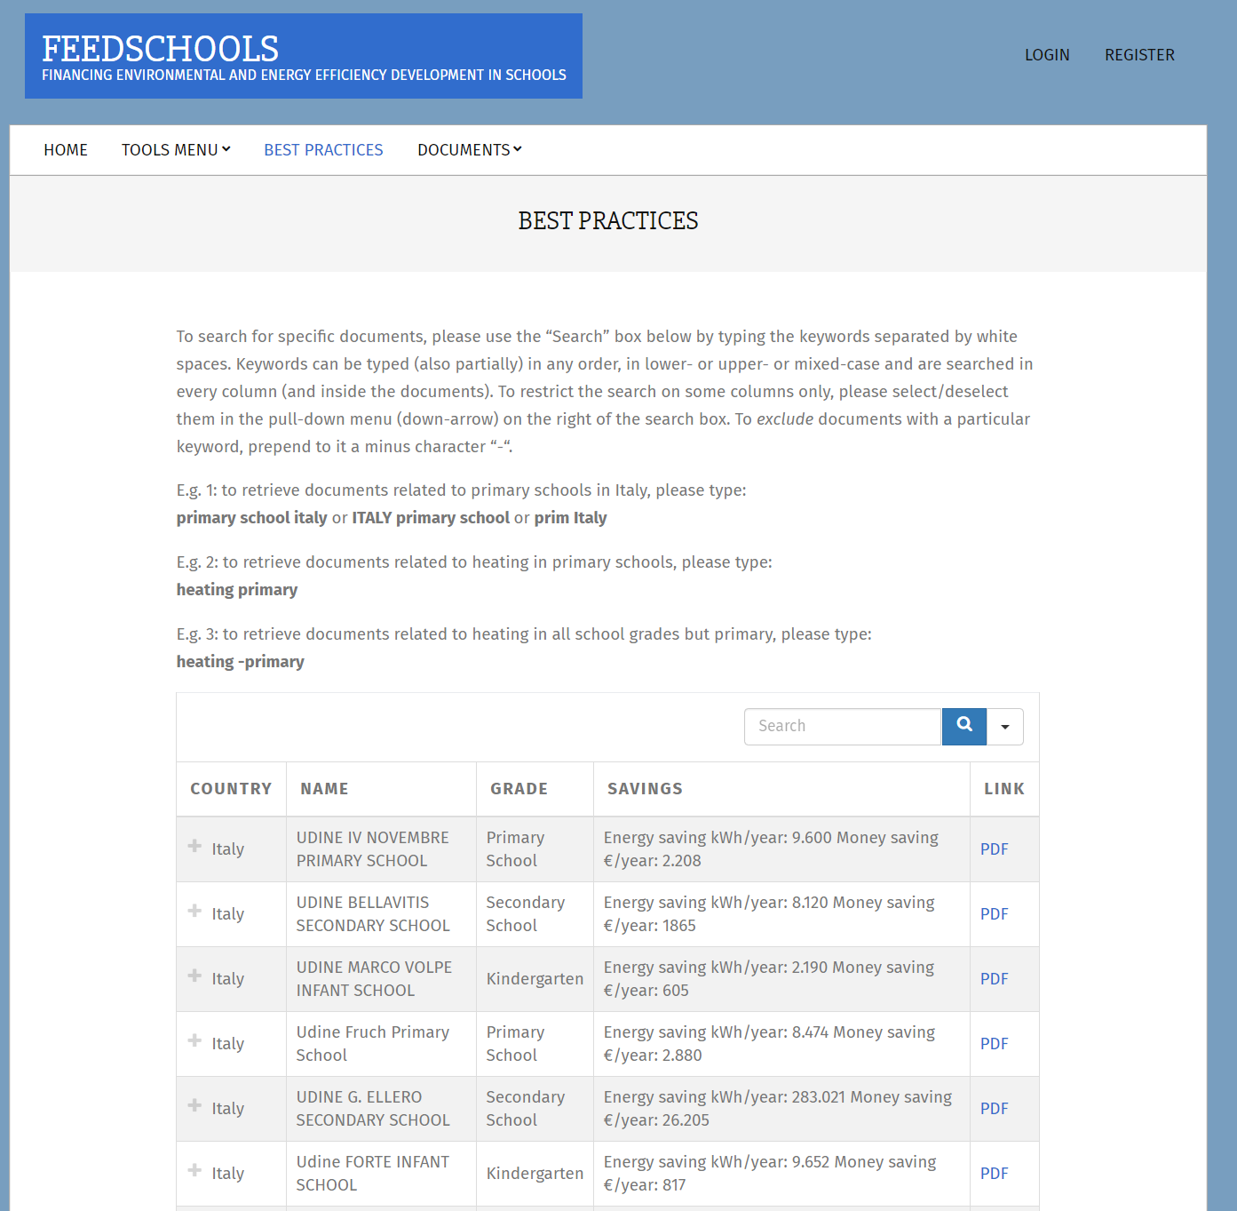
FEEDSCHOOLS project has chosen to make available to users a database that gathers interesting experience in the nZEB field in all the partner countries of the project.
The database is an inventory of the best practices in partner regions; it is located on the web page dedicated to the applications of the project (www.feedschools.eu), it collects examples of school buildings deep renovation that conduct an existing building to an nZEB one.
http://www.feedschools.eu/best-practices/

Slide 12
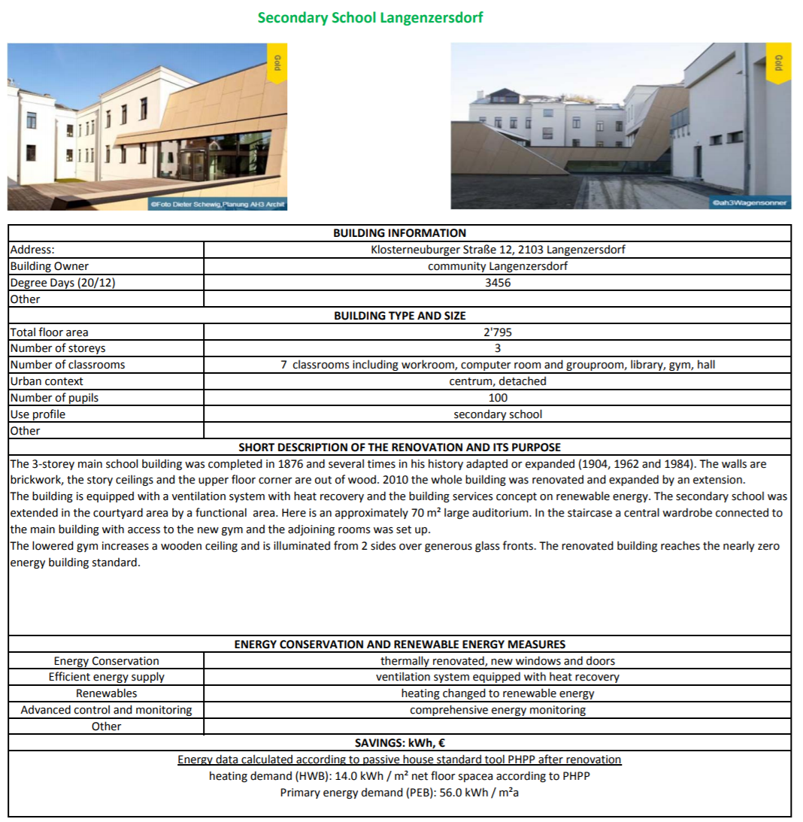
These improvement actions can be used to inspire innovative solutions for all stakeholders (professionals, energy managers, energy auditors…).
In the collected form there are a lot of information on the school building and on the constructive features both for the envelope and for the systems. Important information about renovation plan, renewables and savings are also collected.

Slide 13
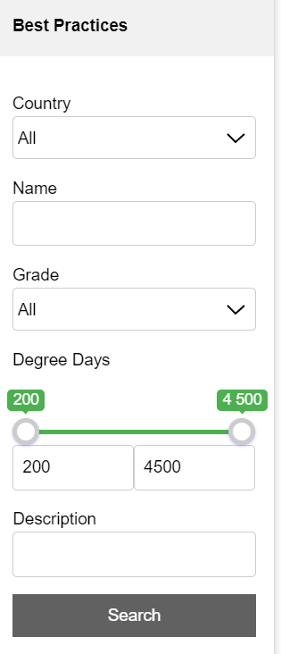
The database will be organized by Country.
But it is foreseen the possibility to perform a dynamic search based on predetermined filters.
Interested parties will be able to choose key elements as Country, Name of a project, School Grade Degree Days and a Description (one or more elements), so as to find solutions that are consistent with their needs.
The aim of the database is to make known, to a broad public, high-performance and advanced techniques and technologies that can lead an existing school building in nZEB.

Slide 14
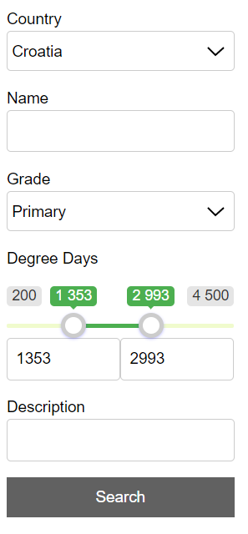
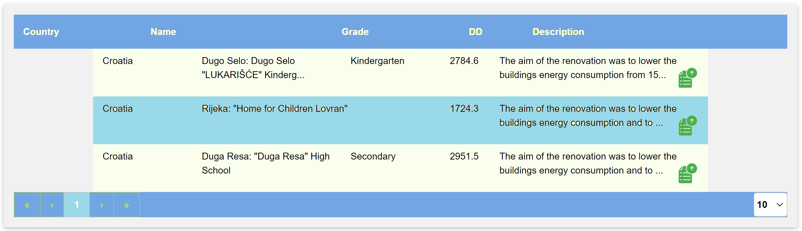

Slide 15
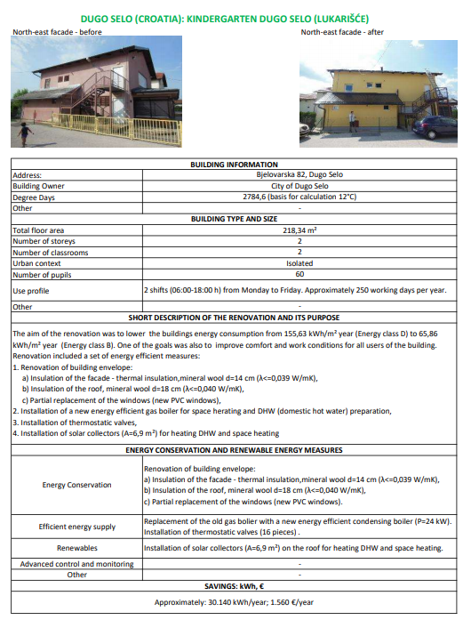

Slide 16
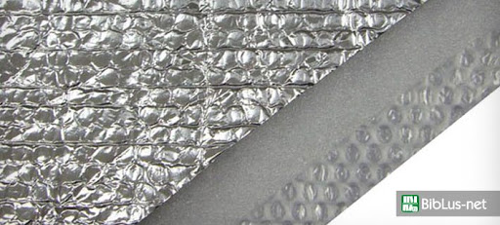
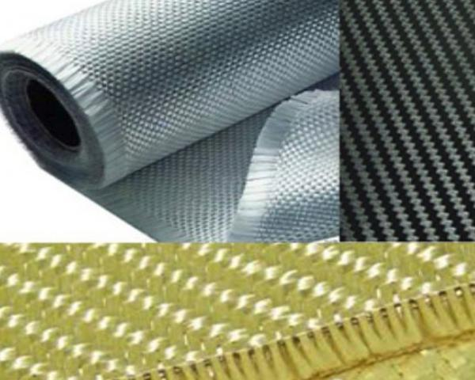
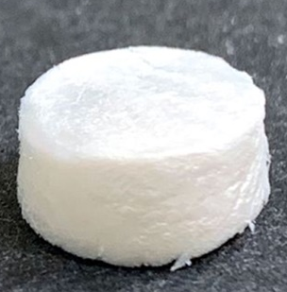

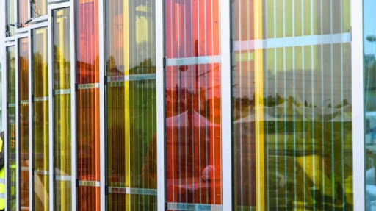
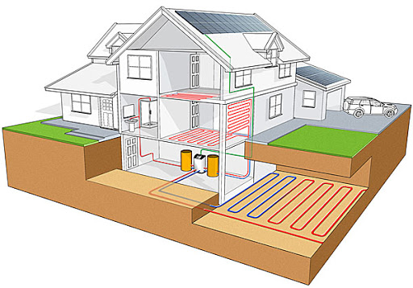
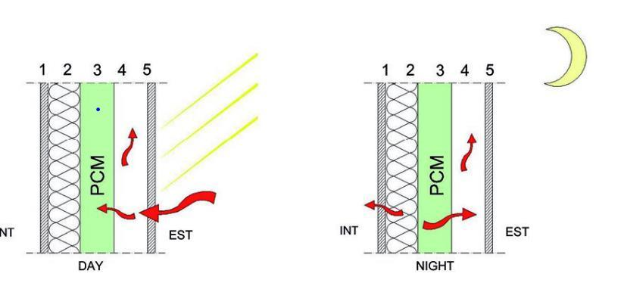
Lately several manufacturers have developed innovative products and technologies with the purpose to tackle the more stringent requirements of European norms.
The database aims to gather the latest technological innovations and demonstrate how they have been used to improve existing buildings.

Slide 17

Maria-Anna Segreto (author and tutor)
Researcher and Head of SEI Laboratory of ENEA
www.enea.it/en/
mariaanna.segreto@enea.it
https://www.facebook.com/eneapaginaufficiale/
https://twitter.com/ENEAOfficial
https://www.linkedin.com/company/enea_2
Notes:
Proposal : Specify the different roles of author and tutor
the author is the person that produced the course content and he/she will remain author whatever may happen (i.e. changes at work, retire, etc.)
the tutor is the person available to provide support, short explanations, etc. when required; if for some reason she/he is not available any longer, this role can be taken by some other colleague; email address must be provided.

Slide 18
Self assessment test
The technologies for nZEBs are
Proven only for some EU countries
Distant and difficult to reach
Ready and proven
what is the reason why technicians find it difficult to get information on nZEBs?
the information is only available for a fee
they are unable to search for them
lack of structured and populated databases
For designers, have information on good practices for nZEBs is:
uninterested
Very important
Not important
Notes:
Selected resources should be provided with a short presentation

Slide 19
Self assessment test
What is collected in FEEDSCHOOLS Best Practices Database?
Envelope solution for energy efficiency improving
Conditions of financing mechanisms
Interesting experience in the nZEB field
For what purpose can the collected improvement actions be used?
Only on the conditions of financing mechanisms available
To inspire innovative solutions for all stakeholders
To copy solutions and not waste time
The database will be organized by:
Country
Energy classification
Improvement measures costs
Notes:
Selected resources should be provided with a short presentation

