Slide 1
Block 5: FEEDSCHOOLS applications
5.2 Financial application
D.T4.3.1 e-learning course
FEEDSCHOOLS, by ENEA (Maria-Anna Segreto)

Slide 2
Block 5: FEEDSCHOOLS applications
5.2 Financial application
Learning Objective: The FEEDSCHOOLS project address the identified challenges with an holistic approach which takes in account the financial, environmental and energy aspects of NZEB renovation of public buildings. The project also support the analysis and application of financial schemes applicable such as the energy performance contracts but also other innovative mechanisms. The purpose of this block is to make people understand what the added value of financial analysis is. In fact, an energy refurbishment project cannot be considered complete and effective without a financial analysis that gives information on the economic feasibility.
5.1.1
Financial Analysis
(link)
5.1.2
FEEDSCHOOLS Financial App
(link)
Notes:
General learning objective of the block and list of content with link to each unit’s introductory page

Slide 3
Block 5: FEEDSCHOOLS applications
4.1 Financial application
5.1.1
Financial Analysis
5.1.1 obiective
This unit aims to give an overview of the Financial Analysis for energy improvement actions.
Notes:
Unit’s introductory page; it is needed per each unit

Slide 4
Italian Financing Scheme for School Buildings
The recast of the energy performance of buildings Directive (EPBD) describes a comparative methodological framework to promote energy efficiency and establish minimum energy performance requirements in buildings at the lowest costs. The aim of the cost-optimal methodology is to foster the achievement of nearly zero energy buildings (nZEBs), the new target for all new buildings by 2020, characterized by a high performance with a low energy requirement almost covered by renewable sources
Improving and investing in energy renovation of the EU building stock is a key aspect not only for the derived savings and CO₂ emissions reduction, but also for the potential growth and employment that this sector can provide.

Slide 5
Italian Financing Scheme for School Buildings
Improving and investing in energy renovation of the EU building stock is a key aspect not only for the derived savings and CO₂ emissions reduction, but also for the potential growth and employment that this sector can provide. According to the EPBD, Member States have to consider cost-optimality to establish minimum energy performance requirements in buildings at the lowest costs.
A methodology is provided by Delegated Regulation No. 244/2012 and its Guidelines to derive cost-effectiveness from a technical and economic perspective. The methodology foresees a comparison in terms of costs and energy performance of construction alternatives to be taken into account both in new and existing buildings undergoing major or non-major renovation.

Slide 6
Italian Financing Scheme for School Buildings
The cost optimal is influenced by different factors, such as building typology, variants, discount rate, energy price, and cost data. As a heterogeneous situation characterizes Member State in relation to cost-optimal levels mainly depending on building types and climates, there is the need to develop a common methodology: we can do this using universally recognized economic indicators.
The FEEDSCHOOL project aim is the identification of the strategies and optimal solutions for the renovation of existing school buildings. The methodology presented helps the decisional and management process of the designers who want to guarantee comfort and cost-optimal solutions in school retrofitting, being a useful tool for municipalities at the same time. It shows how providing a reduction of energy consumption and greenhouse gas emission in a cost-effective way during building’s lifecycle.

Slide 7
Self assessment test
The aim of the cost-optimal methodology is:
To spend less
to foster the achievement of nearly zero energy buildings
To obtain incentives
A methodology for cost optimal analysis is provided by:
Delegated Regulation No. 422/2012
Delegated Regulation No. 242/2012
Delegated Regulation No. 244/2012
The FEEDSCHOOL project aim about cost optimal analysis is:
the identification of the strategies and optimal solutions for the renovation of existing school buildings
the identification of the strategies and optimal solutions for the renovation of new school buildings
the identification of the strategies and optimal solutions for the renovation of both existing and new school buildings
Notes:
Selected resources should be provided with a short presentation

Slide 8
Block 5: FEEDSCHOOLS applications
4.1 Financial application
5.1.2
FEEDSCHOOLS Financial App
5.1.2 obiective
This unit aims to give an overview of the Financial App included in the FEEDSCHOOLS Web Tool
Notes:
Unit’s introductory page; it is needed per each unit

Slide 9
FEEDSCHOOLS Financial App
As any activity, energy renovation has its related costs, which vary according to the refurbishment depth (number and complexity of implemented energy efficiency measures). Therefore, any decision on energy renovation of a building must carefully evaluate these costs and ensure financing, in order to reap the benefits after the implementation.
The most usually utilized financing models include: own funding, loan financing, ESCO model (Energy Performance Contracting – EPC), public-private partnership (PPP), grant schemes or some combination of the before mentioned models
There is no universally best solution, but for each particular situation (country, region, building) an optimal solution should be tailor-made.

Slide 10
FEEDSCHOOLS Financial App
Usually, especially in the public sector, it is possible to combine a maximum of two different funds, to make the refurbishment operation more feasible.
The activities of FEEDSCHOOLS project presented, in different report, available financing models in each participating country and, based on the Project partners’ feedback, provided a comparative analysis of availability, current usage and planned usage of different financing models.
The results of this in-depth analysis, performed by HEP Esco (Croatian project partner), were used to introduce a financial app within the web tool.

Slide 11
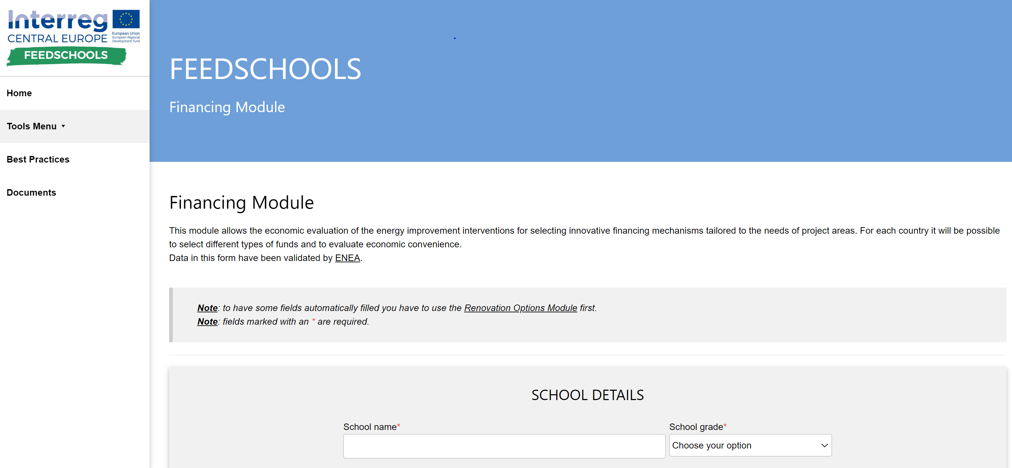
FEEDSCHOOLS Financial App
The feasibility of Energy Efficiency refurbishments depends on both technical potentials of applied measures in terms of energy savings and on the conditions of financing mechanisms available for their support.
Within FEEDSCHOOLS project, a calculation model for school buildings has been developed aiming at analyzing different available financing models and deciding on the optimal model.

Slide 12
FEEDSCHOOLS Financial App
Calculation parameters (7), like available grant rates or loan interest rates are obtained through feedback of Project partners and are presented in Table below:
Criteria/ Model
Interest rate
Discount rate
Life cycle of EE renovation (years)
Administrative, legal and architect cost
Other bank cost
ESCO cost
PPP cost
The indicators in the table vary according to the country and must be carefully evaluated in order to obtain valid results.

Slide 13
FEEDSCHOOLS Financial App
The analysis included 5 models:
The Financial App also determine the subsidy rate needed to break even.
The model was validated through the results of performed energy audits for each school, for each country, in order to ensure the correctness of the results.
Analysis
Budget financing
Loan (credit) financing
ESCO financing
PPP financing
Combination of ESCO and subsidy (with 95% subsidy rate)

Slide 14
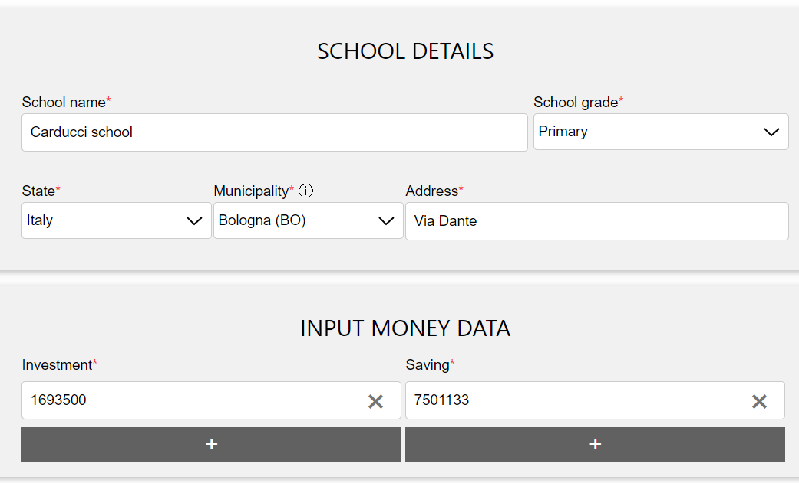
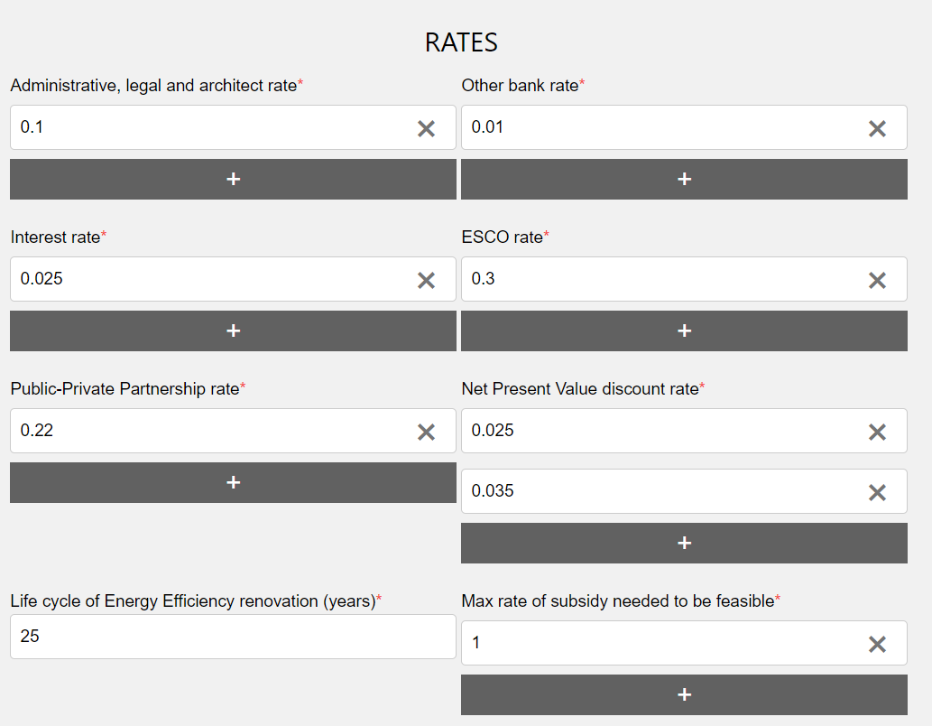
FEEDSCHOOLS Financial App
To apply the financial module, user add information about school, investment, saving and Country. The user can manually enter the data or, if he used the Renovation Option Module, he can import them automatically.
Automatically rates are calculated.
If the user deems it useful, he can manually change the preset rate values.

Slide 15
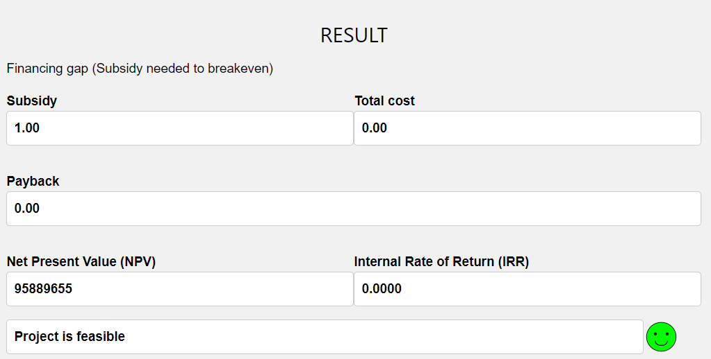
FEEDSCHOOLS Financial App
Then the calculation is returned. An indicator (green, yellow or red face) is also inserted next to the result: it indicates whether the final solution is feasible, almost feasible or not feasible

Slide 16
Self assessment test
Is there a solution universally considered the best in analyzing optimal costs?
Yes, the one with the least payback time
Yes, the one with the least cost
No, because for each particular situation (country, region, building) an optimal solution should be tailor-made.
The feasibility of Energy Efficiency refurbishments depends:
Only on technical potentials of applied measures
Only on the conditions of financing mechanisms available
On both technical potentials of applied measures and on the conditions of financing mechanisms available
How many economic indicators are calculated by the FEEDSCHOOLS financial app?
3
7
5
Notes:
Selected resources should be provided with a short presentation

Slide 17
Self assessment test
How many models are analyzed with the FEEDSCHOOLS financial app?
3
7
5
The FEEDSCHOOL financial model was validated through:
Stakeholder suggestion
Partner feedbacks
Performed energy audits
Notes:
Selected resources should be provided with a short presentation

Slide 18

Maria-Anna Segreto (author and tutor)
Researcher and Head of SEI Laboratory of ENEA
www.enea.it/en/
mariaanna.segreto@enea.it
https://www.facebook.com/eneapaginaufficiale/
https://twitter.com/ENEAOfficial
https://www.linkedin.com/company/enea_2
Notes:
Proposal : Specify the different roles of author and tutor
the author is the person that produced the course content and he/she will remain author whatever may happen (i.e. changes at work, retire, etc.)
the tutor is the person available to provide support, short explanations, etc. when required; if for some reason she/he is not available any longer, this role can be taken by some other colleague; email address must be provided.

