Slide 1
Block 5: FEEDSCHOOLS Applications
5.1 ERE App
D.T4.3.1 E-learning course
Feedschools, by ENEA (Alessandro Tallini)

Slide 2
Block 5: FEEDSCHOOLS APPLICATIONS
5.1 ERE App
This block is part of a training package developed to provide local authorities with free tuition that may inspire and help them in adopting new technical and financial solutions to implement ‘nearly Zero Energy Building’ (nZEB) renovation activities in schools.
Specify block content:
The aim of the webtool is to simplify the energy analysis of school buildings and to implement energy improvement actions to support school decision makers to understand if it is worth implementing improvement actions and to identify which actions bring the greatest savings.
Level: intermediate
The topics dealt with in this block do not require specific knowledge on the building energetics, technical features of the building envelopes and energy systems. Therefore, webtool is likely to be used by users without specific knowledge. However, for a profitable use it is recommended at least to know: what is meant by energy consumption, installed power, emissions benefits, efficiency of a heat generator, and related units of measurement; the most basic energy efficiency measures; how to identify the parameters that influence the calculation of energy savings. Therefore, it is recommended to study of the previous blocks.
Notes:
Brief introduction to the block as part of the training package, including content and level

Slide 3
Block 5: FEEDSCHOOLS APPLICATIONS
5.1 ERE App
Learning Objective:
At the end of this block we will be able to use “Energy Profile Module” to evaluate performance of school building by checking the energy class and “Renovation Options Module” to evaluate the energy savings, carbon footprint and investment cost of some improvement actions and its contribution to total savings.
5.1.1
Method for calculation of specific energy consumption
(link)
5.1.2
Evaluation of schools’ specific energy consumption
(link)
5.1.3
Use of web tool: Energy Profile Module
(link)
5.1.4
Use of web tool: Renovation Options Module
(link)
Notes:
General learning objective of the block and list of content with link to each unit’s introductory page

Slide 4
Block 5: FEEDSCHOOLS APPLICATIONS
5.1 ERE App
5.1.1
Method for calculation of specific energy consumption
5.1.1 Objective
In this unit will you know the method for calculation of specific energy consumption of building schools by comparing them with the reference consumption of a significant sample of building schools: the calculation steps of the method, the mean of the “normalisation” of energy consumption and the normalisation factors will be described, and finally the calculation of the normalised energy indicators (NEI).
Notes:
Unit’s introductory page; it is needed per each unit

Slide 5
Method for calculation of specific energy consumption
  normalisation of the energy consumption
The fuel and electricity consumption of schools should be determined and evaluated by comparing them with the reference consumption of a significant sample of schools.
Regarding the consumption of heating fuel, the comparison could be made using the average specific consumption, referring to volume unit and degree days (DD). The specific consumption in schools, however, depends not only on "modifiable" and therefore optimisable factors (efficiency, heat loss through walls, etc.) but also on non-modifiable factors such as the shape of the building (S/V ratio) and the heating time.
From the analysis of a sample of schools, used as a reference, it was possible to quantify, with good approximation, the dependence of consumption on the latter two factors.
The values of S/V ratio and the number of daily hours for heating corresponding to the average specific consumption of the reference sample can be identified.
At this point if the school has the same S/V ratio and the same number of daily hours for heating, the comparison with the average specific consumption of the reference sample would be homogeneous and any deviations could be attributed to the modifiable factors.
If, instead, these two factors are different, the comparison would be affected by this difference.
For example, if S/V or the number of heating hours in the school under examination was greater than that corresponding to the average consumption of the sample, there would be a greater energy consumption due to a greater dispersion of the building or to the prolonged heating time.

Slide 6
Method for calculation of specific energy consumption
  normalisation of the energy consumption
In order to normalise with respect to the average consumption of the sample, the parameter 1.00 is attributed to the sample, then certain consumption intervals, higher and lower than the average consumption, are parameterised proportionally, each of which corresponds to a range of S/V and number of daily hours for heating.
To carry out the parameterisation, the correlation found between the consumption of the schools in the sample and the relative factors is used.
The "normalization" of the school energy consumption is made by multiplying the energy consumption by the parameter corresponding to the class relative to the value of S/V or heating hours of the school.
School consumption needs to be corrected with so-called "normalisation" factors.
The corrected specific consumptions are called respectively:
ENI_{H} energy normalized indicator for heating
reference consumption is referred to the heated volume unit and the Day Degrees unit
ENI_{E} energy normalized indicator for electricity
reference consumption is referred is obtained from the ratio between average annual consumption and surface area on the floors, normalised with respect to the school's operating hours

Slide 7
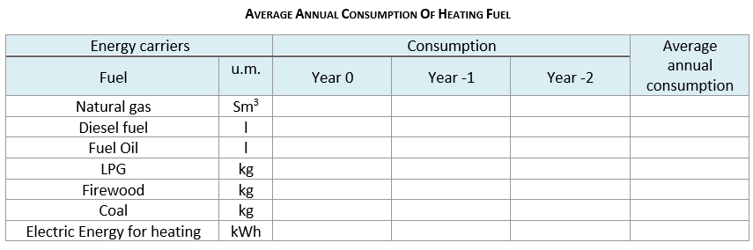
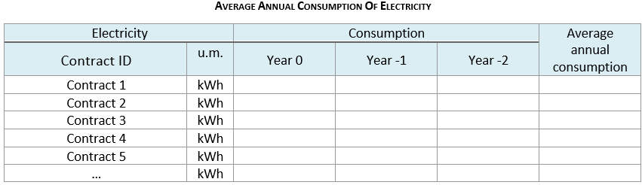
Method for calculation of specific energy consumption
  CALCULATION STEPS – Energy Consumption
Energy consumption for heating and electricity consumption are taken from the bills for the last three years. Both fuel and electricity consumption over the three years are added together and are divided by 3 to obtain the average annual consumption.

Slide 8
Method for calculation of specific energy consumption
  CALCULATION STEPS – Dimensional & Climatic Data
Gross heated volume V [m³] It can be measured by the drawings, if available, or the building is measured from the outside. It includes the exterior walls. Unheated parts of the building must be excluded. If the school consists of several buildings, it represents the sum of the volumes of the individual buildings.
Dissipating surface S [m²] It is obtained from the plans of the buildings or through direct reliefs including also the partition walls, excluding the perimeter walls. If the school consists of several buildings, it represents the sum of the floor areas of the individual buildings.
Shape factor S/V [m⁻¹] S/V ratio.
Gross floor Area Ap [m²] It is the sum of the individual surfaces surrounding the gross.
Degree Days [DD] Heating degree days are a measure of how much (in degrees), and for how long (in days), the outside air temperature was below a certain level. It is a measurement designed to quantify the demand for energy needed to heat a building. Formally, DD are defined as the sum of the differences between the internal design temperature (20 °C) and the average daily outdoor temperature for all heating days of the winter season in a given location.

Slide 9
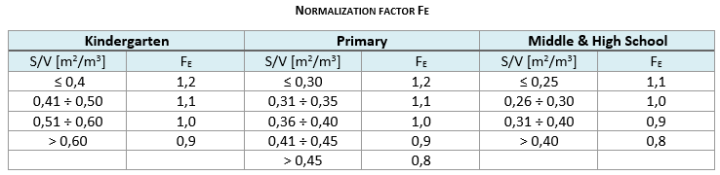
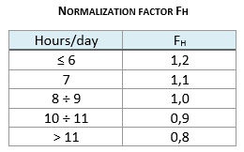
Method for calculation of specific energy consumption
  CALCULATION STEPS – Normalisation Factors
Heating Consumption Normalization Factor F_{E}
In order to make the specific consumption comparable with the reference consumption of the sample schools, it must be normalised with respect to the S/V ratio. The normalization factor F_{E} (to be multiplied by the specific consumption for heating) is obtained as a function of S/V and the type of school.
  Operating Time Normalization Factor F_{H}
  The normalisation factor F_{H} depends on the operating time of the school buildings. F_{H} found for the school must be multiplied by the specific consumption for heating and the specific electricity consumption of the school.

Slide 10
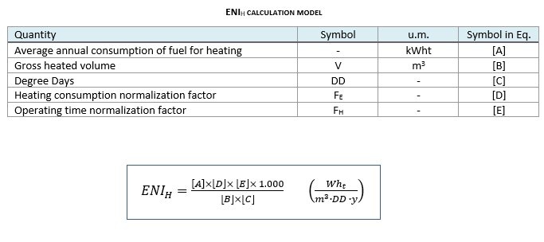
Method for calculation of specific energy consumption
    CALCULATION STEPS – Calculation of Normalised Energy Indicators
ENI_{H} energy normalized indicator for heating

Slide 11
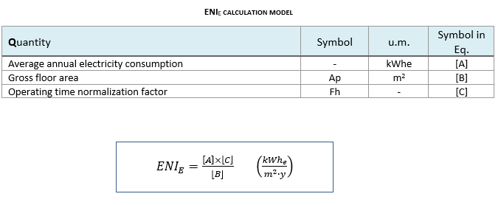
Method for calculation of specific energy consumption
    CALCULATION STEPS – Calculation of Normalised Energy Indicators
ENI_{E} energy normalized indicator for electricity

Slide 12
Block 5: FEEDSCHOOLS APPLICATIONS
5.1 ERE App
5.1.2
Evaluation of schools’ specific energy consumption
5.1.2 Objective
This unit let you know how the evaluation of the normalisation energy indicators is carried out by comparing this index to the specific reference consumption for a significant sample of schools.
Notes:
Unit’s introductory page; it is needed per each unit

Slide 13
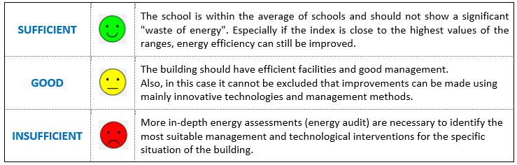
evaluation of schools' specific energy consumption
    Definition of energy classes
    The following tables show the specific reference consumption organized by school type an energy rating class (for heating and electricity) (energy class). The class of merit of the school is identified by using the reference tables of the NEI_{H} and NEI_{E}.
    The reference table are calculated according to the consumption of the selected country and to the average standard of the country.
    Evaluation of results

Slide 14
Block 5: FEEDSCHOOLS APPLICATIONS
5.1 ERE App
5.1.3
Use of web tool: Energy profile module
5.1.3 Objective
In this unit you will learn how the web tool modules work. In order to apply the procedure described in (ENI_{H} and ENI_{E} calculation method) and define energy classes for schools as defined, an example of a case study of a school building is shown.
Notes:
Unit’s introductory page; it is needed per each unit

Slide 15

Use of web tool
Energy profile module
  Energy profile module
  This module calculates the energy index of your school building and estimates its performance compared to the national benchmark. Starting by entering a few basic data, all easily available – gross heated volume, dissipating surface of the building, gross floor area, annual fuel and electricity consumption over the last 3 years webtool allows to determine the ENI_{H} and ENI_{E} indicators and therefore the energy rating class of the school and therefore whether or not improvement actions are needed. A case study is now being analysed as an example.

Slide 16
Use of web tool
Energy profile module
  Energy profile module
After registering and logging in to your private area clicking on Tools Menu, you can see these options:
Energy Profile Module
Renovation Options Module

Slide 17

Use of web tool
Energy profile module
  Energy profile module
Click on Energy Profile Module
The tool is available to perform first level energy analysis and assess renovation options for the following countries:
Austria, Croatia, Czech Republic,
Hungary, Italy, Poland, Slovenia
Selecting a Country from the drop-down list e.g. Italy you can access the module for the calculation of energy indices of your school building and estimate its performance compared to the national benchmark.

Slide 18
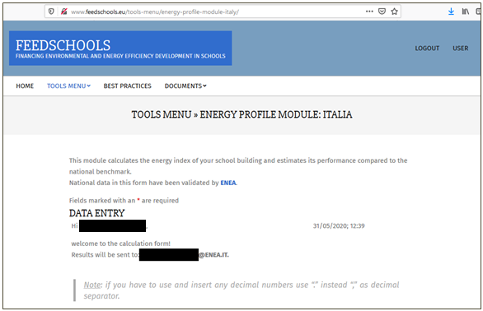
Use of web tool
Energy profile module
  Energy profile module
Now we are in our personal area and the data entry process can start.

Slide 19
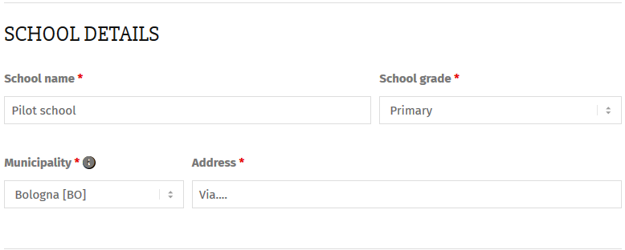
Use of web tool
Energy profile module
    School Details
    In the School details box, fill in general information fields as shown below:

Slide 20
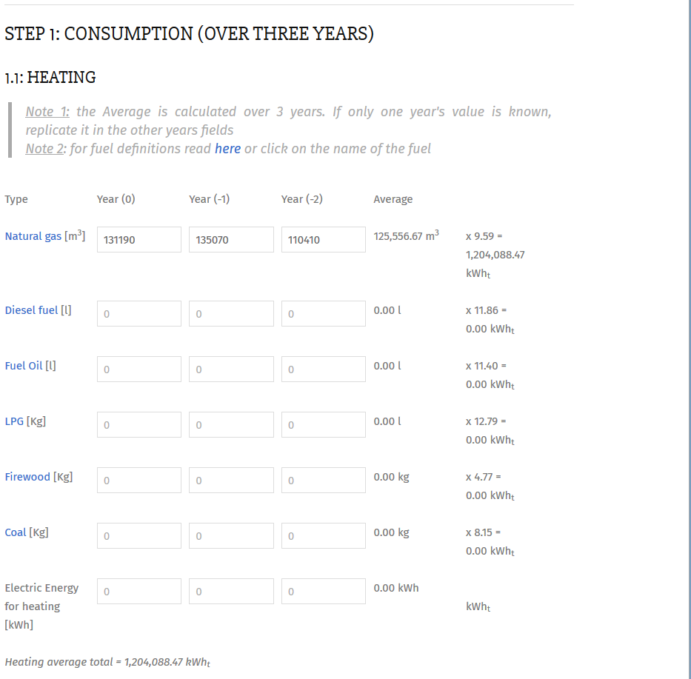


Use of web tool
Energy profile module
    ENERGY CONSUMPTION
    Heating energy consumption
    In Heating box, you can enter the consumption for several fuels (one or more than one) over the last three years.
    For the school considered the only fuel is natural gas.
The value of the following quantities is shown as output Heating average total [kWht]
If you do not enter consumption for the all the three years, the result displayed is an incorrect value! In fact, the average consumption is calculated over three years
No spaces between thousands!

Slide 21
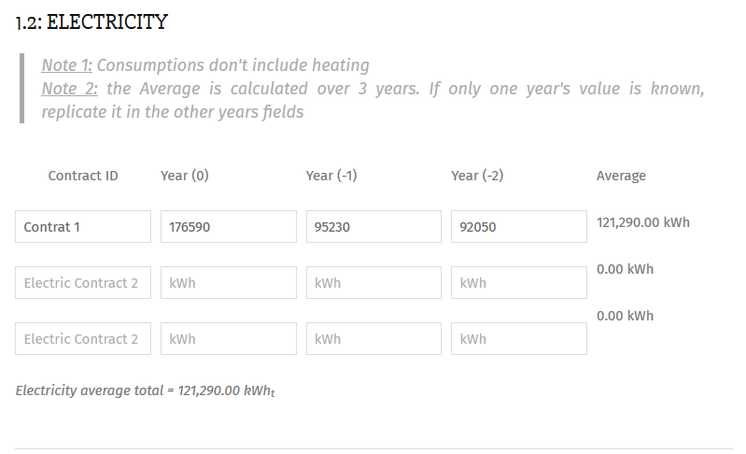
Use of web tool
Energy profile module
    Energy Consumption
    Electricity consumption
In Electricity box, the same way as for heating energy consumption, check the box corresponding to supply contracts (ID) and enter the energy consumption for 3 years for each contract.
The value of the following quantities is shown as output: Electricity average total [kWhe]
If you do not enter consumption for the all the three years, the result displayed is an incorrect value! In fact, the average consumption is calculated over three years
No spaces between thousands!

Slide 22
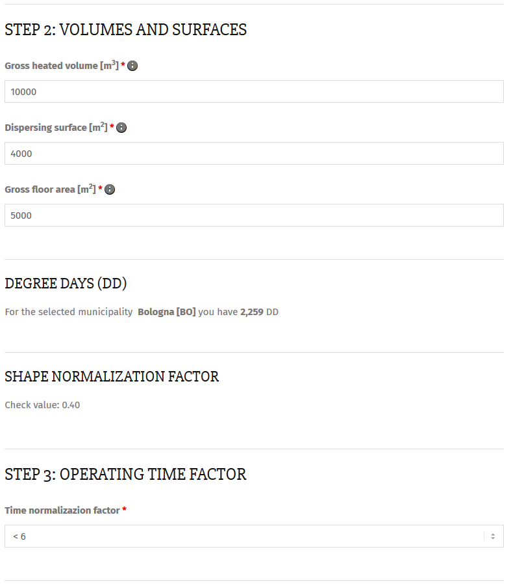
Use of web tool
Energy profile module
    Volume And Surfaces, Degree Days, Normalisation Factors
In Volumes and surfaces box, fill the fields related to gross heated volume, dissipating surface and gross floor area
The Degree Days of the location are calculated according to the location entered in the school details box.
In Shape Normalisation factor is provided according to the S/V ratio.
In Operating Time Factor box, you can choose a value from the list.
In this case the choice corresponds to a value F_{H}=1,2

Slide 23
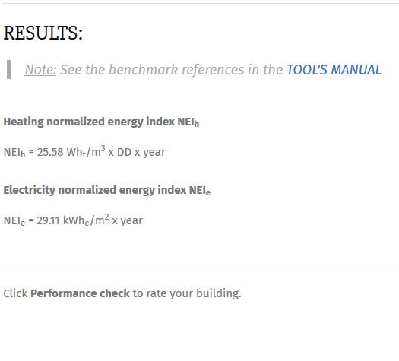
Use of web tool
Energy profile module
    Results
At the end of the data input, Results box provides the values of:
ENI_{H} energy normalized indicator for heating
ENI_{E} energy normalized indicator for electricity
Click on performance check to rate the building to check the performance rate of building.

Slide 24
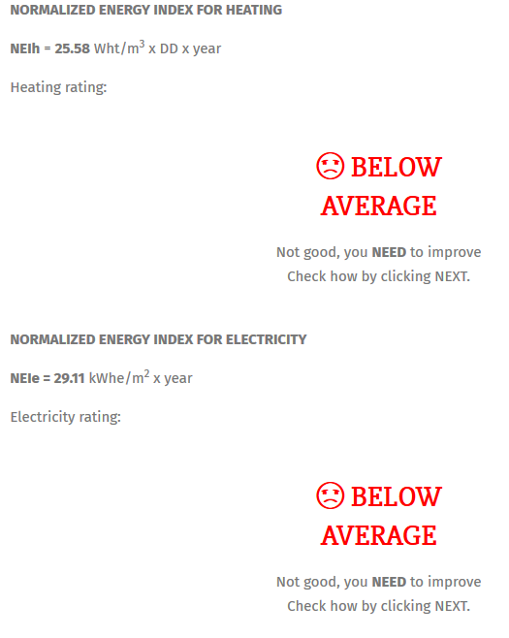
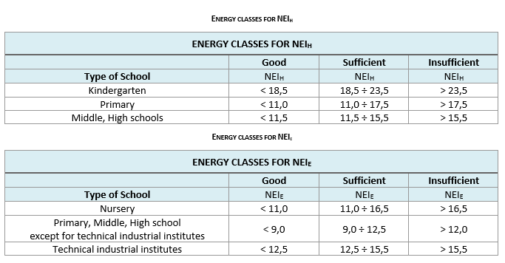
Use of web tool
Energy profile module
    Results
    In line with the definition of the energy classes the performance are insufficient from the point of view of heat and electricity consumption
ENI_{H} energy normalized indicator for heating
ENI_{E} energy normalized indicator for electricity

Slide 25
Block 5: FEEDSCHOOLS APPLICATIONS
5.1 ERE App
5.1.4
Use of web tool: Renovation Options Module
5.1.4 Objective
In this unit you will learn how the web tool renovation option module work. This module calculates the potential energy savings of your building and helps in selection the most promising renovation action. Renovation Options Module takes into consideration a limited number of simple renovation options which we analyse in detail one by one.
Notes:
Unit’s introductory page; it is needed per each unit

Slide 26
Use of web tool renovation options module
    Two ways to use the renovation options module
    The Renovation Options Module can be accessed via two ways:
    1) By accessing the Renovation Options Module at the end of the complete compilation of the Energy profile Module (as in the example shown below).
    2) Directly from the Renovation Options Module by filling a reduced number of boxes than in the previous case: School Details, Consumption (over three years), Operating Degree Days boxes.

Slide 27
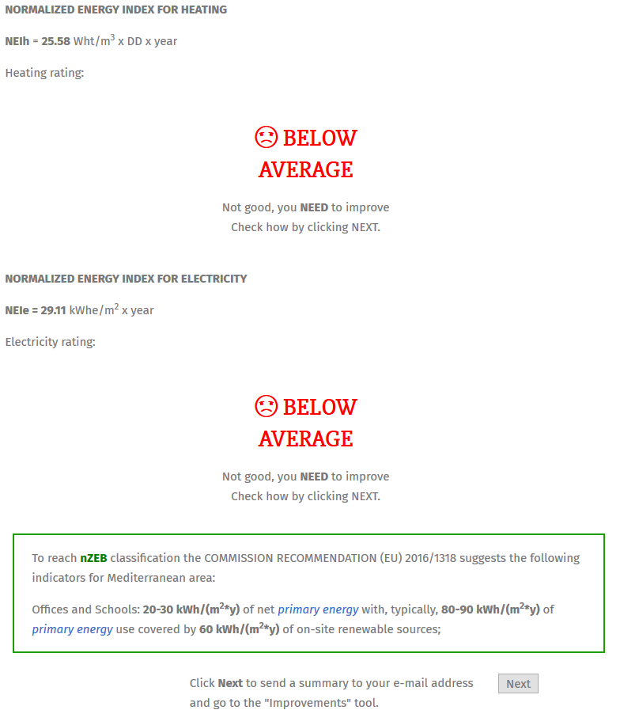
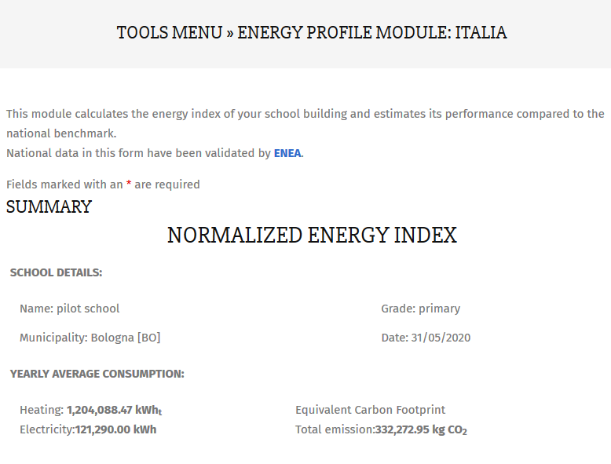
Use of web tool renovation options module
    Two ways to use the renovation options module
    We consider the case 1) to start filling the Renovation Options Module that can be accessed by clicking Next at the end of the page at the end of the last page of the Energy Profile Module that shows normalized indexes:

Slide 28
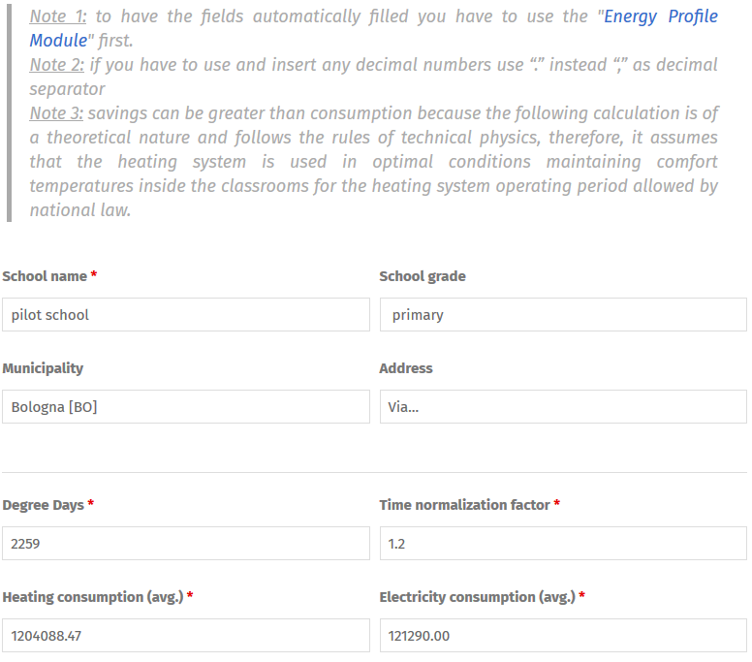
Use of web tool renovation options module
    Two ways to use the renovation options module
    The screen summarises the main information from the Energy Profile Module as:
    School details
    Degree Days
    Time normalisation factor
    Heating average consumption
    Electricity average consumption
    Renovation Options Module takes into consideration a limited number of simple renovation options which we analyze in detail one by one.

Slide 29
Use of web tool renovation options module
    Architectural elements
This section of Renovation Options Module allows to evaluate some energy improvement actions by identifying the simplest actions to improve the energy quality of school buildings and evaluating the opportunity to carry out, through an energy specialist, more in-depth energy audits.
FEEDSCHOOLS webtool allows to choose different improvement actions to evaluate the savings (kWh/y) and the percentage weight of the savings compared to the total savings.
It is possible to evaluate simple interventions on the envelope by selecting the category to which it belongs:
    Glazing
    Roof
    Walls
    Floor

Slide 30
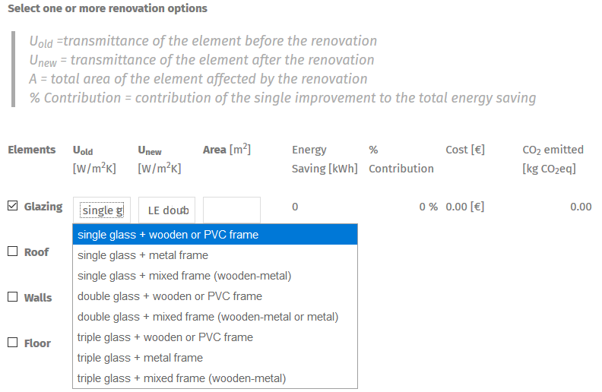
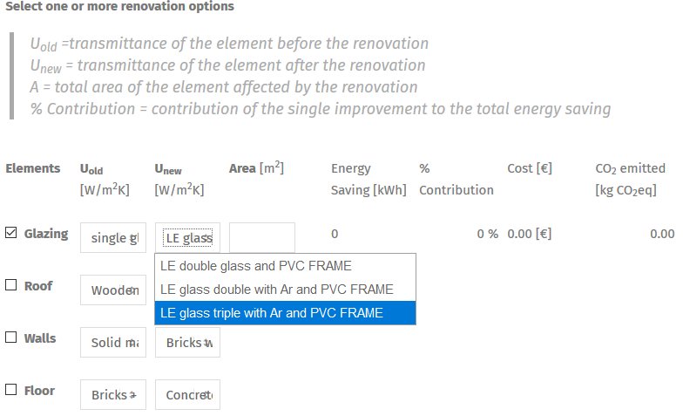
Use of web tool renovation options module
    Architectural elements – GLAZING
    Checking the Glazing, within the U_{old} box you can select an option for the existing state from the list.
    Within the U_{new} box you can select an option for the renovation option from the list.
Existing state
Renovation option

Slide 31
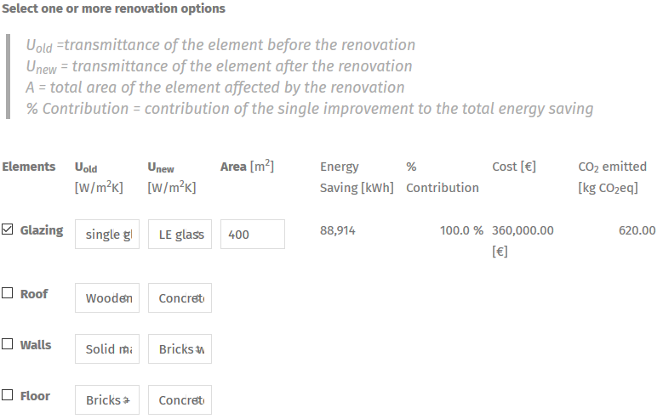
Use of web tool renovation options module
    Architectural elements – GLAZING
    Filling in the Area box, total area of the element affected by renovation we can obtain as output the absolute energy savings obtained and the (partial*) contribution of the single improvement to the total energy saving, the cost and the CO₂ avoided emissions (the final contribution of each improvement is obtained after considering all the interventions)

Slide 32
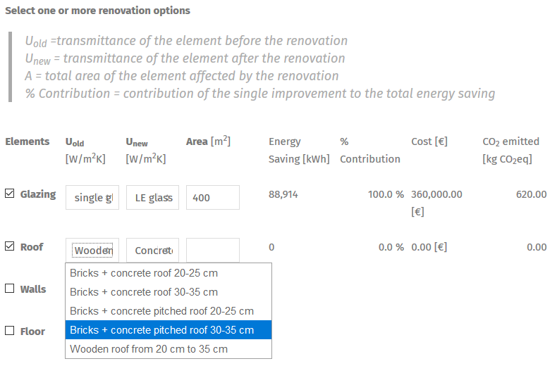
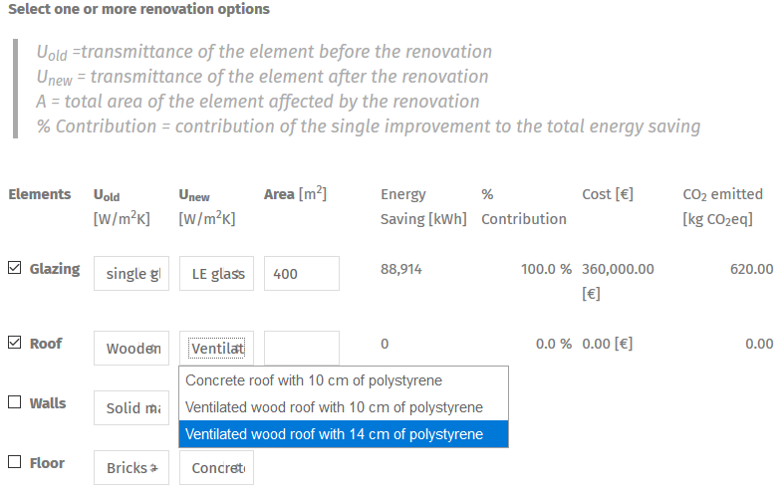
Use of web tool renovation options module
    Architectural elements – ROOF
    Checking the Roof, within the U_{old} box you can select an option for the existing state from the list.
    Within the U_{new} box you can select an option for the renovation option from the list.
Existing state
Renovation option

Slide 33
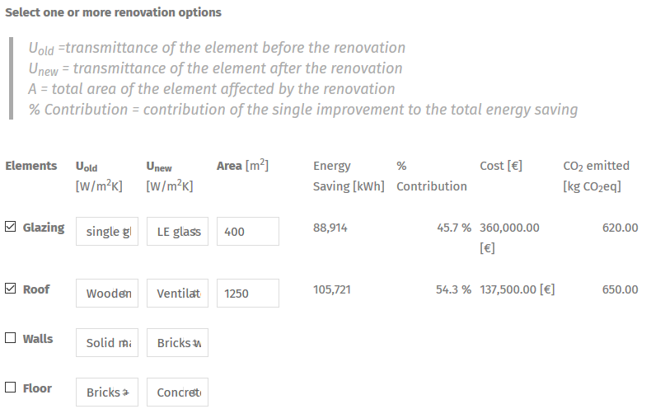
Use of web tool renovation options module
    Architectural elements – ROOF
    Filling in the Area box, total area of the element affected by renovation we can obtain as output the absolute energy savings obtained and the (partial*) contribution of the single improvement to the total energy saving, the cost and the CO₂ avoided emissions (the final contribution of each improvement is obtained after considering all the interventions)

Slide 34
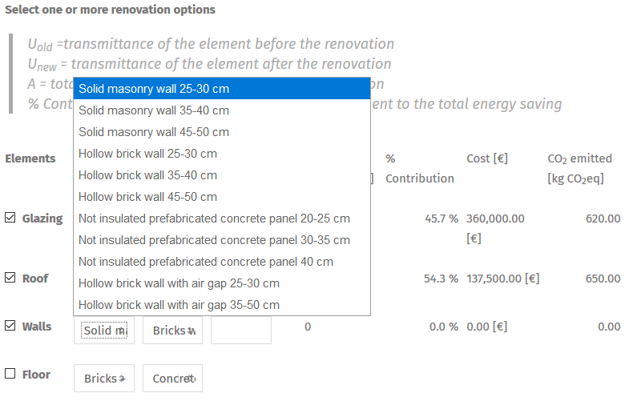
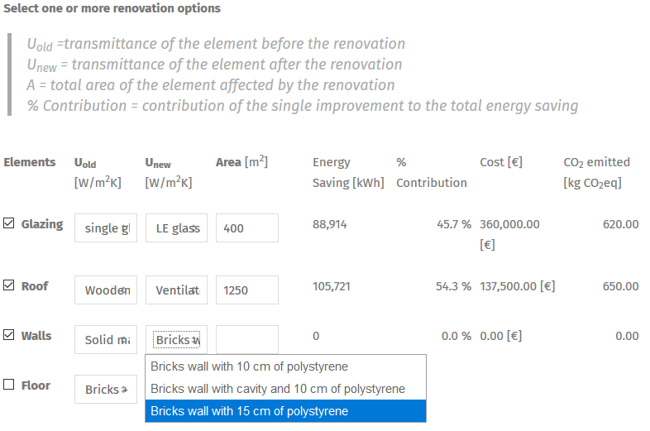
Use of web tool renovation options module
    Architectural elements – WALLS
    Checking the Walls, within the U_{old} box you can select an option for the existing state from the list.
    Within the U_{new} box you can select an option for the renovation option from the list.
Existing state
Renovation option

Slide 35
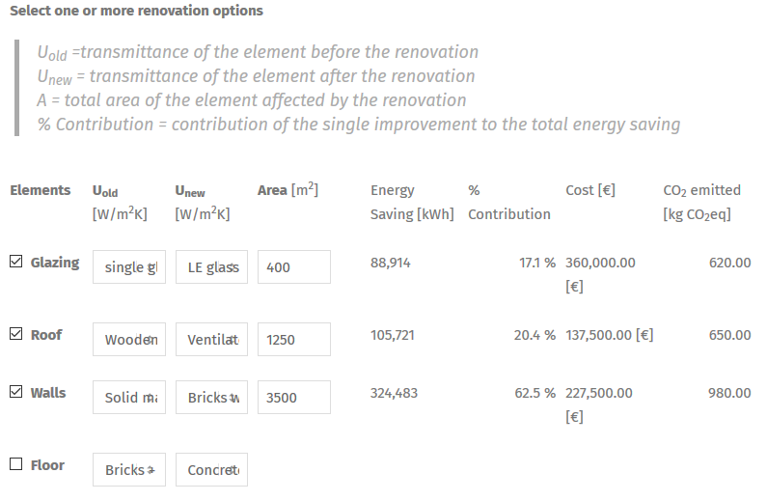
Use of web tool renovation options module
    Architectural elements – WALLS
    Filling in the Area box, total area of the element affected by renovation we can obtain as output the absolute energy savings obtained and the (partial*) contribution of the single improvement to the total energy saving, the cost and the CO₂ avoided emissions (the final contribution of each improvement is obtained after considering all the interventions)

Slide 36
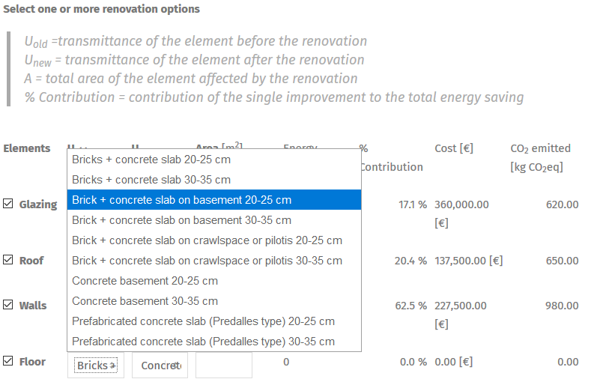
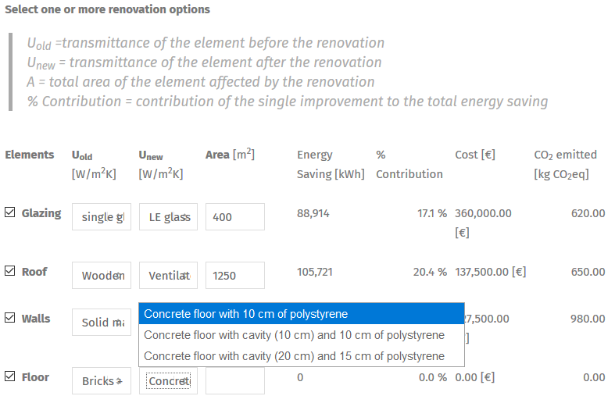
Use of web tool renovation options module
    Architectural elements – FLOOR
    Checking the Floor, within the U_{old} box you can select an option for the existing state from the list.
    Within the U_{new} box you can select an option for the renovation option from the list.
Existing state
Renovation option

Slide 37
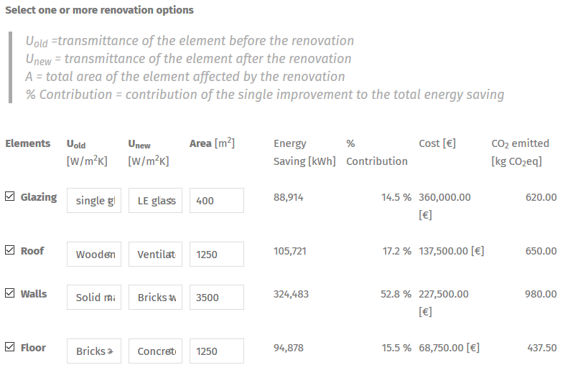
Use of web tool renovation options module
    Architectural elements – FLOOR
    Filling in the Area box, total area of the element affected by renovation we can obtain as output the absolute energy savings obtained and the (partial*) contribution of the single improvement to the total energy saving, the cost and the CO₂ avoided emissions (the final contribution of each improvement is obtained after considering all the interventions)

Slide 38
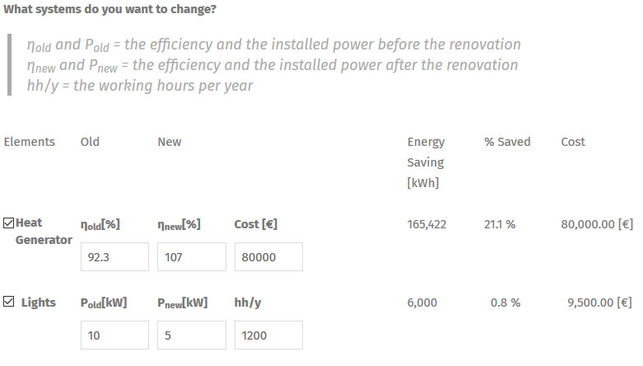
Use of web tool renovation options module
    SYSTEMS
It is possible to evaluate simple interventions by selecting the relevant category: Heat generator, Lights
Checking the Heat generator, the value of the primary energy conversion efficiency of the system must be indicated. In the Efficiency before renovation (η_{old}) field, you must enter the efficiency value of the heat generator to be replaced. The efficiency value of the new generator must be entered in the Efficiency before renovation (η_{new}) filed and the cost of replacing the heat generator.
At the end of the data input, the values
of the following quantities are displayed:
Energy saving [kWh]
% contribution [%]
CO₂ equivalent [kg CO_{2eq}]

Slide 39
Use of web tool renovation options module
    SYSTEMS
Checking the Lights, the Power before renovation (P_{old}) and Power after renovation (P_{new}) fields, it is necessary to enter the value of the total power of lighting system before and after the renovation.
In addition, in the Working hours per year before renovation (hh/y) field, it is necessary to indicate the indicative number of hours per year the system is switched on.
At the end of the data input, the values of the following quantities are displayed:
Energy saving [kWh]
% contribution [%]
CO₂ equivalent [kg CO_{2eq}]

Slide 40
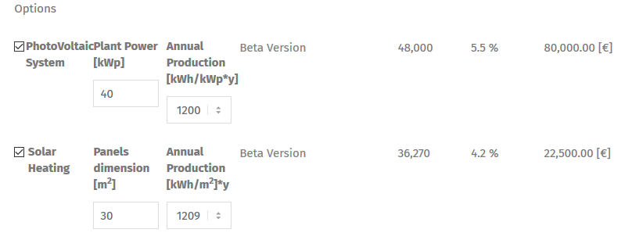
Use of web tool renovation options module
    OPTIONS (Beta version)
Checking the Photovoltaic system box, it is necessary to enter the power plant (kWp) value and select the estimated annual production option (kWh/kWp*y) from a drop-down list.
Checking the Solar heating box, it is necessary to enter the panels dimension (m²) value and the estimated annual production option (kWh/m²*y) from a drop-down list.
At the end of the data input, the values of the following quantities are displayed:
Energy saving [kWh]
% contribution [%]
CO₂ equivalent [kg CO_{2eq}]

Slide 41
Use of web tool renovation options module
    Results
At the end of data input Results box provides the values of the following quantities are displayed:
Total THERMAL Energy saved [kWh]: sum of the thermal energy saved from the single renovation options.
Equivalent to save [€]
Improvement action cost [€]
Fuel carbon footprint [kgCO₂e] for each fuel
Total ELECTRIC Energy saved [kWh]: sum of the electric energy saved from the single renovation options.
Equivalent to save [€]
Improvement action cost [€]
Fuel carbon footprint [kgCO₂e] for electricity
Total PRIMARY Energy saved [kWh]
Total improvement cost [€]
Total CO2 saved [kgCO₂e]
Total saved [€]

Slide 42
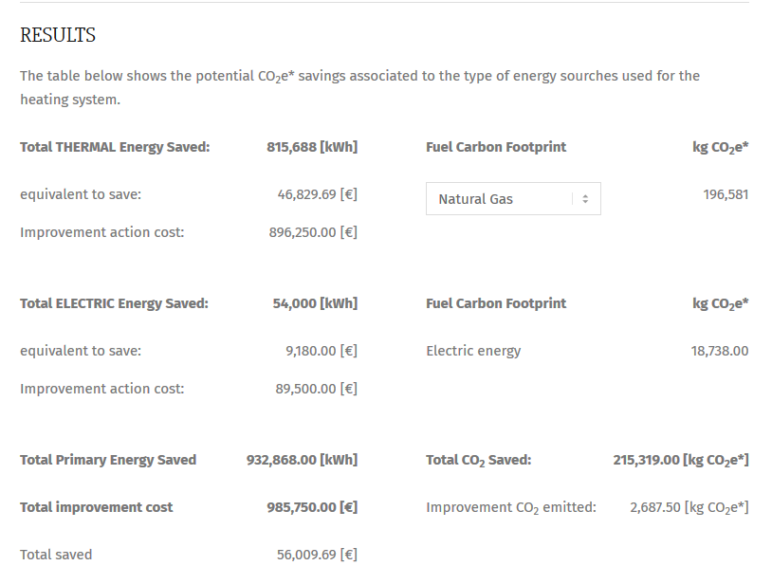
Use of web tool renovation options module

Slide 43
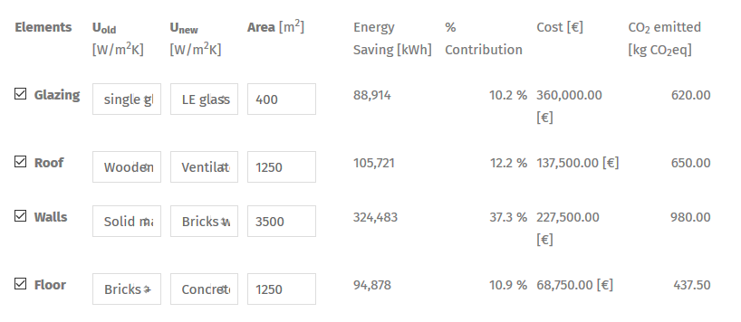
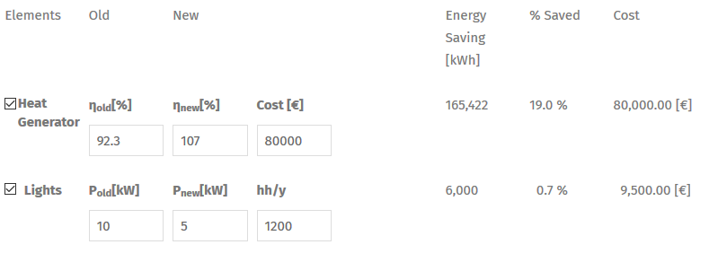
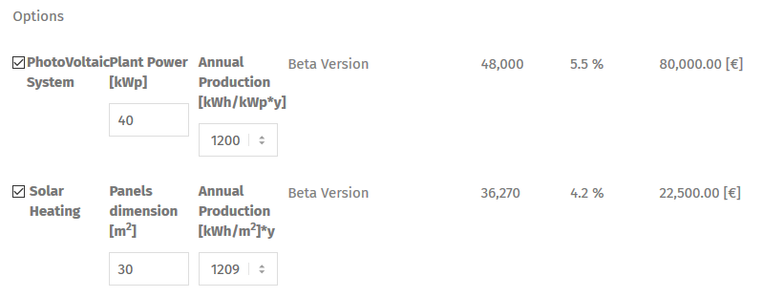
Use of web tool renovation options module
    Results
The Results box provides the percent contribution of the single improvement to the total energy saving.
As we can see the total is 100%.
Please note that the energy savings calculated using the tool is a value that does not take into account that multiple energy efficiency actions on the same building can generate additional savings due to mutual influences on the operation of the building system.
As a result...
…by carrying out multiple interventions energy savings may be higher than those resulting from the calculation!
100%

Slide 44
Self assessment test
5.1.1 Method for calculation of specific energy consumption
Mark the correct answer
Question 1
The normalization of the energy consumption:
A
is the process of correcting the fuel and electricity consumption of schools to make them comparable with the reference consumption of a significant sample of schools
B
is carried out in the same way for fuel and electricity
C
does not depend on the operating time of the school buildings
Notes:
Selected resources should be provided with a short presentation

Slide 45
Self assessment test
5.1.1 Method for calculation of specific energy consumption
Mark the correct answer
Question 2
The normalised energy indicators:
A
ENI_{H} and ENI_{E} can be calculated by knowing the energy consumption of the bills for the last three months
B
ENI_{H} can be determined by knowing the consumption of fuel, surface area, gross heated volume and Degree Days of the location
C
ENI_{H} and ENI_{E} are energy normalized indicator for heating and electricity respectively
Notes:
Selected resources should be provided with a short presentation

Slide 46
Self assessment test
5.1.2 Evaluation of school’s specific energy consumption
Mark the correct answer
Question 3
The values of normalized energy indicators:
A
have been covenantly grouped into 4 classes according to the type of school
B
allow to identify the performance rating of a school by means of classes of merit according to the type of school and the value of the indicators (energy classes)
C
vary little from school to school and therefore it makes no sense to define energy classes
Notes:
Selected resources should be provided with a short presentation

Slide 47
Self assessment test
5.1.2 Evaluation of school’s specific energy consumption
Mark the correct answer
Question 4
If a school belongs to the energy class defined as “sufficient”:
A
the building does not have efficient facilities and good management
B
it may be too expensive to carry out energy efficiency measures on such a building
C
also, in this case it cannot be excluded that improvements can be made using mainly innovative technologies and management methods
Notes:
Selected resources should be provided with a short presentation

Slide 48
Self assessment test
5.1.3 Use of web tool: Energy Profile Module
Mark the correct answer
Question 5
The “Energy Profile Module”:
A
for its use requires you to enter a lot of data of different types
B
it may be too expensive to carry out energy efficiency measures on such a building
C
calculates the energy index of school building and estimates its performance compared to the national benchmark
Notes:
Selected resources should be provided with a short presentation

Slide 49
Self assessment test
5.1.3 Use of web tool: Energy Profile Module
Mark the correct answer
Question 6
Within the “Energy Profile Module”:
A
it is possible to enter the consumption even for only one year, because the average consumption is calculated correctly even in this case
B
it is necessary to enter data for all fuels over the last 3 years
C
the form returns warning messages in the case of data input that does not match each other
Notes:
Selected resources should be provided with a short presentation

Slide 50
Self assessment test
5.1.4 Use of web tool: Renovation Options Module
Mark the correct answer
Question 7
When you use the “Renovation Options Module”:
A
only interventions that affect the building envelope can be selected
B
you can choose different improvement actions to evaluate the savings and the percentage contribution of the savings compared to the total savings
C
the value of the U-value before (U_{old}) and after (U_{new}) the intervention on the building envelope (e.g. glazing, roof, walls, floor) must be known in order to evaluate the energy savings.
Notes:
Selected resources should be provided with a short presentation

Slide 51
Self assessment test
5.1.4 Use of web tool: Renovation Options Module
Mark the correct answer
Question 8
In the box for the interventions on systems:
A
old boilers can only be replaced with modern condensing boilers
B
For lighting projects, the Power before renovation (P_{old}) and Power after renovation (P_{new}) are the value of the total power of LED system before and after the renovation
C
it is possible to evaluate the energy and economic benefits linked to interventions related to the use of renewable sources plants
Notes:
Selected resources should be provided with a short presentation

Slide 52
Selected resources
Selected resources (click on text to access the resource)
FEEDSCHOLS project website
The FEEDSCHOOLS project aims to provide local authorities with new solutions, both technical and financial, which will help them to implement ‘nearly Zero Energy Building’ (NZEB) renovation activities in schools.
TEESCHOOLS project website
The project aims to support Local Autorithies to implement nZEB refurbishments in Mediterranean schools. An integrated set of user-friendly tools has been tested and validated by pilot actions in each partner region.
Guida all'efficienza energetica negli edifici scolastici - ENEA
Operational guide addressed to public administrators and school managers as a first information tool on the complex matter of energy requalification of buildings, in particular school buildings.
SafeSchool 4.0 – ENEA
The ENEA App for the seismic and energy assessment of schools.
School of the Future: Towards Zero Emission with High Performance Indoor Environment
The aim of the project is to design, demonstrate, evaluate and communicate shining examples of how to reach the future high-performance building level.
Notes:
Selected resources should be provided with a short presentation

Slide 53

Alessandro Tallini(author and tutor)
Researcher of SEI Laboratory of ENEA
www.enea.it/en/
Alessandro.tallini@enea.it
https://www.facebook.com/eneapaginaufficiale/
https://twitter.com/ENEAOfficial
https://www.linkedin.com/company/enea_2
Notes:
Proposal : Specify the different roles of author and tutor
the author is the person that produced the course content and he/she will remain author whatever may happen (i.e. changes at work, retire, etc.)
the tutor is the person available to provide support, short explanations, etc. when required; if for some reason she/he is not available any longer, this role can be taken by some other colleague; email address must be provided.

Slide 54
Self assessment test results
5.1.1 Method for calculation of specific energy consumption
Correct answer is green
Question 1
The normalization of the energy consumption:
A
is the process of correcting the fuel and electricity consumption of schools to make them comparable with the reference consumption of a significant sample of schools
B
is carried out in the same way for fuel and electricity consumption
C
does not depend on the operating time of the school buildings
Notes:
Selected resources should be provided with a short presentation

Slide 55
Self assessment test results
5.1.1 Method for calculation of specific energy consumption
Correct answer is green
Question 2
The normalised energy indicators:
A
can be calculated by knowing the energy consumption of the last three months bills
B
ENI_{H} can be determined by knowing the consumption of fuel, surface area, gross heated volume and Degree Days of the location
C
are energy normalized indicator for heating and electricity respectively
Notes:
Selected resources should be provided with a short presentation

Slide 56
Self assessment test results
5.1.2 Evaluation of school’s specific energy consumption
Correct answer is green
Question 3
The values of normalized energy indicators
A
have been covenantly grouped into 4 classes according to the type of school
B
allow to identify the performance rating of a school by means of classes of merit according to the type of school and the value of the indicators (energy classes)
C
vary little from school to school and therefore it makes no sense to define energy classes
Notes:
Selected resources should be provided with a short presentation

Slide 57
Self assessment test RESULTS
5.1.2 Evaluation of school’s specific energy consumption
Correct answer is green
Question 4
If a school belongs to the energy class defined as “sufficient”:
A
the building does not have efficient facilities and good management
B
it may be too expensive to carry out energy efficiency measures on such a building
C
also, in this case it cannot be excluded that improvements can be made using mainly innovative technologies and management methods
Notes:
Selected resources should be provided with a short presentation

Slide 58
Self assessment test results
5.1.3 Use of web tool: Energy Profile Module
Correct answer is green
Question 5
The “Energy Profile Module”:
A
for its use requires you to enter a lot of data of different types
B
it may be too expensive to carry out energy efficiency measures on such a building
C
calculates the energy index of school building and estimates its performance compared to the national benchmark
Notes:
Selected resources should be provided with a short presentation

Slide 59
Self assessment test results
5.1.3 Use of web tool: Energy Profile Module
Correct answer is green
Question 6
Within the “Energy Profile Module”:
A
it is possible to enter the consumption even for only one year, because the average consumption is calculated correctly even in this case
B
it is necessary to enter data for all fuels over the last 3 years
C
the form returns warning messages in the case of data input that does not match each other
Notes:
Selected resources should be provided with a short presentation

Slide 60
Self assessment test results
5.1.4 Use of web tool: Renovation Options Module
Correct answer is green
Question 7
When you use the “Renovation Options Module”:
A
only interventions that affect the building envelope can be selected
B
you can choose different improvement actions to evaluate the savings and the percentage contribution of the savings compared to the total savings
C
the value of the U-value before (U_{old}) and after (U_{new}) the intervention on the building envelope (e.g. glazing, roof, walls, floor) must be known in order to evaluate the energy savings.
Notes:
Selected resources should be provided with a short presentation

Slide 61
Self assessment test results
5.1.4 Use of web tool: Renovation Options Module
Correct answer is green
Question 8
In the box for the interventions on systems:
A
old boilers can only be replaced with modern condensing boilers
B
For lighting projects, the Power before renovation (P_{old}) and Power after renovation (P_{new}) are the value of the total power of LED system before and after the renovation
C
it is possible to evaluate the energy and economic benefits linked to interventions related to the use of renewable sources plants
Notes:
Selected resources should be provided with a short presentation

