Slide 1
Block 3: Energy Efficiency Measures and Technologies
3.3 New technologies - state of art
Feedschools, by GEA

Slide 2
This block is part of a training package developed to provide local authorities with free tuition that may inspire and help them in adopting new technical and financial solutions to implement ‘nearly Zero Energy Building’ (NZEB) renovation activities in schools.
You will be introduced to actual possibilities of new technologies in your buildings.
The focus are technologies, which are spreading at the moment to a common future standard (sometimes without subsidies not yet the economic best solution).
Basic level: Technical knowledge is not needed, the training gives a first simple overview

Slide 3
Learning Objective:
In this block attendees will be provided with a short overview of some possible and most likely future standards in Nearly Zero Energy buildings. After being introduced you get a short overview of PV-systems with storage, stationary fuel cells, smart metering and energy management, predictive control systems and prefabricated facades.
Notes:
General learning objective of the block and list of content with link to each unit’s introductory page

Slide 4
3.3 Units:
3.3.1 PV in combination with storage systems
3.3.2 Stationary fuel cells for heating and electric power
3.3.3 Smart metering and smart energy management
3.3.4 Predictive control systems and useful sensors
3.3.5 Prefabricated facades for NZEB renovations

Slide 5

Technologies are changing fast.
Things that seemed to be inno-
vative a couple of years ago (e.g.
LED lighting) are standards a view
years later.
The following presentation gives
a short overview of some of
most likely future standards in the
(existing and new) buildings.
They all have the aim to reduce CO2 emissions significantly.

Slide 6
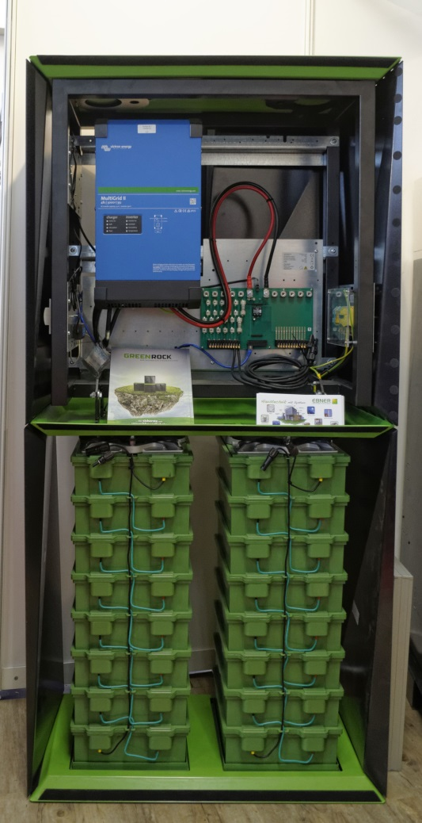
PV systems just got into acceptable and self-economic amortisation times (low subsidies are necessary).
Storage systems help to rise the share of own usage and can serve as emergency power supply and off-grid systems.
Different technologies are already on the market. Very promising seems to be the Natrium-Ion technology (“salt water battery”), an completely secure and environmentally friendly system.
It contains Sodium salt water as electrolyte, all containing materials are non-toxic.
Further information:
https://www.bluesky-energy.eu/en/home-2/
Photo (c) Ra Boe / Wikipedia, Sindelfingen Haus & Energie 2019 by-RaBoe 126, CC BY-SA 3.0 DE

Slide 7
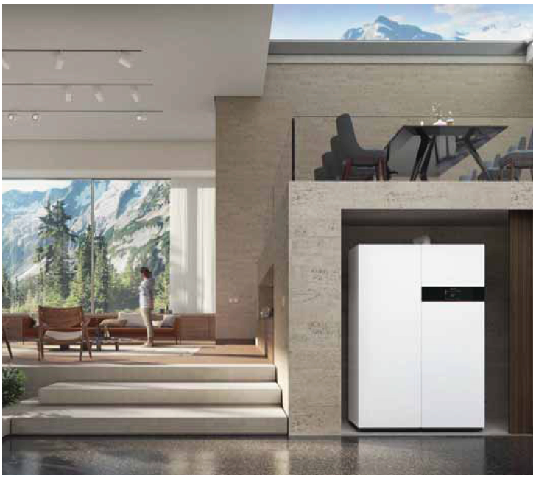
Hydrogen driven fuel cells are already on the market in different variations. They produce heat and electricity in cogeneration.
At the moment the hydrogen is generated by natural gas (in a reformer). The aim is to use the hydrogen directly in future.
Commercial products are already available e.g.:
https://asue.de/wer-bietet-an#brennstoffzellen (German)
Photo: https://www.viessmann.de,
product Vitovalor PT2

Slide 8
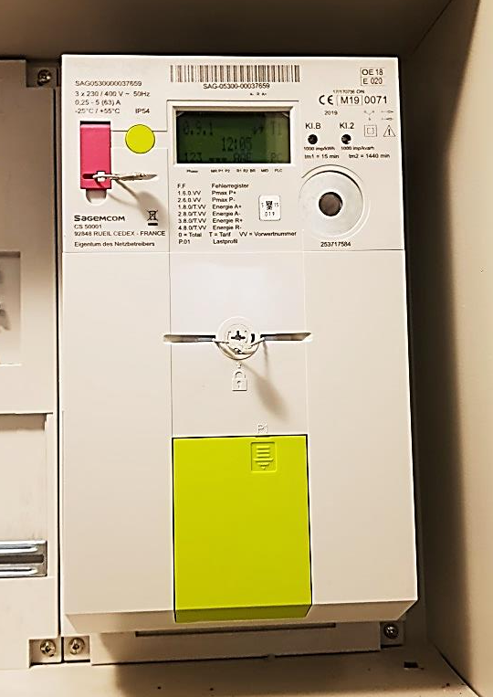
Smart metering is on the way in Europe (obligation until 2020 – Directive 2009/72/EC) for electricity.
A lot of households already have smart meters, but don´t use all functions...
What are the advantages in comparison to the old mechanic meter?
Real time daily and quarterly hour consumption information (online)
Comparison of the consumption in graphs
Optimal dimensioning of PV and storage is possible
Information basis for efficiency measures
Automatic meter reading and billing (communication via power LAN and wireless)
Photo: Gerhard Bucar
Graz Energy Agency

Slide 9
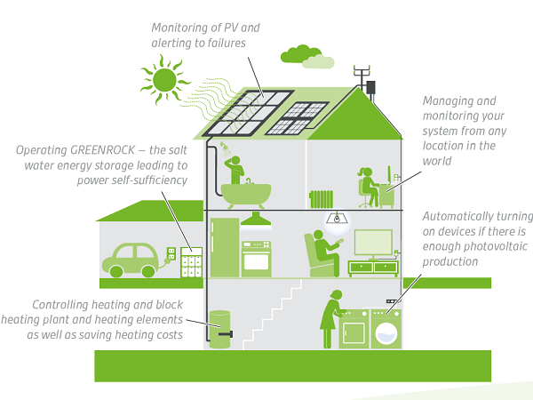
Picture: BlueSky Energy; https://www.bluesky-energy.eu/en/2018/09/12/smart-ems-energy-management-system/

Slide 10
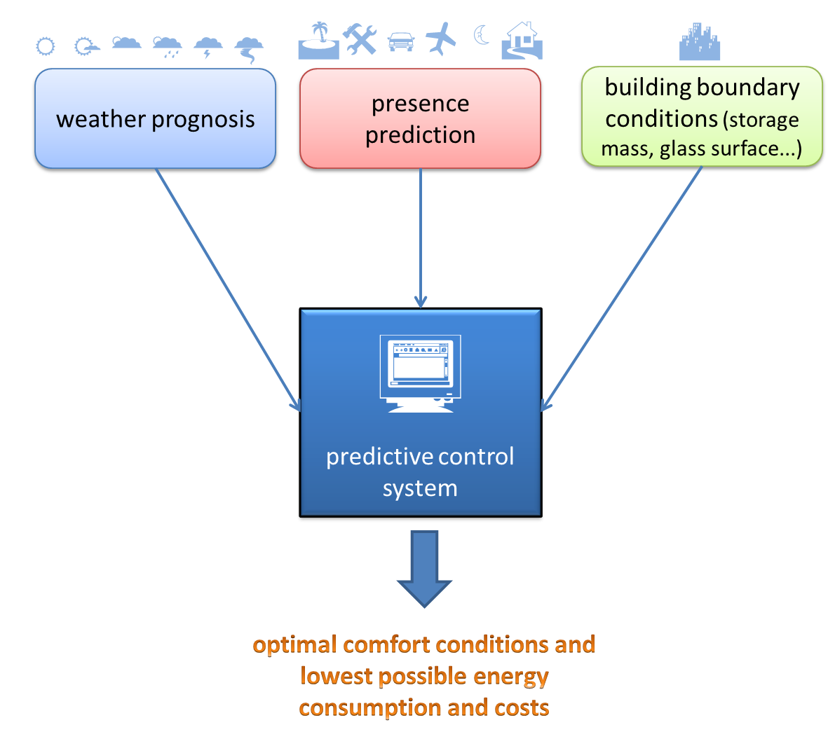
Normal control systems are linear and not at all predictive – they react on existing thermal conditions. Overheating in a lot of cases is common.
Predictive control systems take into account presence (with learning from sensors, calendar weekend, holidays, travels etc.), the weather prognosis and the boundary conditions of the building (glass surfaces, construction, orientation...)
to reduce energy consumption!

Slide 11
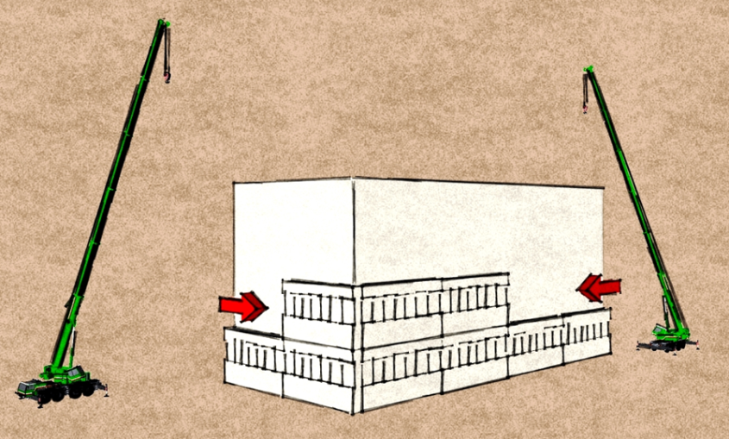
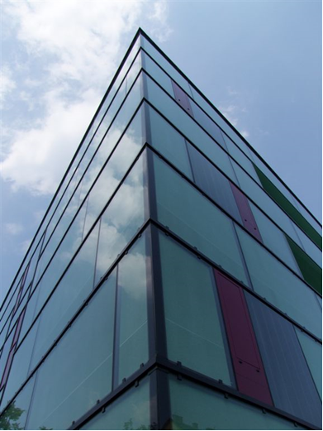
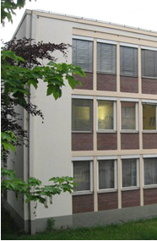
Prefabrication can reduce construction time significantly and renovation is possible during full usage.
The new facade parts normally are in-sulated wooden constructions and can also contain prefabricated technical equipment (cooling, ventilation, heat distribution).
It is necessary to plan very precise in detail and to survey the building in detail (3D scan with highest accuracy).
Mounting the facades needs special skills and techniques and good planning.
You get the highest standards in best time!
before
after renovation
(c) Graz Energy Agency

Slide 12
Gerhard Bucar
Graz Energy Agency
www.grazer-ea.at/
bucar@grazer-ea.at
+43 316 811848-13
facebook.com/grazerea
linkedin.com/in/gerhard-bucar-249688123/
twitter.com/GEnergieAgentur

Slide 13
Self Assessment Test (1)
Which promising technology is an efficient, secure and non-toxic storage system for electricity?
Potato battery
Salt water battery (Natrium-Ion technology)
Nickel-cadmium accumulator
A fuel cell generates...?
biogenic liquid fuel
heat and electricity in cogeneration
cool air
A smart meter can be used for (multiple choices possible)

Slide 14
Self Assessment Test (2)
A smart meter can be used for (multiple choices possible)
Getting access to the internet
Automatic meter reading
An information basis for efficiency measures
Predictive control systems take into account (multiple choices possible)
Presence
Wheather prognosis
Your clothing

Slide 15
Self Assessment Test (Answers)
Which promising technology is an efficient, secure and non-toxic storage system for electricity?
Salt water battery (Natrium-Ion technology)
A fuel cell generates...?
heat and electricity in cogeneration
A smart meter can be used for (multiple choices possible)
Automatic meter reading
An information basis for efficiency measures
Predictive control systems take into account (multiple choices possible)
Presence
Wheather prognosis

