Slide 1
Block 3: Energy Efficiency Measures and Technologies
3.2 RES in buildings
Feedschools, by GEA

Slide 2
This block is part of a training package developed to provide local authorities with free tuition that may inspire and help them in adopting new technical and financial solutions to implement ‘nearly Zero Energy Building’ (NZEB) renovation activities in schools.
This block will introduce to the possibilities of renewable energy in your buildings.
The focus is on thermal solar energy, PV-panels, biomass and heat pumps.
Basic level: Technical knowledge is not needed, the training gives a first overview
Notes:
Introduction

Slide 3
Learning Objective:
In this block attendees will be provided with a short overview of typical renewable energy sources in buildings (especially in schools). You get recommendations, first hints for planning, advantages and disadvantages and possible problems.
Notes:
General learning objective of the block and list of content with link to each unit’s introductory page

Slide 4
3.2 Units:
3.2.1 Thermal solar energy
3.2.2 PV-panels
3.2.3 Biomass
3.2.4 Environmental energy (with heat pumps
3.2.5 Information
3.2.4 Environmental energy (with heat pumps)

Slide 5
3.2.1 Thermal solar energy
3.2.1 objective
After being introduced you get an introduction to thermal solar energy. You get recommendations for the right dimensioning.

Slide 6
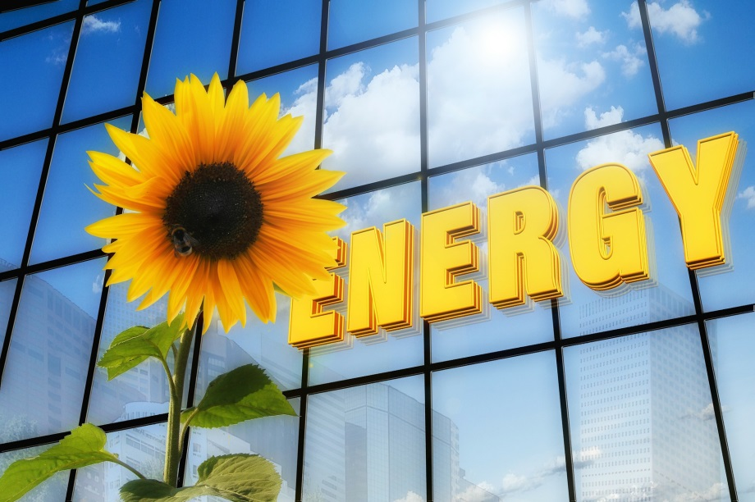
To implement renewables in buildings is state of the art and a very important factor for reducing CO2 emissions.
Renewables have grown rapidly in recent years, driven by cost reductions for solar photovoltaics and policy.
The use cases of renewables in buildings are very diverse:
Solar power for heat and electricity, geothermal power, biomass and biogas, maybe in future hydrogen...
Photo: Gerd Altmann at PIXABAY

Slide 7
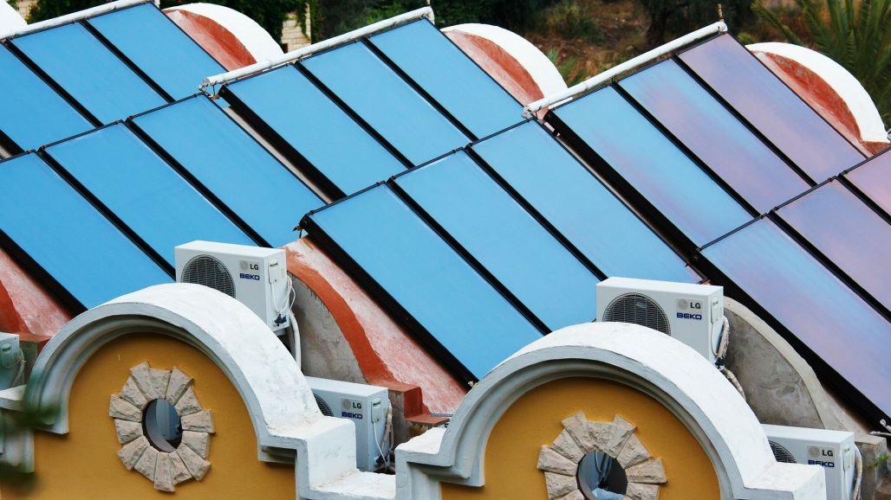
Thermal solar power can be integrated well into existing buildings and heating systems.
It is mainly for hot water use but also for heating and can be well combined with heat pumps.
In schools, the problem is very often that there is no use for the heat in summer and therefore poor economics, but fits perfect to (outdoor) pools and buildings with high hot water demand.
Photo: PublicDomainPictures at PIXABAY

Slide 8
Recommendations for the right dimensioning you can find on the following table:

Slide 9
3.2.2 PV panels
3.2.2 objective
You get basic information about the right planning, optimization of the own usage, planning instruments and typical solar gain.

Slide 10
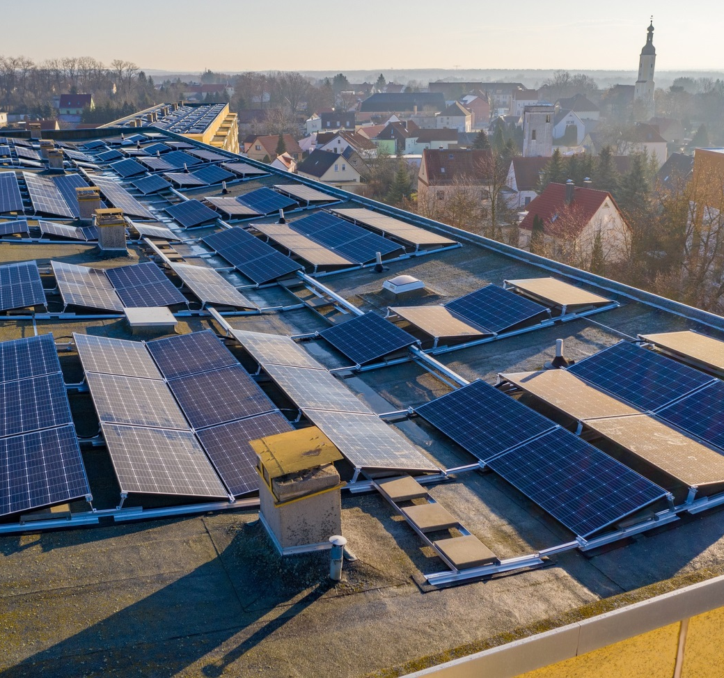
PV-panels are state-of-the-art!
The prices for PV-systems are
still falling (-25% since 2016),
but also the feed-in tariffs are
falling.
Therefore the economic focus
normally lies on a high own usage
of the produced electricity.
Analyse your electricity con-
sumption in detail to get the
most economic dimension of
your PV-system
Battery storage systems raise the share of own use
Photo: Solarimo at PIXABAY

Slide 11
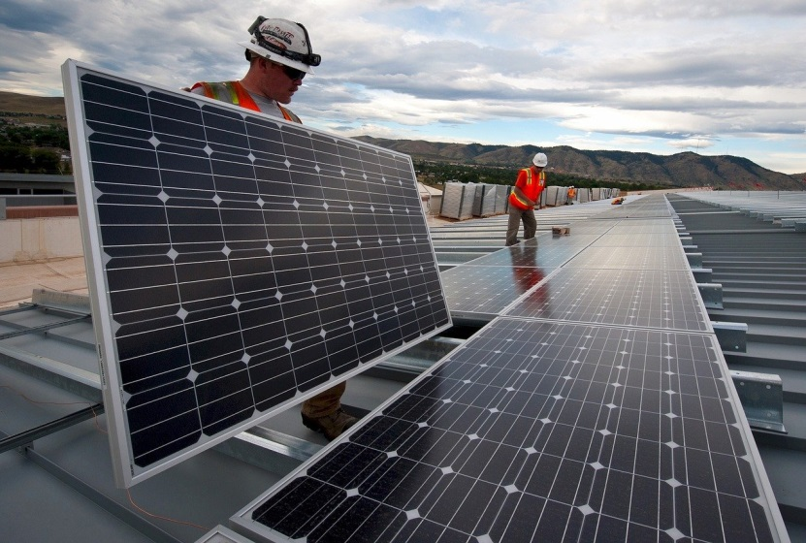
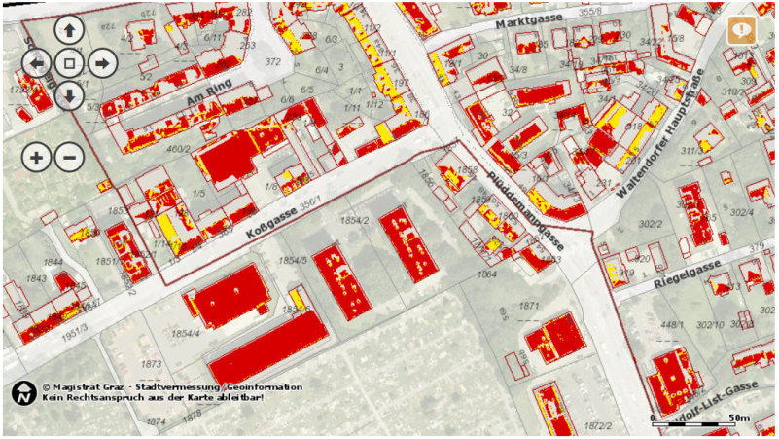
Typical gain per year ca. 1000 kWh per kWp (south oriented, 700 - 800 on south oriented facades
don't forget lightning protection and other security equipment
mind shading – make detailed simulation
is a solar roof register or similar planning instruments available in your city?
You need ≈ 6-8 m² panels per 1 kWp,
the efficiency varies between 12 – 20%
Photo: 272447 at PIXABAY
Photo: solar roof register City of Graz

Slide 12
3.2.3 Biomass
3.2 .3 objective
You get basic information about biomass, efficiency and emissions.

Slide 13
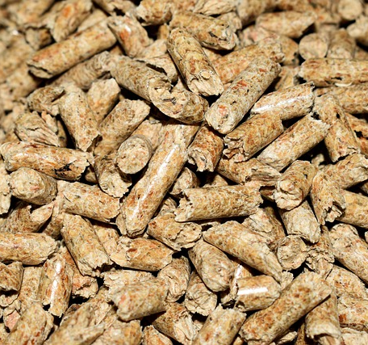
Biomass in solid, liquid or gaseous form (wood and wood-pellets, biogas, etc.) is a usually locally sufficient available energy source and CO2-neutral (fast regenerating).
Its used for heating, electricity and also cooling in absorption processes.
Main focus in buildings is heating.
Modern biomass boilers have an efficiency of up to 106 % (condensing) and very low emissions
Nevertheless there are restrictions in some areas and cities (like Graz) because of emissions (particulate matter)
Photo: Mrdidg at PIXABAY

Slide 14
3.2.4 Environmental energy (with heat pumps)
3.2.4 objective
You get basic information about typical sources for heat pumps, advantages and disadvantages of different heat pumps/situations.

Slide 15
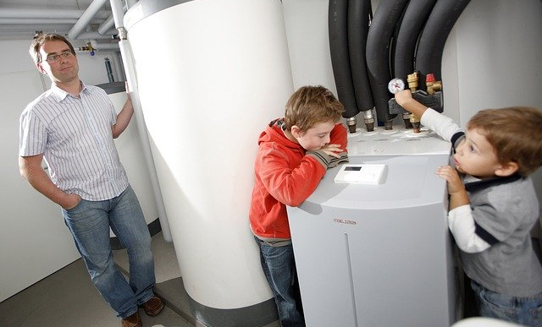
Environmental energy can be used
very well in combination with heat
pumps (for heating and cooling).
You have several typical sources:
ground heat (deep drill and flat
collector)
ground water (approval necessary!)
air (often noise problems)
solar heat (optimizes the solar gain of solar thermal collectors and PV-panels as electrical source – different types)
It is highly recommended to have a low temperature heat distribution system and a efficient storage system!

Slide 16
ADVANTAGES – DISADVANTAGES of different heat pumps/situations:
Optimise the system
for your location!

Slide 17
3.2.5 useful information
3.2.5 objective
You get some useful information (online links) on EU-level and a contact point to the creator of this module.

Slide 18
Renewable Energy Directive:
https://ec.europa.eu/energy/topics/renewable-energy/renewable-energy-directive_en
National renewable energy action plans 2020:
https://ec.europa.eu/energy/topics/renewable-energy/national-renewable-energy-action-plans-2020_en
Renewable Energy Statistics:
https://ec.europa.eu/eurostat/statistics-explained/index.php/Renewable_energy_statistics

Slide 19
Gerhard Bucar
Graz Energy Agency
www.grazer-ea.at/
bucar@grazer-ea.at
+43 316 811848-13
facebook.com/grazerea
linkedin.com/in/gerhard-bucar-249688123/
twitter.com/GEnergieAgentur

Slide 20
Self Assessment Test (1)
How much solar gain do get out of 1 m² thermal collector and year?
30 kWh/year
280 – 350 kWh/year
1000 kWh/year
What are in general the problems with solar thermal energy in schools?
The temperature is not sufficient for a hygienic hot water supply
No or too less hot water and heat demand in summer
It can not be integrated into the heating system
How much solar gain do you get out of 6-8 m² PV-panel on the roof (south oriented)?
300 kWh/year ◻ 500 kWh/year ◻ 1000 kWh/year

Slide 21
Self Assessment Test (2)
In which forms biomass is in general local accessible (multiple choices possible)?
solid (like wood)
liquid (like biofuel)
gaseous (like biogas)
radiation (like solar heat)
What are the advantages of solar heat pumps?
A lot of proofed manufacturers are on the market
Almost everywhere possible
Easy to control

Slide 22
Self Assessment Test (Answers)
How much solar gain do get out of 1 m² thermal collector and year?
280 – 350 kWh/year
What are in general the problems with solar thermal energy in schools?
No or too less hot water and heat demand in summer
How much solar gain do you get out of 6-8 m² PV-panel on the roof (south oriented)?
1000 kWh/year

Slide 23
Self Assessment Test (ANswers)
In which forms biomass is in general local accessible (multiple choices possible)?
solid (like wood)
liquid (like biofuel)
gaseous (like biogas)
What are the advantages of solar heat pumps?
Almost everywhere possible

