Slide 1
Block 3: Energy Efficiency Measures and Technologies
3.1. General energy efficiency measures in buildings
Feedschools, by GEA

Slide 2
This block is part of a training package developed to provide local authorities with free tuition that may inspire and help them in adopting new technical and financial solutions to implement ‘nearly Zero Energy Building’ (NZEB) renovation activities in schools.
After an introduction to the context and importance of the building sector, this block will introduce to typical energy efficiency measures in buildings and how to find them in your buildings.
Advanced: Technical knowledge is needed (heating and control systems, lighting, energy auditing)
Notes:
Introduction

Slide 3
Learning Objective:
In this block attendees will be provided with an overview of typical energy efficiency measures in public buildings (especially schools), how to find some measures and recommendations for planning, insulation measures, heating, electricity, lighting and ventilation. Aim is to get to know the most important efficiency measures in buildings.
Notes:
General learning objective of the block and list of content with link to each unit’s introductory page

Slide 4
3.1 Units
3.1.1 Importance of the building sector
3.1.2 Typical measures in buildings and potentials
3.1.3 First step – get to know your weak points
3.1.4 Recommendations – insulation
- planning
3.1.5 Recommendations – heating system and heat supply
3.1.6 Recommendations – lighting, ventilation and electricity
3.1.7 useful information on EU level
Notes:
Units

Slide 5

The building sector is crucial for achieving the EU's energy and environmental goals.
Buildings are responsible for approximately 40%
of EU energy consumption and 36% of the CO2
emissions. Buildings are therefore the single largest
energy consumer in Europe.
At present, about 35% of the EU's buildings are
over 50 years old and almost 75% of the building
stock is energy inefficient. At the same time, only
about 1% of the building stock is renovated each year
– more or less efficient - with often lost opportunities
for a long time.

Slide 6
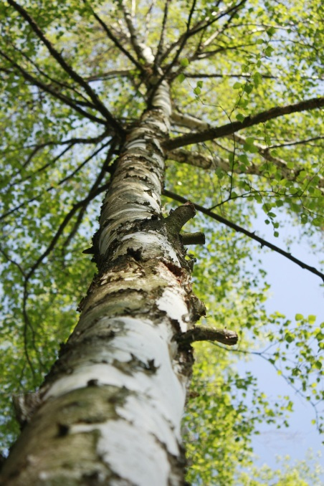
For example, to compensate a gas consumption of
100.000 kWh per year, you need to plant 1760 trees
comprehensive measures are necessary to protect
climate, take advantage of your potentials!
Renovation of existing buildings can lead to significant
energy savings, up to real 70% of existing consumption.
The goals are renovations towards nearly zero
energy buildings. The FEEDSCHOOLS project aims
to provide local authorities with new solutions,
both technical and financial, which will help them
to implement ‘nearly Zero Energy Building’ (NZEB)
renovation activities in schools.

Slide 7
3.1.2 Typical measures in buildings and potentials
3.1.2 objective
Typical measures for renovating buildings are listed

Slide 8
To reach the CO2 reduction goals you have several typical measures in the building sector, especially in schools and public buildings:
insulation of the exterior surface (walls, ceilings) and new windows (potential 20 – 80 %)
hydraulic optimization of the heating distribution system and thermostatic valves (potential 10 – 20 %)
changing the heat and power source towards CO2-friendly sources like biomass, solar energy and heat pumps
new LED lighting (potential 50-80% of lighting consumption)
ventilation with efficient heat recovery
efficient pumps, insulation of pipes, effective and optimized control – potentials depending on existing conditions
energy management and control, behavioural change

Slide 9
3.1.3 First step – get to know your weak points
3.1.3 objective
The first step to find measures is to get to know the weak points of your building. You learn about some methods to find the weak points.

Slide 10
The first step is to analyse your current situation as accurate as possible. The perfect instruments are:
Use the tools of FEEDSCHOOLS (ERE app and financial tool)
Meter the consumptions in detail – 15min intervals are recommended, smart meters help you!
Analyse your energy performance certificate and existing consumption and equipment – make an entire energy audit
Compare the proportion of real heat consumption and climatic conditions
Use thermographic analysis
Measure the buildings air tightness, make blower door tests
(in combination with thermographic analysis)
it will show your potentials...

Slide 11
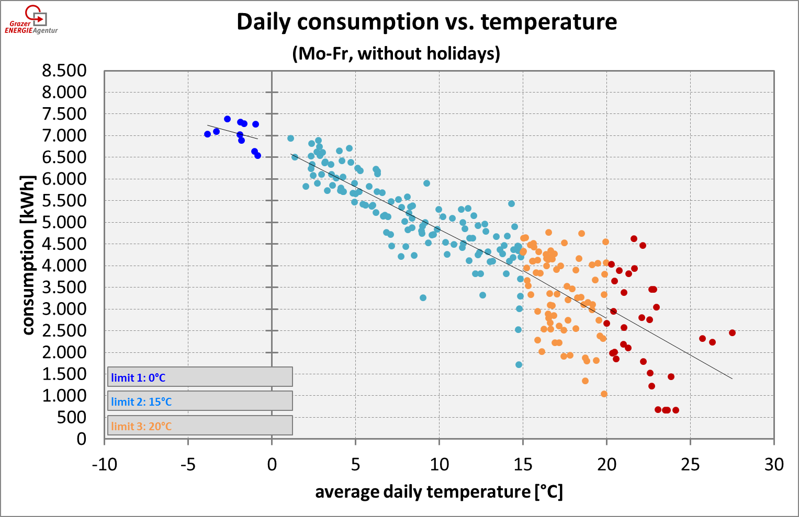
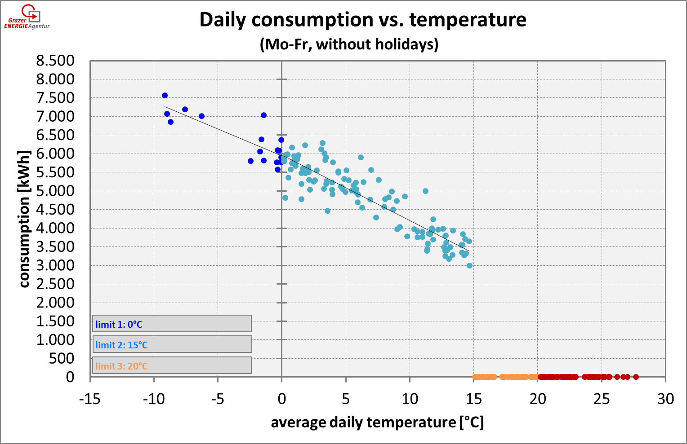
Meter your consumptions and outer temperature at least daily
Compare the daily consumptions with the climate conditions
left picture: high mean variation, not optimal control of the heating system, it even runs in summer
right picture: optimal control of the heating system, the system
is turned off at 15°C average temperature, savings 30%!

Slide 12
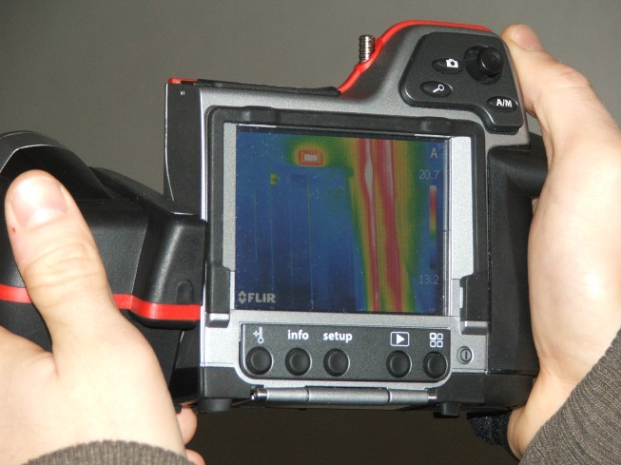
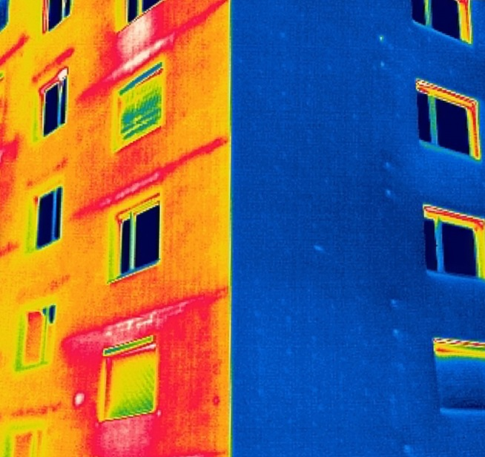
Infrared pictures of your building show you in a clear way the thermal bridges and weak points of your buildings.
Keep in mind:
  The pictures do not replace an energy performance certificate
  The pictures are a snapshot and have to be made and interpreted by experts
  Choose the right outer conditions (winter, in the night, no rain and snow, high temp. difference in/out...) when taking the pictures and a high quality IR-camera
without with
insulation!

Slide 13
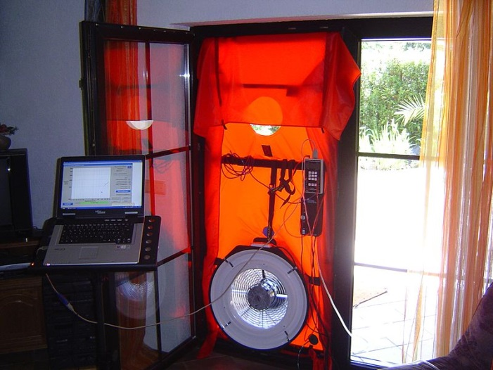
A Blower Door test shows the air tightness of the building
Why is this important?
Unknown leakages can cause problems with the building physics and can harm your buildings
Unwanted leakages can be responsible for a significant higher heat consumption and dry air in winter in the rooms
A tight building envelope is also necessary for buildings with ventilation systems

Slide 14
3.1.4 Recommendations – insulation
- planning
3.1.4 objective
You get some recommendations for planning of insulation measures.

Slide 15
Planning Phase – Integral planning:
Choose the right balance between building and energy source!
A nearly zero-energy house combines very good insulation standards, a high-quality building envelope (no thermal bridges, airtightness) and active energy generation from renewable sources
Copyright: Styrian Energy Agency; http:\www.ea-stmk.at

Slide 16
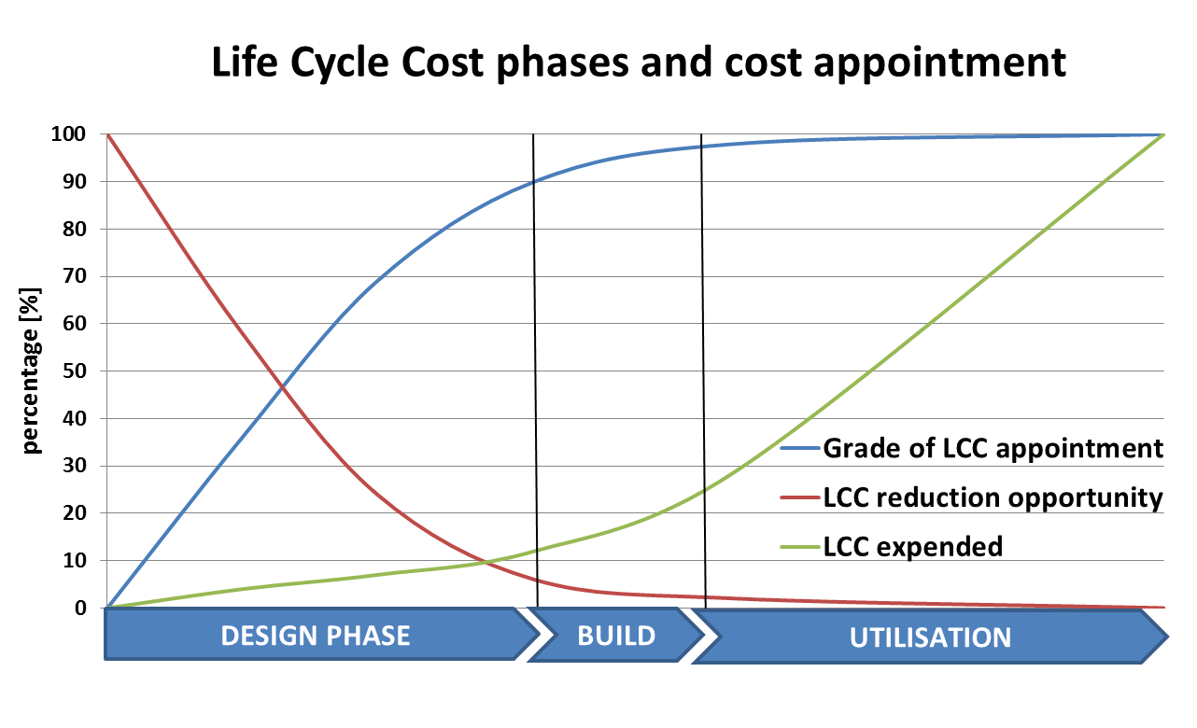
Planning Phase – Integral planning:
Integral planning is a holistic planning approach that takes into account all relevant success factors of sustainable and life cycle-oriented construction.

Slide 17
Invest more in planning – especially in early planning phases!
Define exact energetic and environmental goals (e.g. NZEB standard) and responsibilities
Integrate all specialists as well as the users and operating personnel from beginning on, focus on the operating phase
Define quality control standards and measures (e.g. thermographic analysis after renovation)
All economic analyzes are based on life cycle cost considerations.
Integral planning combines economic, ecological and societal-social aspects in all phases of the life cycle from the first idea to planning, implementation, commissioning, operation until dismantling.

Slide 18
Recommended U-values [W/m²K] for a nearly zero-energy building
Source: Styrian Energy Agency; http:\www.ea-stmk.at

Slide 19
3.1.5 Recommendations – heating system and heat supply
3.1.5 objective
You get some recommendations for heating systems and heat supply.

Slide 20
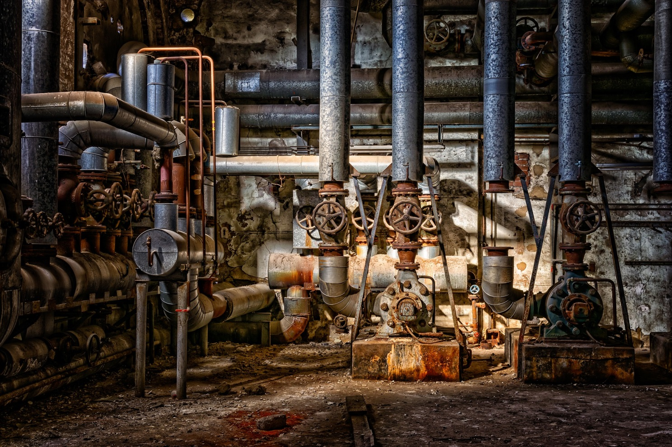
obviously its time to renew the heating system...
Photo: MichaelGaida at PIXABAY

Slide 21
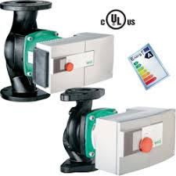
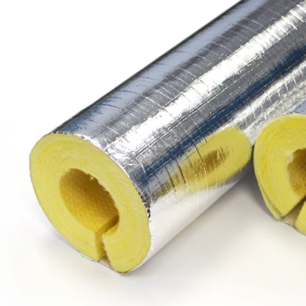
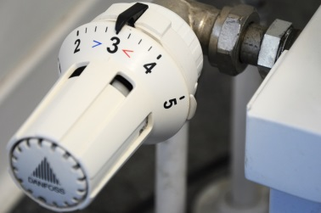
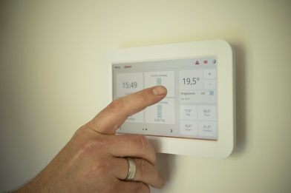
The renewed heating system
has energy efficient circulation pumps
(efficiency class A)
insulated pipes
(at least the thickness of the pipe)
needs hydraulic balancing
has thermostatic valves
has a modern control system
(and at its high end predictive control)
uses renewable resources
takes care of not to high temperatures in the rooms
each 1°C saves about 5% of heat consumption

Slide 22
Gain your energy from the environment or biomass!
Source: Styrian Energy Agency; http:\www.ea-stmk.at

Slide 23
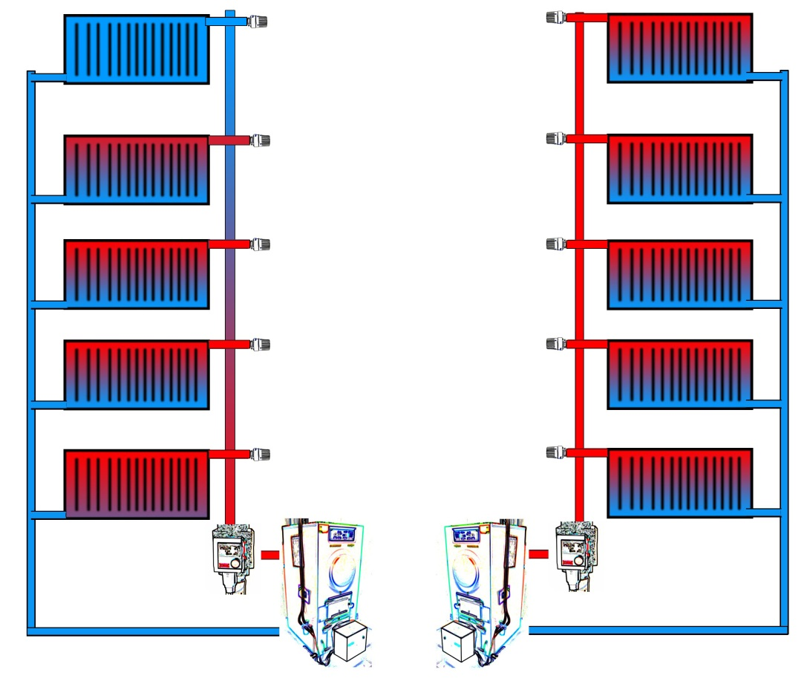
Hydraulic balancing
For a heating system to work perfectly, the radiator must contain exactly the right quantity of hot water. This is not some-thing that just happens. It re-quires exact hydraulic balancing.
Faulty hydraulic balancing can lead to malfunction as ell as increased fuel and pump energy demand. Savings up to 15% and more are possible.
picture (c) Ra Boe / Wikipedia (https://commons.wikimedia.org/wiki/File:Hydraulischer_Abgleich_by-Ra_Boe-1.jpg), „Hydraulischer Abgleich by-Ra Boe-1“, https://creativecommons.org/licenses/by-sa/3.0/de/legalcode

Slide 24
3.1.6 Recommendations – lighting, ventilation and electricity
3.1.6 objective
You get some recommendations for lighting, ventilation and electricity.

Slide 25
The possibilities to optimize the electrical and lighting systems in schools and public buildings are numerous:
LED lighting is state-of-the-art and cost optimal
Switch off the lights if you leave the room or make automatic controls (daylight, presence)
Reduce number of printers, copiers, fridges and vending machines
Use timer for electric boilers (hot water)
Use switchable power strips for your PCs and IT equipment
Buy energy efficient equipment
Reduce standby losses
Change behaviour, make a game out of it
...

Slide 26

LED lighting:
Take care of the right illuminance (EN 12464-1)
- if the existing illuminance is poor (very often with old lighting systems), savings are lower...
Consumption with new lighting should be < 6 kWh/m² and year
Use daylight and presence control in classrooms, most new lighting systems are prepared for it
Sometimes retrofit solutions reduce
costs – take care of technical
limitations; very often the whole
system should be changed

Slide 27
Source: Styrian Energy Agency; http:\www.ea-stmk.at

Slide 28
3.1. 7 useful information
3.1.7 objective
You get some useful information (online links) on EU-level and a contact point to the creator of this module.

Slide 29
FEEDSCHOOLS webpage:
https://www.interreg-central.eu/Content.Node/FEEDSCHOOLS.html
Examples how it works:
https://www.epbd-ca.eu/wp-content/uploads/2011/05/CT5_Report_Selected_examples_of_NZEBs-final.pdf
EU energy performance of buildings directive: https://ec.europa.eu/energy/topics/energy-efficiency/energy-efficient-buildings/energy-performance-buildings-directive_en

Slide 30
Gerhard Bucar
Graz Energy Agency
www.grazer-ea.at/
bucar@grazer-ea.at
+43 316 811848-13
facebook.com/grazerea
linkedin.com/in/gerhard-bucar-249688123/
twitter.com/GEnergieAgentur

Slide 31
Self Assessment Test (1)
How many trees do you have to plant to compensate 100.000 kWh (fossil) gas consumption per year
160 ◻ 1760 ◻ 100000
The saving potential of hydraulic optimization is normally
5% ◻ 10-20% ◻ 50%
What are the first steps to know the weak points of your energy cosumption?
Meter the consumption in detail (15 min. interval), analyse it
Taking IR-pictures in summer at daylight
Taking a photo of the building with your mobile and
sending it to an expert

Slide 32
Self Assessment Test (2)
What is most important to reach an nearly zero energy building?
Insulation of the roof
A new heating system
A combination of very good insulation standards, a high-quality building envelope and energy from renewable sources
What is life-cycle oriented planning?
Taking only investments into account
Planning a house to live in when you are older and retired
Life-cycle oriented planning combines environmental goals, quality control standards, integration of all specialists in early planning phases, taking into account investment- running-
and demolition costs as well

Slide 33
Self Assessment Test (3)
What does a renewed heating system need?
As much power as you can get to heat the house up to 25°C
A good oil filter to get the dirt out of the heavy oil
A modern control system, thermostatic valves, hydraulic balancing, highly insulated pipes, renewable energy source
The state-of the art lighting is
Compact-Fluorescent bulbs (CFL)
LED lighting with automatic control
Conventional light bulbs

Slide 34
Self Assessment Test (ANswers)
How many trees do you have to plant to compensate 100.000 kWh (fossil) gas consumption per year
1760
The saving potential of hydraulic optimization is normally
10-20%
What are the first steps to know the weak points of your energy cosumption?
Meter the consumption in detail (15 min. interval), analyse it
What is most important to reach an nearly zero energy building?
A combination of very good insulation standards, a high-quality building envelope and energy from renewable sources

Slide 35
Self Assessment Test (Answers)
What is life-cycle oriented planning?
Life-cycle oriented planning combines environmental goals, quality control standards, integration of all specialists in early planning phases, taking into account investment- running-
and demolition costs as well
What does a renewed heating system need?
A modern control system, thermostatic valves, hydraulic balancing, highly insulated pipes, renewable energy source
The state-of the art lighting is
LED lighting with automatic control

