Slide 1
Block 2 Energy efficiency in buildings
2.6 Carbon Footprint in building sector
e-learning course
FEEDSCHOOLS, by ENEA

Slide 2
This module is part of a training package developed to provide local authorities with free tuition that may inspire and help them in adopting new technical and financial solutions to implement ‘nearly Zero Energy Building’ (NZEB) renovation activities in schools.
After an introduction of the European context concerning greenhouse gas emissions in the building sector, this block will introduce Life Cycle Assessment, describing its methodology and the Carbon Footprint indicator, the approach employed to asses it and how it is assessed and calculated.
Beginner: No special knowledge is needed
Notes:
Block 2: Energy efficiency in buildings

Slide 3
Learning Objective:
At the end of this module attendees will be provided with basic concepts to understand the issue of the building sector greenhouse gas emissions within the European, the Life Cycle Assessment methodology and the Carbon Footprint indicator.
2.6
Carbon Footprint in building sector
(link)
2.6.1
Background and EU Policies
2.6.2
Life Cycle Assessment
2.6.3
Carbon Footprint
Notes:
General learning objective of the block and list of content with link to each unit’s introductory page

Slide 4
2.6 Carbon Footprint in building sector
2.6 objective
After being introduced to the European context within which the issue of greenhouse gas emissions in the building sector is to be set, you will be provided with basic concepts about Life Cycle Assessment and the Carbon Footprint.
Notes:
Unit’s introductory page; it is needed per each unit

Slide 5
In the 2010 Energy Performance of Buildings Directive and in the 2012 Energy Efficiency Directive the EU promoted the improvement of the energy performance of buildings. As Directives, they needed to be transposed by Member States into their national legislation.
Thanks to the Energy Performance of Buildings Directive (2010), consumers can make informed choices to save energy and money, and this resulted in a positive change of trend in the energy performance of buildings.
Buildings erected after energy efficiency requirements in line with the 2010 Directive were introduced in the national building codes, consume only half as much as typical buildings from the 1980s.
https://ec.europa.eu/energy/en/topics/energy-efficiency/buildings

Slide 6
Approximately 40% of energy consumption and 36% of CO2 emissions in the EU derive from the building sector.
About 35% of EU's buildings are over 50 years old and almost 75% of the building stock is energy inefficient, while only 0.4-1.2% (depending on the country) of the building stock is renovated each year.
Therefore, renovation of existing buildings has the potential to lead to significant energy savings – potentially reducing the EU’s total energy consumption by 5-6% and lowering CO₂ emissions by about 5%.
https://ec.europa.eu/energy/en/topics/energy-efficiency/buildings

Slide 7
In November 2016, as part of the Clean Energy for All Europeans package, the Commission proposed an update to the Energy Performance of Buildings Directive to help promote the use of smart technology in buildings, to streamline existing rules and accelerate building renovation.
In June 2018, the Directive (2018/844/EU) amending the Energy Performance of Buildings Directive was published. It was aimed at boosting the cost-effective renovation of existing buildings and the mobilization of investments to realize the vision of a decarbonised EU building stock by 2050.
The EU target of reducing its total emissions by 20% within 2020 prompted a number of initiatives both in the private and the public sector.
https://ec.europa.eu/energy/en/topics/energy-efficiency/buildings

Slide 8
“LCA is a process of compilation and evaluation of the inputs, outputs and the potential environmental impacts of a product system throughout its life cycle”
Roadmap for the European Platform on Life Cycle Assessment JRC 2013

Slide 9
LCA methodology is a holistic procedure for compiling an inventory (inputs and outputs of materials and energy) of the whole life cycle of a product or service system with a specific function and then for assessing the related environmental impacts.
The life cycle includes raw-material production, manufacture, distribution, use and disposal.
LCA allows quantifying the environmental performance of a system/product/process and avoiding the shifting of the burdens on different life cycle phases or locations.

Slide 10
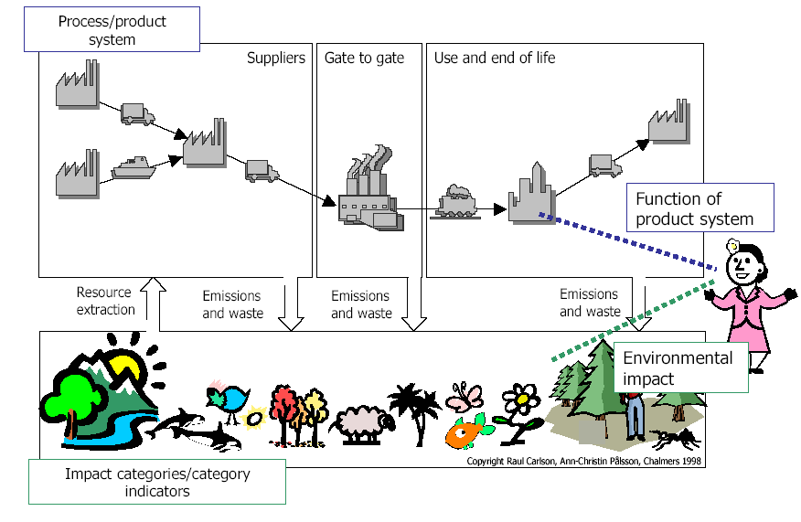

Slide 11
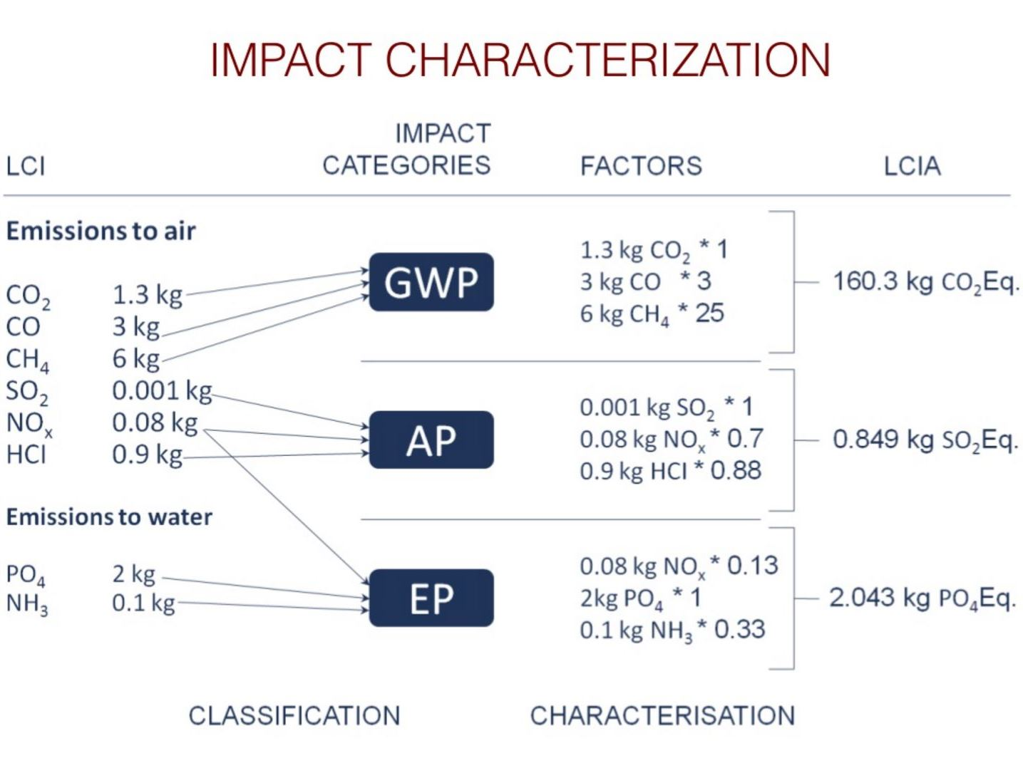
Inputs and outputs are converted into impact categories indicators related to some environmental priorities like Climate change; Nature and Biodiversity; Environment, health and quality of life; Natural resources and wastes.

Slide 12
What is a Carbon Footprint?
It is the sum of greenhouse gas emissions and removals in a product system, expressed as CO₂ equivalents and based on a life cycle assessment using the single impact category of climate change
ISO14067:2013 DEFINITION
www.arpae.it
Notes:
2.6.3 Carbon footprint

Slide 13
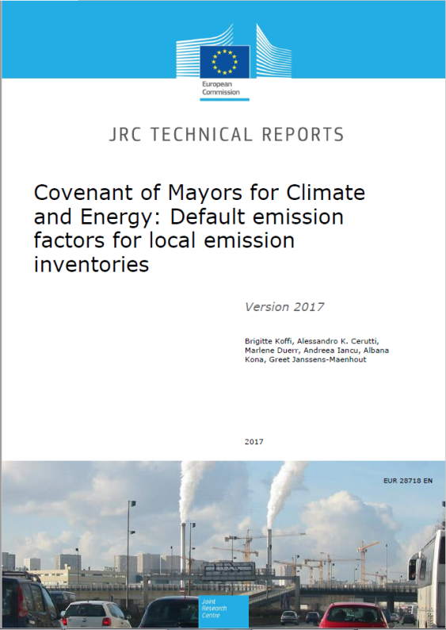
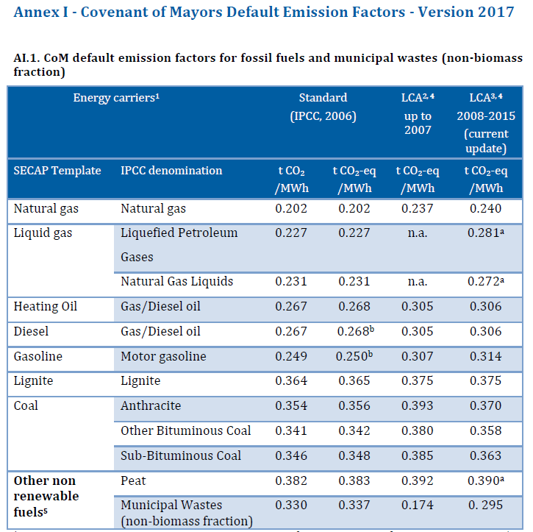
An emissions factor is a representative value that relates the quantity of a pollutant released to the atmosphere with an activity associated with the release of that pollutant.
www.epa.gov
http://publications.jrc.ec.europa.eu/repository/bitstream/JRC107518/jrc_technical_reports_-_com_default_emission_factors-2017.pdf

Slide 14


Pier Luigi Porta - Researcher at ENEA ( Author and Tutor)
www.enea.it/
pierluigi.porta@enea.it
www.facebook.com/eneapaginaufficiale/
twitter.com/ENEAOfficial
www.linkedin.com/company/enea_2/
Notes:
Proposal : Specify the different roles of author and tutor
the author is the person that produced the course content and he/she will remain author whatever may happen (i.e. changes at work, retire, etc.)
the tutor is the person available to provide support, short explanations, etc. when required; if for some reason she/he is not available any longer, this role can be taken by some other colleague; email address must be provided.

Slide 15
Self assessment test
New buildings today consume:
  twice as much as typical buildings from the 1980s.
  half as much as typical buildings from the 1980s.
  as much as typical buildings from the 1980s.
The life cycle includes:
  raw-material extraction, production, manufacture, distribution, use and disposal.
  raw-material extraction and waste disposal
  only the use phase
Carbon Footprint is:
  Is the sum of ozone depletion gasses, expressed as CO₂ equivalents.
  a greenhouse gas
  Is the sum of greenhouse gas emissions and removals in a product system, expressed as CO₂ equivalents and based on a life cycle assessment using the single impact category of climate change
An emissions factor is:
  a representative value that relates the quantity of a pollutant released to the atmosphere with an activity associated with the release of that pollutant.
  the sum of greenhouse gasses, expressed as CO₂ equivalents.
  a representative value of gas.
Notes:
Selected resources should be provided with a short presentation

Slide 16
Selected resources
https://ec.europa.eu/energy/topics/energy-efficiency/energy-efficient-buildings
This website provides the official and most comprehensive access to EU information concerning the building sector.
Jensen, Allan & J, Elkington & Christiansen, Kim & L, Hoffmann & BT, Møller & Schmidt, Anders & F, van. (1998). Life cycle assessment (LCA) - a guide to approaches, experiences and information sources.
This publication, developed for the European Environment Agency (EEA), aims to help business and other readers to find their way through the LCA maze to the right tools for the application they have in mind. The early chapters are written in such a way as to be easily accessible to environmental managers in companies and other similar professionals, whereas the methodology sections may require some LCA background of the reader.
Viola Polesello & Katie Johnson, Energy-efficient buildings for low-carbon cities - ICCG Reflection No. 47/March 2016
This report describes opportunities to realize significant gains in energy efficiency and implement low-carbon strategies in urban areas.
Neves A; Blondel L; Brand K; Hendel Blackford S; Rivas Calvete S; Iancu A; Melica G; Koffi Lefeivre B; Zancanella P; Kona A. The Covenant of Mayors for Climate and Energy Reporting Guidelines; EUR 28160 EN; doi:10.2790/586693
In this report are present information and definition concerning emission factors.
Notes:
Selected resources should be provided with a short presentation

